Slide 1




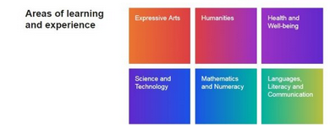
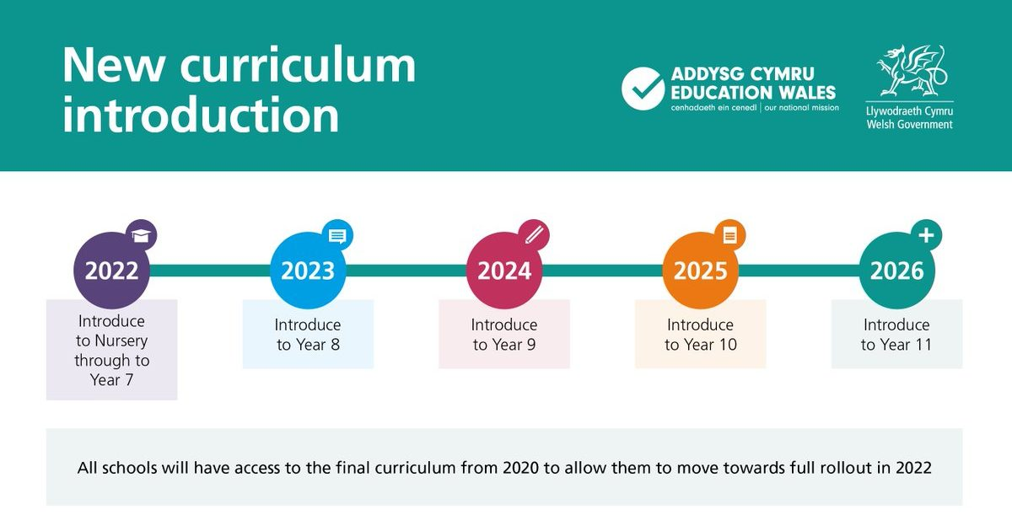
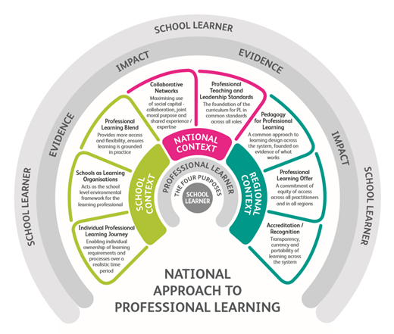
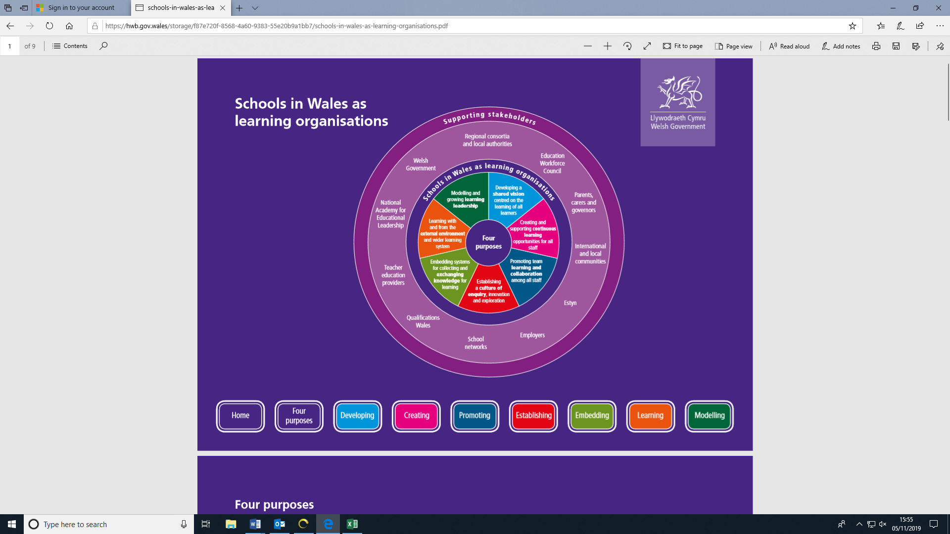
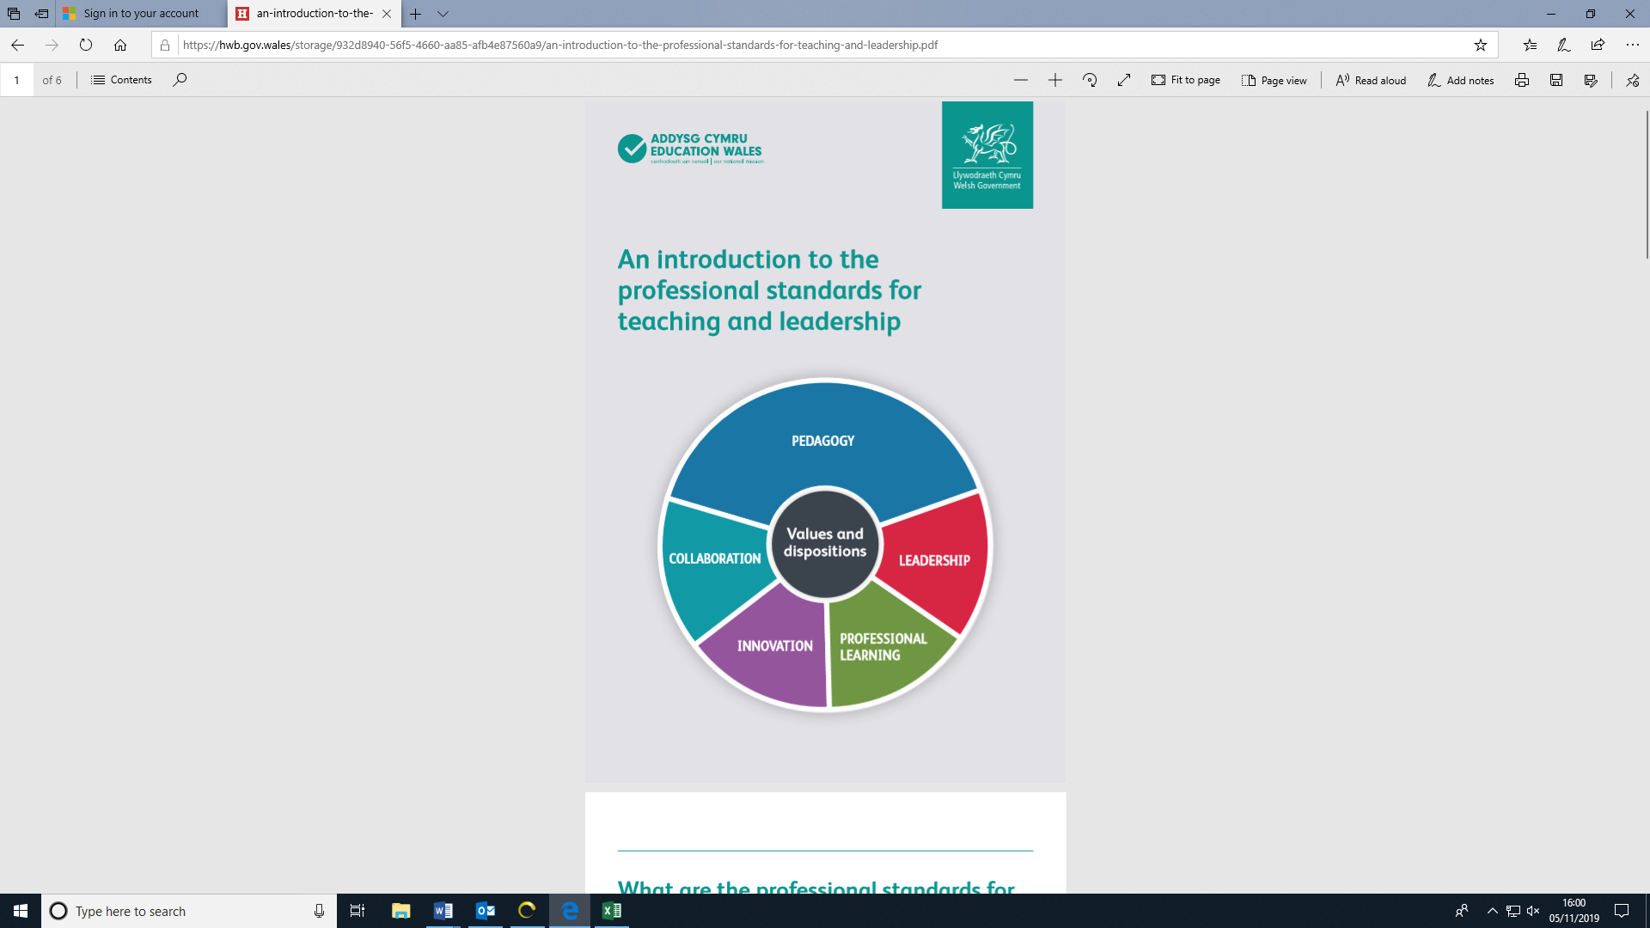
National Professional Enquiry Project (NPEP):
A Journey of Enquiry with our schools
Background
CIEREI Institute for education research, Bangor University, was commissioned by the Welsh Government alongside two other institutions to oversee a series of professional enquiries with Professional Learning Pioneer Schools. The purpose was to support practitioners in becoming professional enquirers to aid the development of the Curriculum for Wales 2022.
Schools, n = 30, Primary, Secondary and Special
Focus of enquiry for 2018-2019
Cycle 1: School based enquiry
Cycle 2 & 3: Cluster school enquiry
• Planning for a purpose-driven curriculum
• Pedagogy and how learning works
• Project-based learning
• Implications for leadership and management
Supported by HEIs, Pioneer Schools began to explore the professional learning implications for the new curriculum with Bangor University
specialising in Languages, Literacy and Communication and Science & Technology.
Focus of enquiry for 2019-2020
Cycle 4: Consolidation and enrichment phase
School based & cluster school enquiry
• Pedagogy and how learning works
HEIs continue to develop enquiry skills of pioneer schools across all AoLEs to become national lead enquiry schools working with cluster schools in partnership with Regional Education Consotia.
Emerging findings
Teachers require new research skills for the enablement of facilitating the Curriculum for Wales 2022
Wide variability within starting points of schools.
Schools require an extended period of time to adapt their working schedules, access and gain a deeper knowledge and understanding of existing subject specific research literature; specifically how to engage meaningfully with published curriculum documents and materials such as ‘What Matters’ and ‘Progression Steps’.
On the whole, schools were enthused and engaged with the enquiry process and valued the collaboration with colleagues across Local Authorities, Regional Education consortia, Welsh Government and Higher Education Institutions (HEIs).
Successful implementation of the Curriculum for Wales 2022 appears to be dependant upon the scale, quality and professional learning support provisions made available for school staff drawing upon unique expert roles from regional education consortia, local authorities and HEIs tailored to their individual organisational context. Transition periods from primary to secondary requires particular attention and clarity in terms of assessments, accountability and qualifications.
Signature pedagogies are not yet fully developed as documents emanating from curriculum development remain in draft form.
Pupil voice considered key component in further research into effective implementation of a purpose-driven curriculum as are the roles of external agencies to ensure authentic learning and maximised rich experiences of learners.
Professional enquiry should be:
  a core part of Initial Teacher Education (ITE) programmes in Wales
  integral to the National Approach to Professional Learning (NAPL) and the Schools as Learning Organisations element
  central part of leadership development across the education system i.e. National Academy for Educational Leadership (NAEL)
  central feature of the National Strategy for Educational Research and Enquiry (NSERE)
  an important element of the Estyn Self-Evaluation for Improvement Framework
  based on strong collaboration between schools and other parts of the education system, especially Universities in alignment with The Welsh Government’s National Strategy for Educational Research and Enquiry to enable learners to engage with the curriculum and practitioners to operate as critical and informed professionals and ‘makers’ of research – close-to-practice researchers
Professional learning should be integrated into the school day (not a ‘bolt-on’) and part of performance management with stronger
links to Professional Learning Passport
Gwilym Siôn ap Gruffudd, Bangor University g.s.apgruffudd@bangor.ac.uk, Dr Bryn Jones, Bangor University b.jones@bangor.ac.uk, Professor Carl Hughes, Bangor University: c.hughes@bangor.ac.uk,
Professor Enlli Môn Thomas, Bangor University: enlli.thomas@bangor.ac.uk, Ruth Thackery, GwE: RuthThackray@gwegogledd.cymru, Euros Davies, GwE: EurosDavies@gwegogledd.cymru

