Slide 1
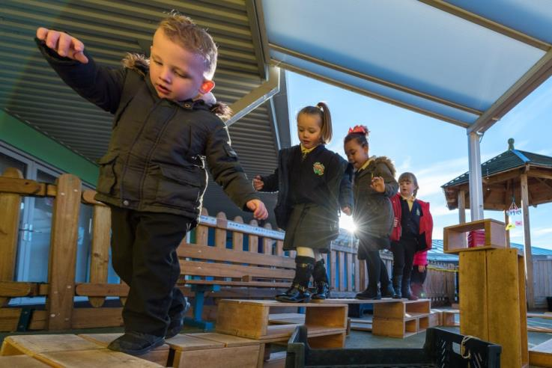
Rhosymedre Community Primary School
Providing Seamless transition between the indoor and outdoor learning environment in Nursery and Reception

Slide 2
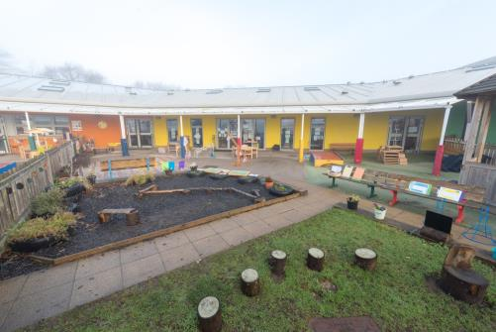
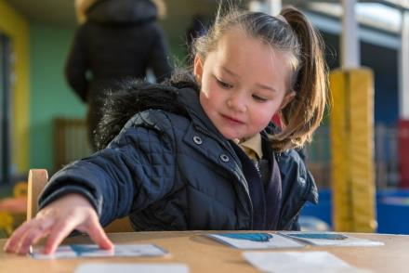
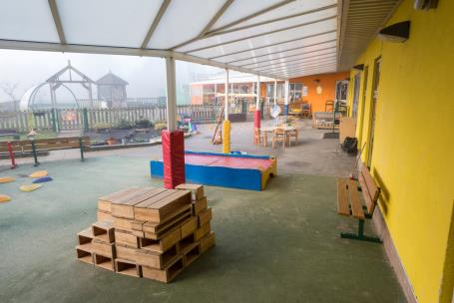
Background
Rhosymedre Community Primary School is on the edge of a large housing development, south of Wrexham, between Ruabon and Llangollen. There are 237 learners on roll aged from 3 to 11 years of age, including 30 part-time nursery learners.
Within Rhosymedre School there is an Early Phase unit containing approximately 60 Nursery and Reception learners and the appropriate ratio of staff. A majority of learners enter the school with literacy, numeracy and personal and social skills that are below those expected for their age.

Slide 3
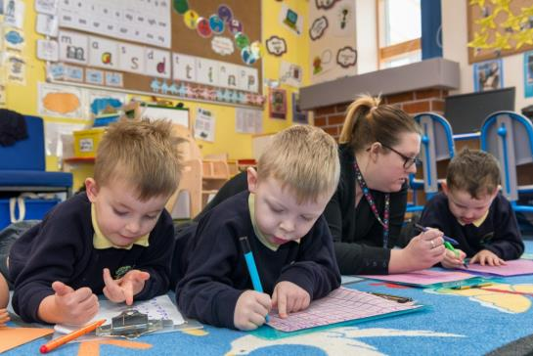
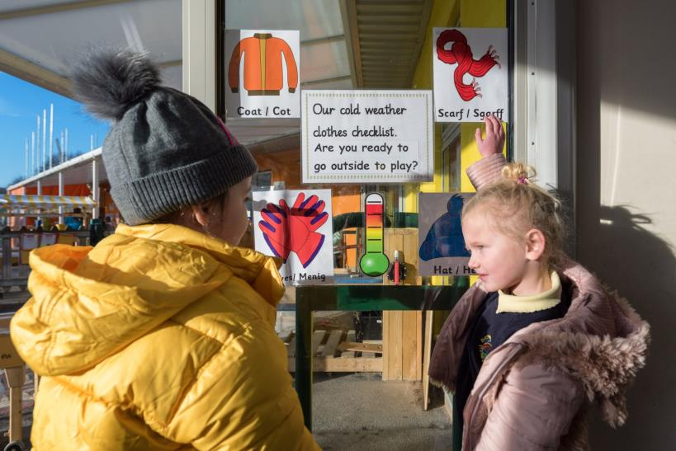
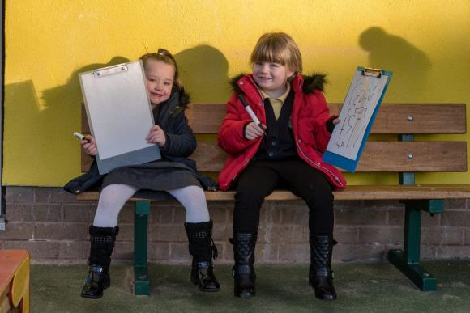
Creating a Philosophy
When establishing the provision practitioners met regularly to agree a clear vision of how they wanted the environment to develop and support the role of outdoor learning. The team agreed that outdoor learning was fundamental to children’s learning and development and discussed how they could facilitate this. Practitioners agreed that there would be at least an hour every session (morning and afternoon) where there was free flow between the indoor and outdoor environments. Before setting up the outdoor provision staff visited identified settings to observe good practice. Every member of the team visited, which allowed them to reflect on the practice observed and plan how to establish this approach within the setting.

Slide 4
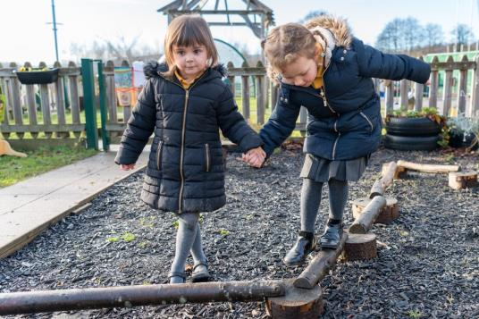
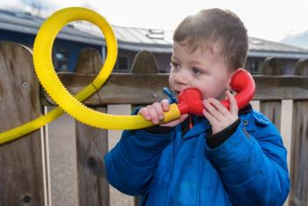
After auditing current resources a ‘wish list’ of appropriate resources was created to ensure that the outdoor provision provided an effective environment for children. Staff felt it shouldn’t replicate the indoor classroom but should complement it. Staff were passionate that skills development should be carefully planned for and learners should have the opportunity to practise, consolidate, use and apply Literacy and Numeracy skills across both the indoor and outdoors environments. This influenced the resources that were ordered, for example, number cones, paintbrushes and buckets.
  Practitioners, as enabling adults, agreed that engaging experiences in effective environments would be provided for learners every day within the teaching and learning environments, both indoors and outdoors.

Slide 5
Areas of provision
The team wanted the environment to be led by the learner’s needs and interests, however, they needed a core set of open ended and flexible resources in order to observe learner’s interaction with them to reflect on the resources to be provided.
The team set up the following areas every day, in all weathers which were based on the learners predictable needs and interests.
Block play, mark making with brushes and water, table top, small world, water, sand, digging, music basket, books and physical.
Over time the outdoor provision evolved as the adult’s pedagogical understanding developed. Changes to provision were made after observations of learner’s interaction with the resources. The team were then able to provide appropriate additional resources to promote skills development. For example, in the outdoor water tray practitioners observed learner’s bringing the baby’s clothes from the home corner inside and washing them within the water! This told the observing adults that the learner’s needed a washing line to peg the clothes on and also to hang their water aprons on.

Slide 6
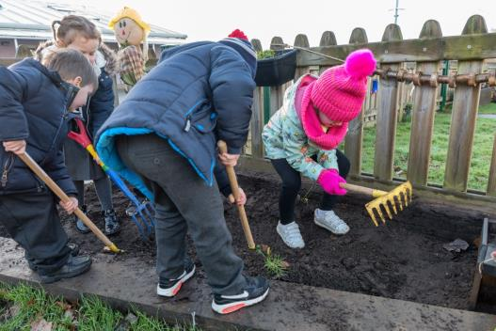
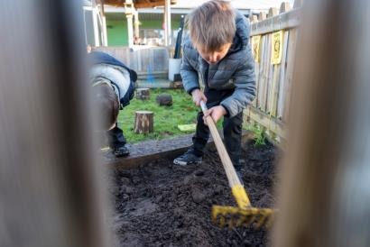
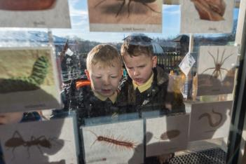
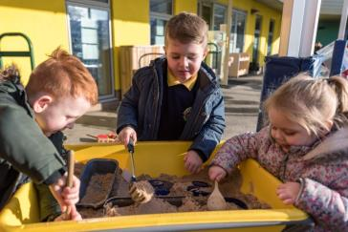
The team recognised that learners may get muddy when working in the outdoors, for example, in the digging area . As the team valued the experiences this area provided, they agreed that if the indoor environment gets muddy, then it would be vacuumed!

Slide 7
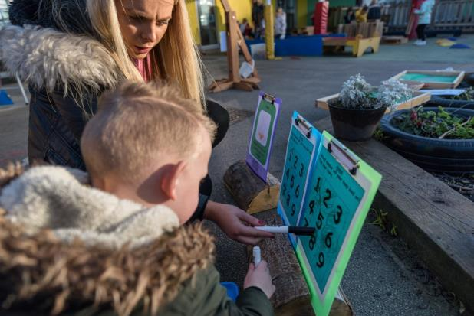
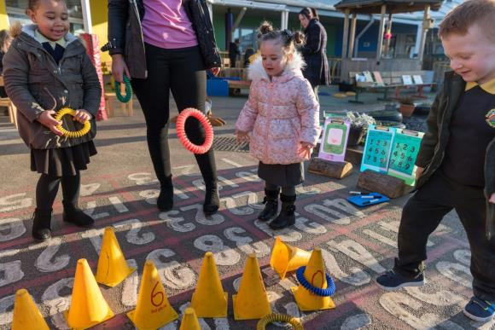
The team were flexible in response to the needs and interests of learners. For example, on days where the play is of a very high and sustained quality they don’t stop the flow and tidy up until absolutely necessary! They actively encourage learning though play and don’t interrupt the flow for children as this is where they observe and respond to their needs.
The team believe that learners will demonstrate what they really know and understand within the environment provided. Therefore staff ensure that they are all free to observe learners practicing skills and reinforcing/embedding their knowledge during this time. For example, if learners have been taught one to one correspondence during Maths, adults observe if learners can transfer this skill in their self initiated learning in the outdoors. Staff believe that it is only when a child can independently use and apply a skill taught within the learning environment that the learner truly understands it.

Slide 8
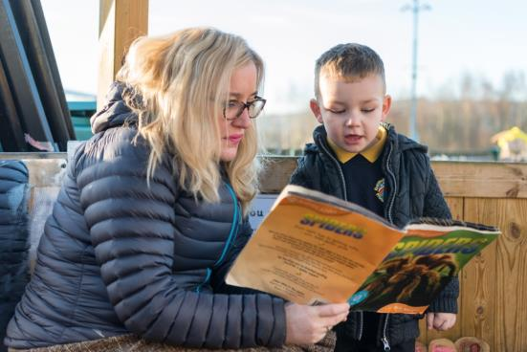
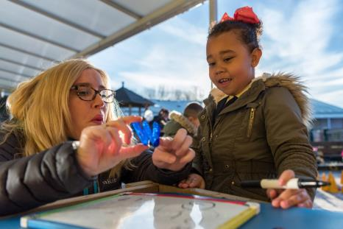
Role of enabling adults
The role of the adults is to facilitate learning and to further promote skills development. Adults facilitate learning by modelling appropriate language, skills and behaviours with learners. Adults facilitate the play, supporting learners with their ideas and interests. This enables them to understand if there are gaps in provision which can be addressed and also to identify the skills learners are naturally using within the environment. Subsequently staff observe children’s learning to inform future planning, developing the children's skills in a meaningful way.

Slide 9
Effective environments
Environments are changed and adapted as learner’s needs are identified, to support their interests and further develop their skills. New resources brought into the learning environment are carefully chosen to support the learning and are chosen, where applicable, to promote literacy and numeracy. These can be a physical resource or a written challenge.
The adults will then facilitate the play and link exploration to the resource, where appropriate. Learners will often transfer resources from the indoor environment to the outdoor environment to support their skills development whilst engaging with the resources.
Often, the learners will self populate the areas to support a developing need or emerging interest. The team do not plan ‘must do challenges’ as they believe that skills are transferable within any environment at a pace suitable for individual learners, scaffolding their learning and skills development.

Slide 10
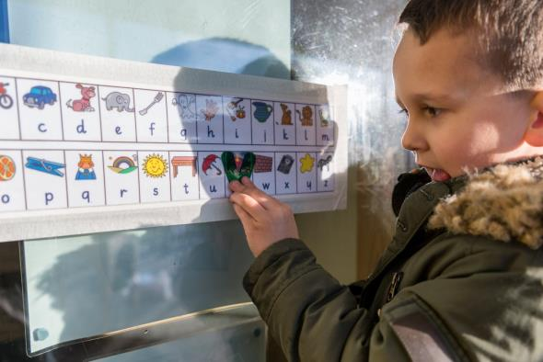
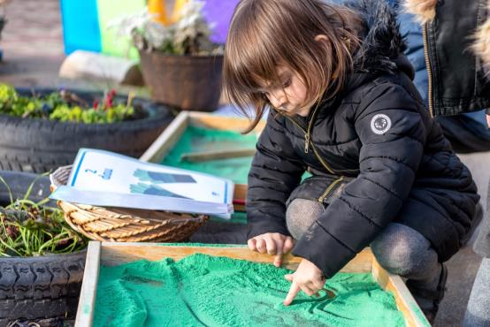
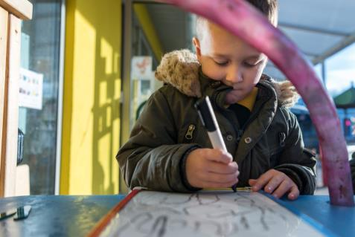
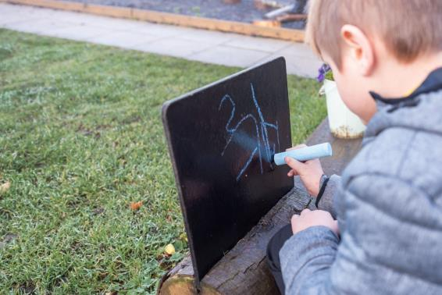
Impact
Since the changes have been introduced the school has seen improvements in learner’s Language, Literacy and Communication skills as well as Mathematical skills and Personal and Social skills.

