Slide 1
Short Hand Notes and Writing A Match Report
Language, Literacy and Communication – Year 6
Euro 2016: A Welsh Curriculum Resource for 7-11 year olds

Slide 2
Wales v England – Developing match commentary and broadcasting skills
Match Commentary Skills
Broadcasting Skills

Slide 3
A Commentator
A sports commentator gives a running commentary of a game or event in real time, usually during a live broadcast, traditionally delivered in the historical present tense. The comments are normally a voiceover, with the sounds of the action and spectators also heard in the background.
In the case of television commentary, the commentators are rarely on screen, if at all, during the event (although they may appear on camera at the start or near the end of the broadcast).

Slide 4
Commentator comprehension
http://www.telegraph.co.uk/men/the-filter/11789490/11-things-no-one-tells-you-before-you-become-a-football-commentator.html
Click on this link above and answer questions based on this newspaper article written by Ian Crocker

Slide 5
Commentator tips
BBC Sport's Steve Wilson's tips on how to become a football commentator
http://www.bbc.co.uk/schoolreport/31510665
Lead football Commentators
http://worldsoccertalk.com/2014/11/04/a-guide-to-english-soccer-tv-commentators-usa/

Slide 6
Broadcasting tips
from Huw Edwards (BBC News Reporter)
http://news.bbc.co.uk/1/hi/school_report/7499921.stm

Slide 7
Tips to make a great Broadcaster
  Make your story clear. If you have doubts, pretend you’re telling the story to a Year 1. Choose the most appropriate words and follow a logical sequence.
  Be yourself, be unique. Use your own words, your own language. Listeners can feel if something sounds ‘forced’ or even worse.
  Record your voice in interesting places (if you’re not live of course). A background noise can make all the difference. If this is not possible, make an interesting use of sound effects.

Slide 8
Tips to make a great Broadcaster - continued
  Be concise. Your audiences’ time is valuable.
  If you’re in a public place, ask for an opinion of passers-by.
  Make clever use of sound effects. The right sound effect can turn a flat piece into a unique and engaging experience.
  Prepare well for the closure. This is probably the most important part of your production. Try and leave your audience with something to think about.
  But most important, try and have fun!

Slide 9
Quiz time:
Can you write, report or post safely and legally
There are laws about reporting to ensure that journalists are accurate and fair.
Make sure you are within the law by reporting what is true, with a balanced point of view and thinking about how your report might affect the people you feature.

Slide 10
Question 1
You and your classmates make a short documentary about healthy eating to put on the school website. Which of these end credits do you use?
A: This documentary was made by Josh Davies, Ellie Jones, Iwan Llewellyn.
B: This documentary was made by Josh, 10, Ellie, 11, Iwan, 11.
C: This documentary was made by Josh Davies, 10, Ellie Jones, 11, Iwan Llewellyn, 11.

Slide 11
Question1
B: This documentary was made by Josh, 10, Ellie, 11, Iwan, 11.

Slide 12
Question2
You are making a TV report about a new energy drink to improve a footballer’s performance in a match. The energy drink was created by sports nutrition experts. Which three people do you interview?
A: A classmate whose dad works in sports nutrition, a classmate who plays sport, the school nurse.
B: A classmate whose dad works in sports nutrition, a classmate who has lots of pets, your 6 year old cousin.
C: Your head teacher whose son plays for a professional football team, a teacher who plays sport, the school caretaker.

Slide 13
Question 2
A: A classmate whose dad works in sports nutrition, a classmate who plays sport, the school nurse.

Slide 14
Question 3
Your football team has changed their kit supplier. Lots of your team think the quality of kit has dropped. You put together a balanced report, gathering the views of those who wear it – players – and those who designed the kit – the School Council. This is what three pupils say. Which do you include in your report?
A: It’s rubbish. The kit is really tight and it sticks to your body. The material is to blame and we would have preferred a kit with a different material. I think that the Wales football kit is good quality because professionals wear it.
B: It’s horrible. There is no way I am wearing that kit ever again, forget it.
C: Football kit? More like pyjamas! It’s going to make us look stupid and make us lose.

Slide 15
Question 3 - Answer
A: It’s rubbish. The kit is really tight and it sticks to your body. The material is to blame and we would have preferred a kit with a different material. I think that the Wales football kit is good quality because professionals wear it.

Slide 16
Question 4
You write a report about a famous Welsh manager. You find a picture of him on the internet. What do you do?
A: Add the photograph to your report. Write the name of the photographer under the picture
B: Find out who took the photograph. Get their written permission before attaching the picture.
C: Add the photograph to your report.

Slide 17
Question 4 - Answer
B: Find out who took the photograph. Get their written permission before attaching the picture.

Slide 18
Question 5
You read on a news website that a local school has won a match but they cheated. What do you do?
A: Report on it using your own words.
B: Copy large parts from the report.
C: Choose a different story to write about.

Slide 19
Question 5 - Answer
C: Choose a different story to write about.

Slide 20
Question 6
You are deciding how to report on a news story – about cheating in sport – which people around Wales will be able to see on your school fortnightly newspaper. Which of these would you choose to do?
A: Describe the player who cheated and never got caught.
B: Explain how cheats always win and never feel guilty.
C: Explain why sports people are being warned about cheating in sport.

Slide 21
Question 6 - Answer
C: Explain why sports people are being warned about cheating in sport.

Slide 22
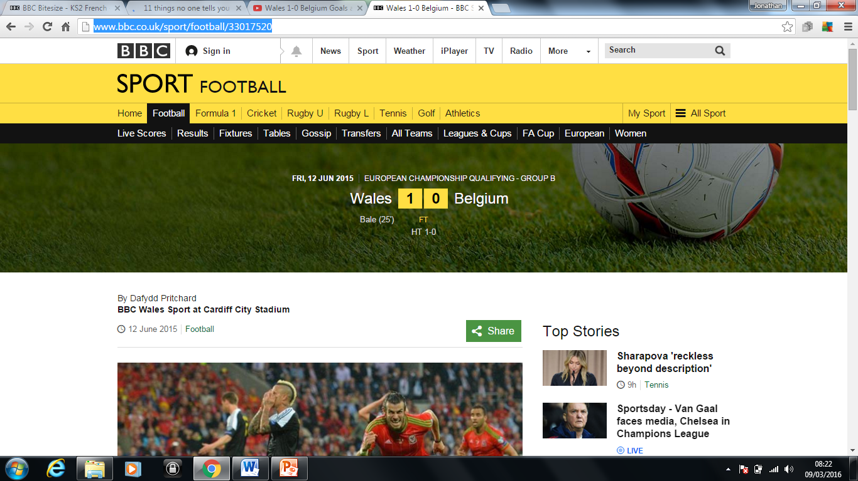
Wales v Belgium Commentary
Cardiff City Stadium
Friday 12th June 2015
The full write up of the game:
http://www.bbc.co.uk/sport/football/33017520

Slide 23
Watch the game and produce highlights over the top
Link to the Wales v Belgium game is below
  https://www.youtube.com/watch?v=F-DZWUBiZz4
Turn the volume down and record yourself on a voice recorder once you have researched the game and prepared notes.

Slide 24
Commentary of a Wales game
Find the Wales v England match on BBC
Watch 5 minutes of live action of the game on the BBC i Player or watch the highlights footage.
Try and record yourself on a voice recording app as you would if you were commentating live.
iTalk Recorder, Voice Record Pro, Voice Recorder HD, HT Professional Recorder, QuickVoice2Text Email Pro Recorder, Quick Recorder, Clear Record Premium, Recorder & Editor,
Remember the tips to being a commentator.
Competition | Teams | Date | Kick Off | TV Channel
European Championship - Group B | England v Wales | Thu 16 Jun | 14:00 | BBC

