Slide 1
Schools as Learning Organisations (SLO) automated survey

Slide 2
Email link to SLO mailbox
Click here to register

Slide 3
Your school 6/7 digit reference number can be found on the ‘My Local School’ website

Slide 4
If no, search for your school reference number on the my local school website

Slide 5
The Headteacher must register

Slide 7
Email address you used to register

Slide 8
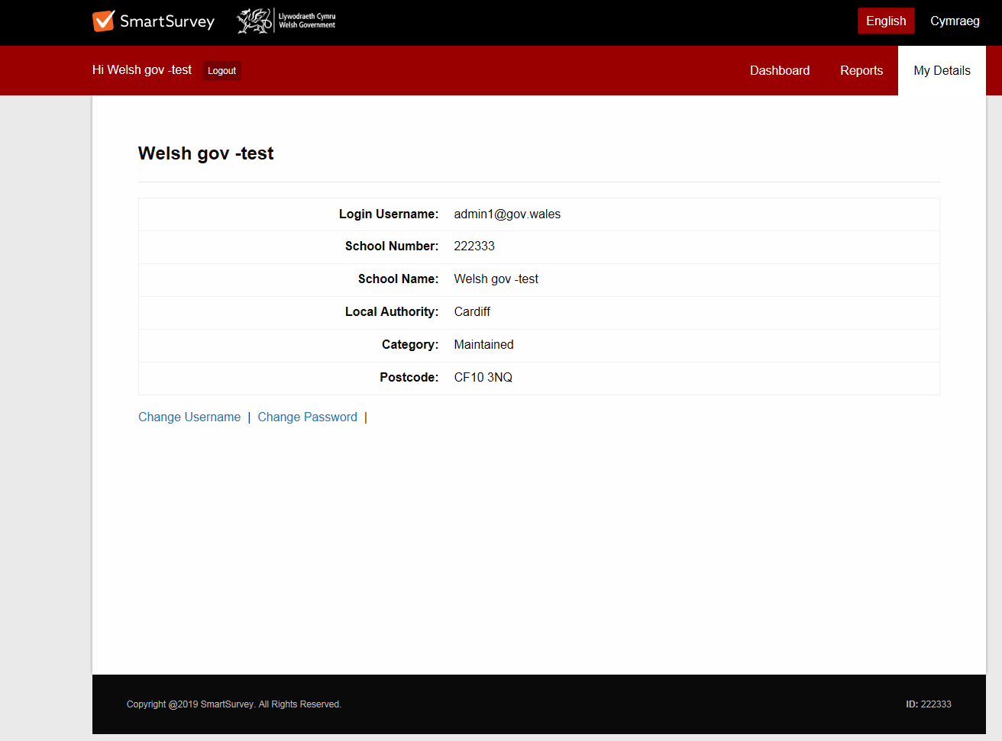

Slide 9
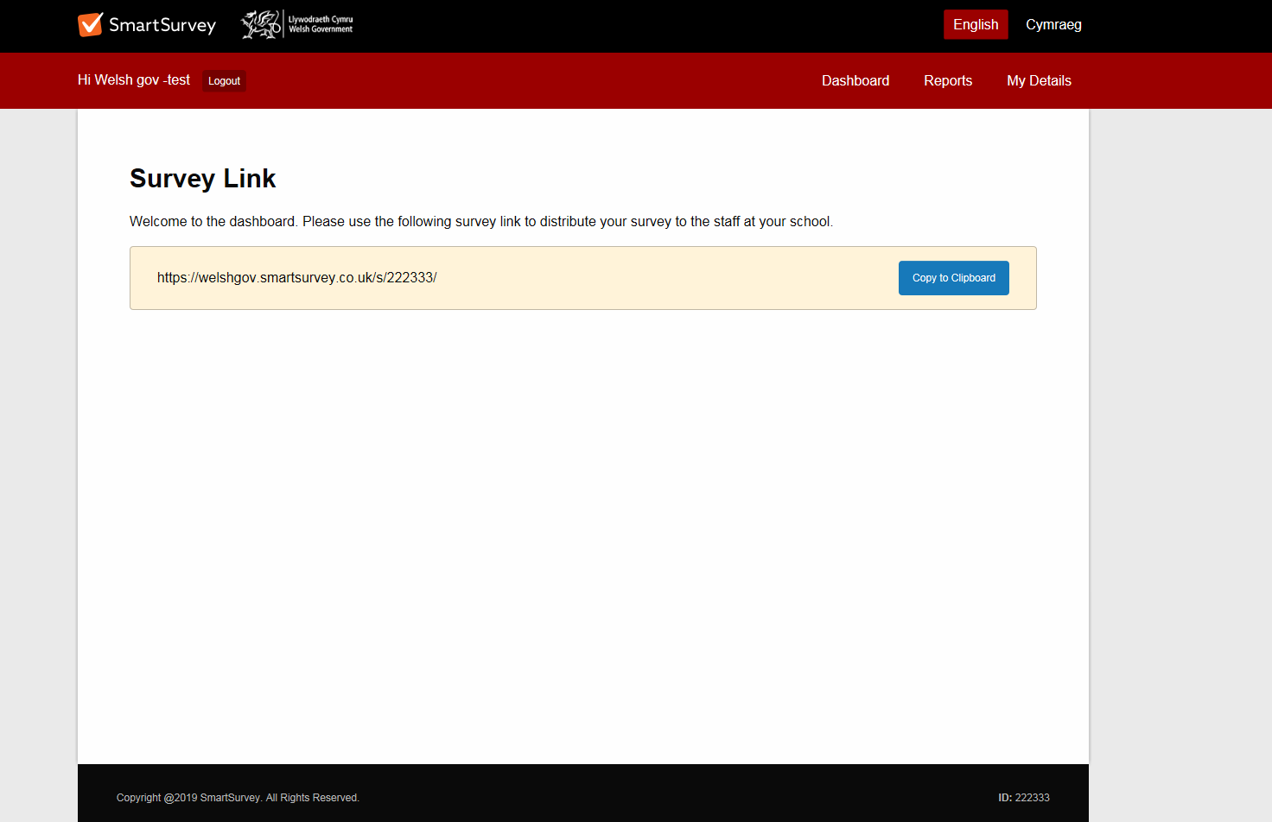
Copy this link in to a separate email and send to staff in your school

Slide 10
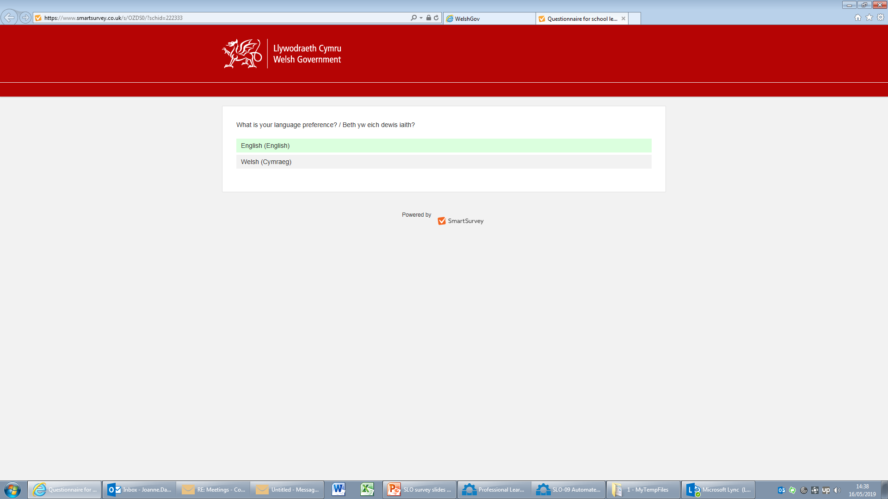
Select your language

Slide 11
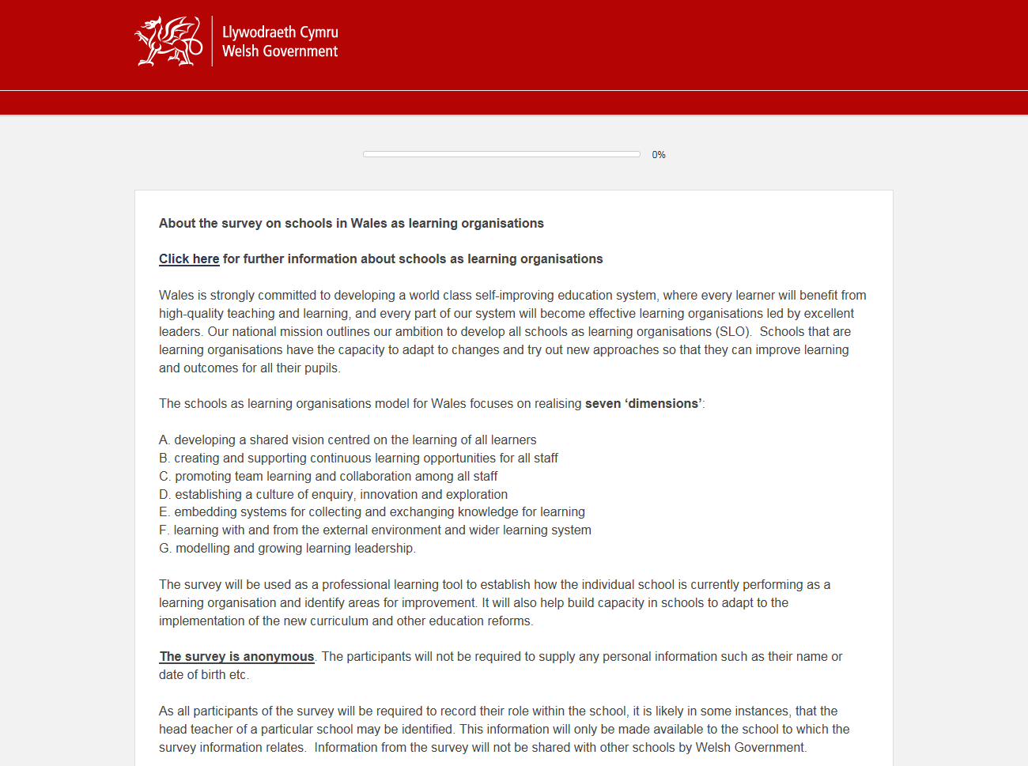
Survey disclaimer

Slide 12
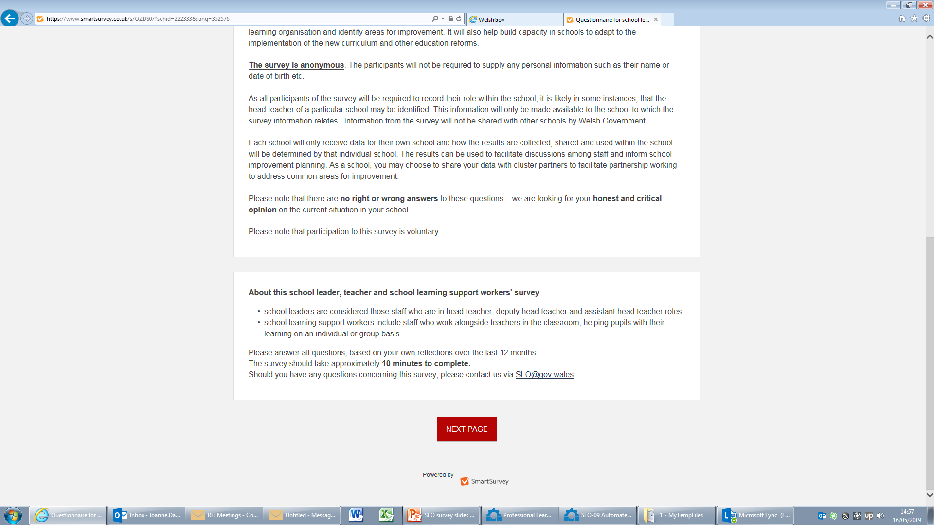
Survey disclaimer

Slide 13
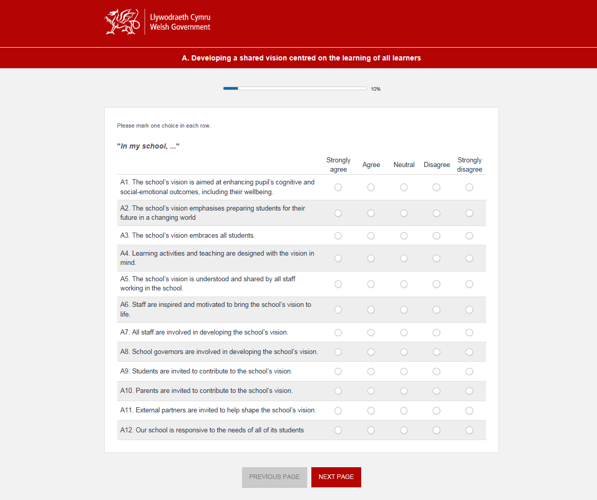
First page of the survey questions

Slide 15
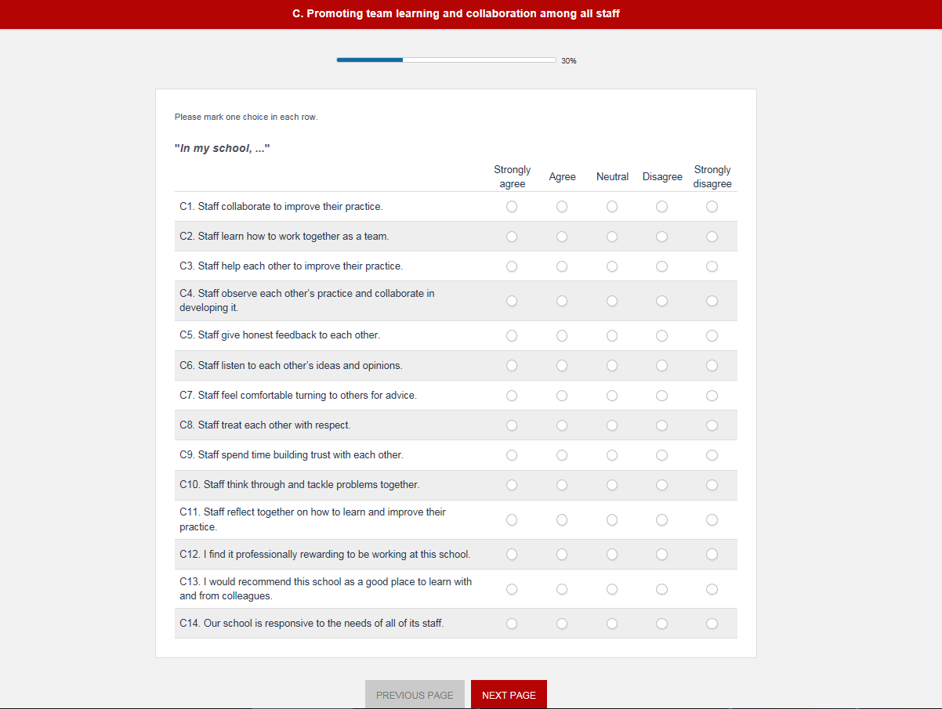

Slide 19
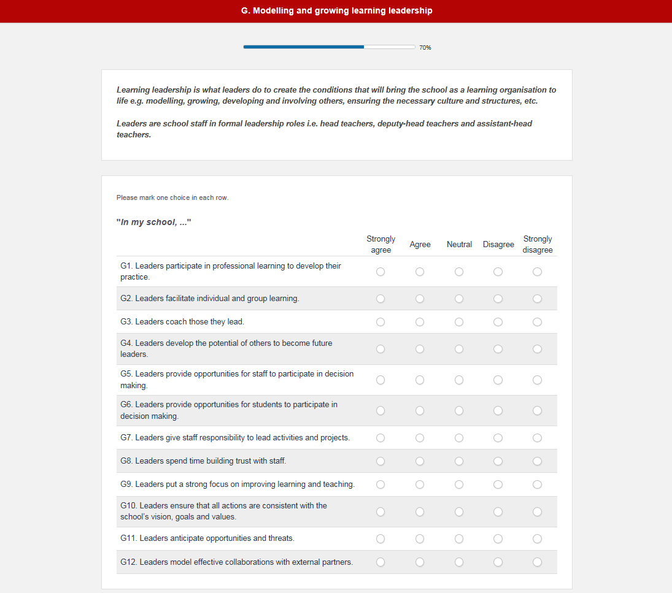

Slide 22
The Headteacher can decide the timeline for staff to complete the survey.
The survey portal will update every 3 hours, please allow 3 hours between last person completing the survey and running of the snapshot and reports.
On your chosen date, log back in to the portal to view your snapshot and reports.

Slide 23
Log back in to view your reports

Slide 24
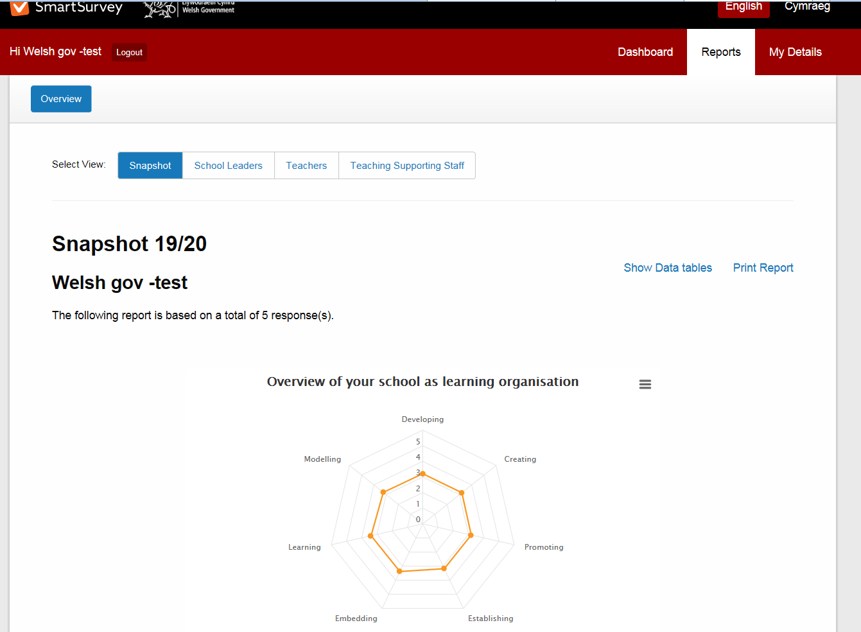
Select ‘Reports’

Slide 25
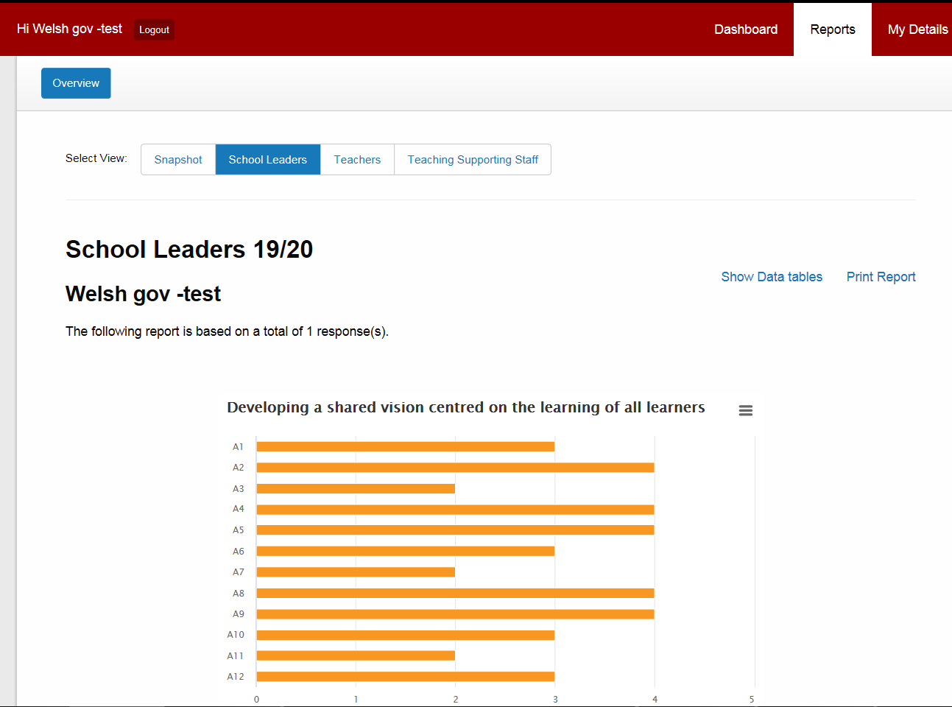
Select each tab as required

Slide 26
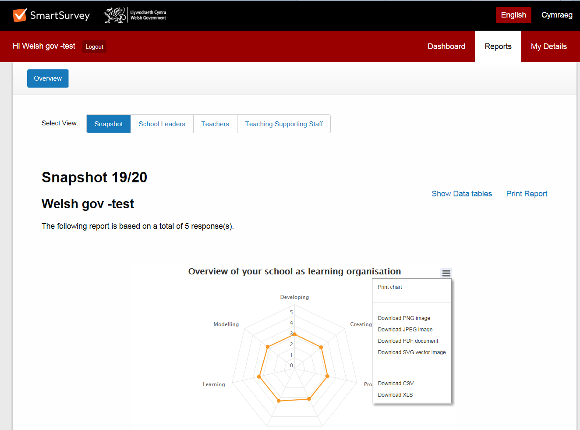
Print or download snapshot / reports

