Slide 1
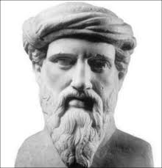
Pythagoras’ Formula
Key Words
History / other notes
Examples

Slide 2
TASK 1
Each question has a real-life problem involving Pythagoras, and represents a letter:
P-Y-T-H-A₁-G-O-R-A₂-S
Try to answer the question relating to your letter with a partner in your group.
You can then discuss your solution with your group to see if they agree.
Your teacher has a hint for each question should you need it!

Slide 3
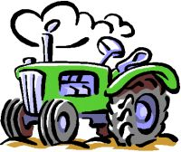
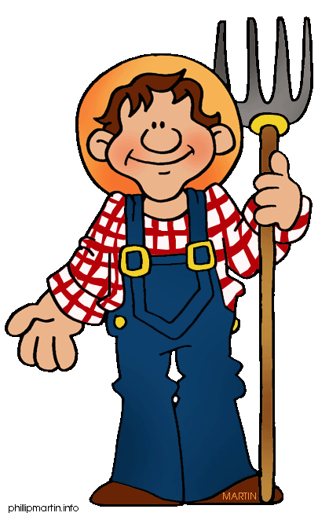
P
A farmer has a rectangular field, and must walk from one corner to the opposite corner to get to his tractor.
How far is this?
45 m
60 m

Slide 4
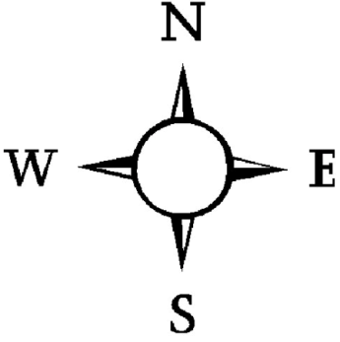
Y
A maintenance boat sails due East from a Harbour (H), to a marker buoy (B), 15 miles away. At B the boat turns due South and sails for 6.4 miles to a Lighthouse (L).
Make a sketch of the journey.
What is the distance from the Harbour to the Lighthouse?

Slide 5
T
A ladder can extend to 5.7 m.
Health and Safety Regulations state that this ladder must be a safe distance of 1.3 m from the base of the wall when fully extended.
How high up a wall can the ladder reach when fully extended?

Slide 6
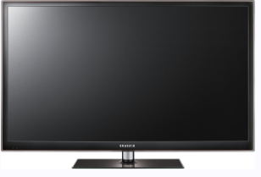
H
Andy’s television screen has width 36.6 inches and height 20.6 inches.
Andy thinks he has a 46 inch TV.
Is he correct?
Maths is COOL!

Slide 7
A₍₁₎
A plane left Edinburgh Airport. The pilot flew 70 kilometres West. He then flew 55 kilometres due North.
How far is the plane from Edinburgh Airport?

Slide 8
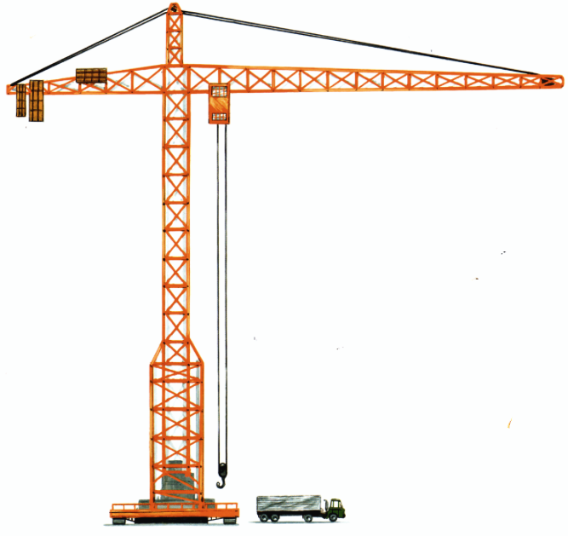
A crane needs a length of cable replaced. The length of the arm of the crane is 50 m and the height from the arm to the cable is 15 m.
How long is the cable that needs to be replaced?
G
15 m
50 m

Slide 9
O
Find the area of the triangle below.
13 cm
5 cm

Slide 10
R
Is this triangle right-angled?
10 cm
23 cm
25 cm

Slide 11
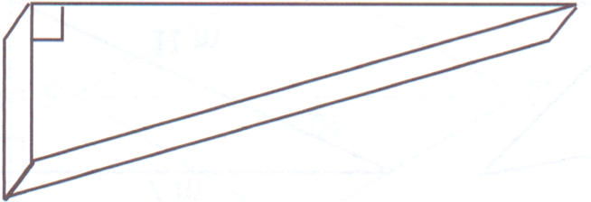
A₍₂₎
David has made a doorstop.
The distance between the door and the floor is 1.6 cm.
Is the doorstop big enough to hold the door open?
A diagram of the doorstop is shown with some measurements.
10.2 cm
?
10 cm

Slide 12

S
What is the screen size of an iPhone 5?
3.49 inches
1.96 inches

Slide 13
P - 75.0 m
Y - 16.3 miles
T - 5.5 m
H - 42.0 inches. No, Andy is wrong.
A₍₁₎ - 89.0 km
G - 52.2 m
O - base = 12.0 cm, area = 30.0 cm².
R - c = 25.1 cm. Not right angled.
A₍₂₎ - height = 2.0 cm. Yes it is big enough.
S - 4.0 inches
Solutions

Slide 14
TASK 2
Calculate the total volume of turf needed to cover this garden.
Turf is sold in a depth of 50mm.
Round all answers to 2 d.p.

Slide 15
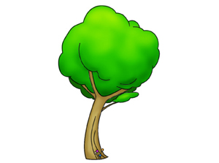
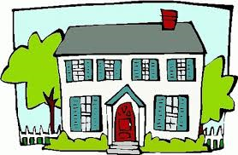

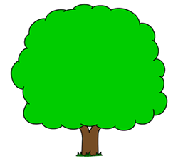
150cm
3m
2m
7m

Slide 16
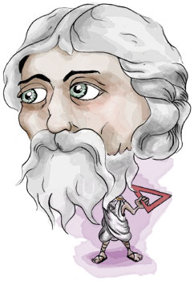
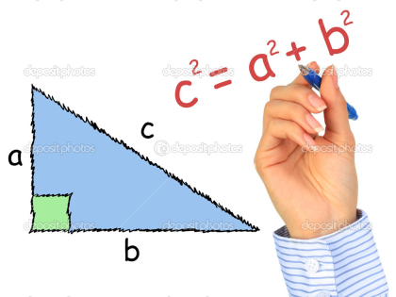
Workings

Slide 17
Model Solution
150cm = 1.5 m
Area = ½ x 1.5 x 1.32 = 0.99m²
1.32m
(Pythagoras – shorter side)
C² = 3² + 7²
C² = 9 + 49
C² = 58
C = √58
C = 7.62m
2m
Area = 2 x 7.62 = 15.24m²
Area = 3 x 7 = 21m²
3m
3m
7.62m
(Pythagoras - hypotenuse)
2m
7m
7m
2² = 1.5² + B²
4 = 2.25 + B²
B² = 4 – 2.25
B = √1.75
C = 1.32m
Area = π x r²
= 3.14 x 7²
= 153.86 / 2
= 76.93m²
Area = ½ x 3 x 7 = 10.5m²

Slide 18
Model Solution
Total Area
= 0.99 + 15.24 + 21 + 10.5 + 76.93
= 124.66 m²
^{Total Volume}
^{= 124.66 x (50 ÷ 10 ÷ 100)}
= 6.23 m³
Converting from millimetres to metres

Slide 19

Extension A
The following triangular pond is planned to be added to the garden in the future. What percentage of the garden’s area would this pond take up?
2m
6m

Slide 20
Extension B
The depth of the turf is correct to the nearest 10 millimetres.
What would be the maximum and minimum volume of turf needed?

