Slide 1

Self-esteem and well-being in a digital world
The basics for a good foundation
Primary
Notes:
Notes for facilitator
To jump right into the topic, ask the participants if they have ever looked up their own name online. If they say no, invite them to take out their smartphones, go to a search engine and type their name. As they see the results, invite them to click on “images” and then “videos.”
Some of the participants may be surprised by what shows up on their screens.
Inform the participants that the results of that search will be included in the topics of discussion, these being self-image, online reputation, digital footprints and well-being in our digital age.

Slide 2

Self-image
Self-worth.
Self-judgement.
Self-value.
Notes:
Background
How you portray yourself can determine one’s self-image (http://hwb.wales.gov.uk/Resources/resource/723d9fed-a222-452a-8113-4c1d7ed23440/en)
Self-image is how we view ourselves, our self-worth, our self-judgment and our self-value. As the image shows, if we have positive self-worth we may view ourselves as a lion, even when we are not.
Tips for the facilitator
Children today not only create their identity in the real world, but they also create an online identity.
Online identity is not the same as an offline identity and every website that a child uses “sees” the child differently.
Parents or carers can help their children create positive self-images by helping them understand: Treat others, as you want to be treated.

Slide 3
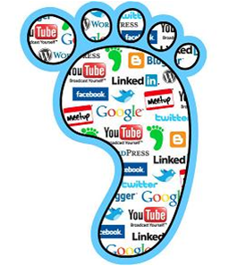
What are digital footprints?
Digital traces of ourselves online.
Information put online leaves a trail that others can follow.
Notes:
Background
“There are two main types of digital footprint: passive and active. A passive digital footprint is created when data is collected without the owner knowing. An active digital footprint is created when personal data is shared or posted online deliberately by a user.”
Digital Footprint and Reputation for parents and carers (https://hwb.gov.wales/onlinesafety/resources/resource/cd4a603f-1460-4a93-a7d5-bc808db159ae )
Digital footprints are digital traces of ourselves online; information that we put online they are the things that online that leave a trail that others can follow.
Tips for the facilitator
Information put online can be seen by lots of people and might stay online forever. These digital footprints are trails that others can follow and gather information.
We can also think of digital footprints as digital dust or traces left across the internet.
We all leave digital footprints with every new profile, photo or comments. As parents or carers we need to be aware of the and encourage our children to think critically about the information they leave online whether they are social networking, playing games, researching or just surfing the net.

Slide 4
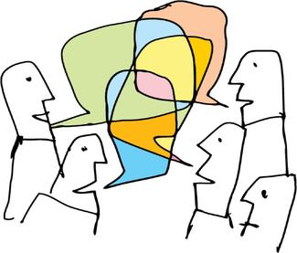
Online reputation
Notes:
Background
Online reputation exists forever.
“It is important too that all of us understand the permanency of what is shared, and the potential audience today and, of course, in the future. In other words, what we post adds to our reputation; what our family and friends, our teachers, our future employers think about us, based on what they see online.”
Tips for the facilitator
Questions to parents and carers to consider are “what are YOU saying about you?” and what are your children saying about themselves?”
As parents and carers we all need to be aware that everything we put online, contributes to our online reputation, good or bad.

Slide 5
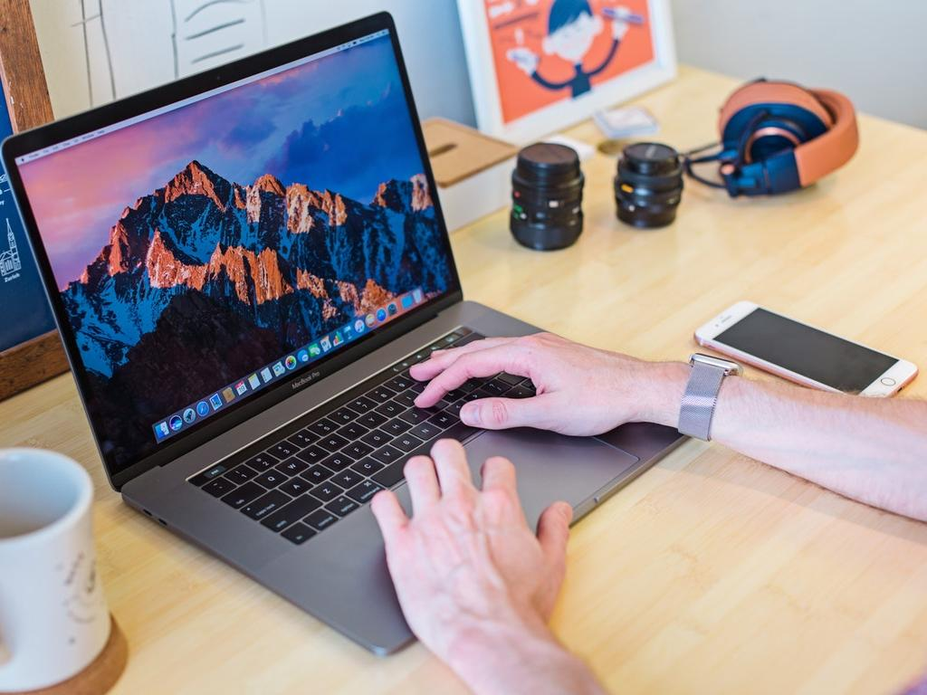
What is well-being in a digital world?
Using digital
technology
responsibly
and safely.
Photo by Mia Baker - Creative Commons No known copyright restrictions https://unsplash.com/@miabaker?utm_source=haikudeck&utm_medium=referral&utm_campaign=api-credit
Notes:
Background
The internet is everywhere.
Digital technology can be used to communicate and connect with others locally and globally via text, image, photographs, video, newsletters, e-mail, web services and more.
Tips for the facilitator
The internet, technology and social media is increasing in all of our communities, whether by small increments or large.
Understanding the impact that digital technology can have on our lives and the lives of our children is a necessary first step in ensuring well-being in a digital world.
Using digital technologies responsibly and safely can help reduce some of the negative consequences of being online.

Slide 6

Importance of self-esteem and well-being
There is strength to be found in understanding your value in the digital world.
Notes:
Background
“The features of good mental health and emotional (psychological) well-being are the abilities to:
develop psychologically, emotionally, intellectually, creatively and spiritually
use and enjoy solitude
develop a sense of right and wrong, understanding and valuing the differences between people and respecting the right of others to have beliefs and values different to others
recognise and manage strong feelings such as frustration, anger and anxiety
initiate, develop and sustain mutually satisfying personal relationships, including friendships
become aware of others and empathise with them
play and learn effectively and co-operatively
solve problems with others and alone and deal with and resolve conflict effectively and fairly
face and recover from problems and setbacks and use any psychological distress that results as a developmental process and learn from them in ways that do not impair or hinder further development.”
Thinking positively. Emotional health and well-being in schools and Early Years settings. (http://learning.gov.wales/docs/learningwales/publications/121128thinkingen.pdf ) Produced by the Welsh Government.
The features of good well-being online are essentially the same as those identified above.
Tips for the facilitator
Parents and carers can help children increase their emotional well-being by:
talking to them
by praising them for a job well-done
by generally helping their children feel positive about themselves.

Slide 7

Importance of positive online presence
Self-esteem.
Self-value.
Empowerment.
Notes:
Tips for the facilitator
Just as having self-esteem and well-being, a child with a positive online presence will be empowered to act positively.
Children, who have learned that they have a choice on how they share personal information or how they engage with others online, will be empowered to act respectfully.
Children who understand their own self-value will continue to maintain a positive online presence by word and by deed.

Slide 8
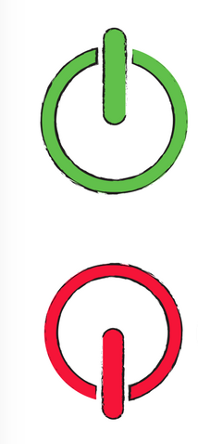
Online behaviour
Offline behaviour
Notes:
Background
Actions have consequences both offline and online and rules for citizenship are in place, just as rules for digital citizenship are in place for online activities.
“It’s important for all of us to encourage teenagers to spend time with their friends in the real world – to find a balance between the image they curate online and what they experience in the real world with their real friends.”
Tips for the facilitator
The lines may be blurred in some activities for young people as they multi-task, but for children the lines are usually very straightforward: either a child is online engaged in some sort of activity or they are offline.
Parents and carers can help their children understand the similarities and differences in how children present themselves online. For example, online you do not share personal information or details as you may when playing with another child.
Even though there is a gap between online and offline identity, children should understand that they must behave responsibly in both spaces.

Slide 9
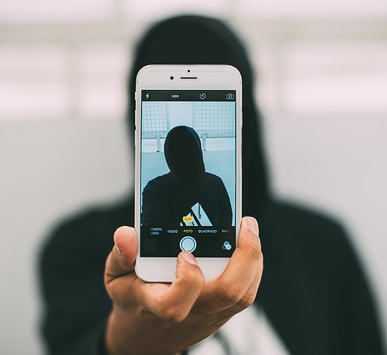
Psychology of behaviour and anonymity online
Online dis-inhibition.
Act differently.
Deception.
Not everyone is who we may think.
Notes:
Background
Anonymity or perceived anonymity online can have different impacts. It can be considered the “modern-day equivalent of superhero power invisibility” where people can use their powers for good or for bad. It can also fuel online dis-inhibition where human behaviour is amplified and accelerated online. Positive examples could be online altruism where people give anonymously whereas negative examples could be trolling, bullying and other judgment-impaired activities. Dr. Mary Aiken, The Cyber Effect, John Murray Publishers, 2017, p5.
Tips for the facilitator
Being anonymous can make children feel disguised and they may try to push limits or act in ways they wouldn’t do in the real world.
Using a different digital identity may be a way for children to avoid personal consequences or to dare something outrageous.
For young children, parents and carers may be able to step in and support their children before any real damage is done. However, for young people, they may be creating online reputations that may stay online for years to come.

Slide 10
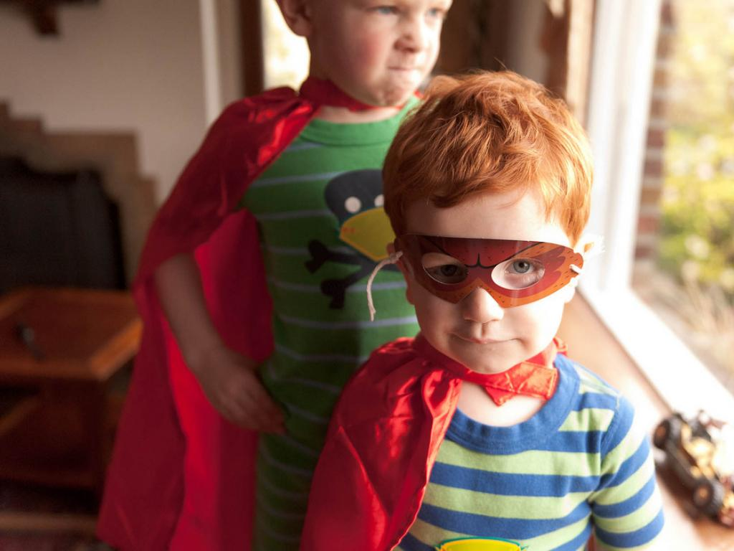
Self-confidence and self-esteem
Comfortable online with parental support but only for age-appropriate sites and platforms.
Photo by B.K. Dewey - Creative Commons Attribution-NonCommercial License https://www.flickr.com/photos/9052666@N05
Notes:
Background
“This refers to the way children feel about themselves. Positive feelings indicate a high self-esteem, while negative feelings about themselves are an indication of low self-esteem.”
This document for foundation phase practitioners by Welsh Government may be useful. (http://learning.gov.wales/docs/learningwales/publications/140828-observing-children-en.pdf)
Tips for the facilitator
All parents and carers want their children to feel self-confident and have self-esteem, but it is difficult to help children when they are alone in their digital world.
When parents and carers are involved in the online activities of their children, they are better able to support their children and boost positive feelings.
Being active also means that parents and carers can step in and discuss any negative feelings before they have lasting impact.

Slide 11

Creating well-being in a digital world
Ignoring well-being can decrease physical well-being.
Notes:
Background
Experts advise parents and carers to limit screen time in order to aid child development. Experts advise parents to limit screen time in order to aid child development.
The Media and Young Minds report (http://pediatrics.aappublications.org/content/early/2016/10/19/peds.2016-2591 ) from the Council on Communications and Media provides a useful overview of research into technologies their positive use and related health concerns.
Screen time means children are lying down or sitting for long periods of time, which has been linked to unhealthy weight in childhood. (Obesity may lead to other health problems such as diabetes, low self-esteem and asthma).
Here is some advice from NHS Wales about screen time. (http://www.wales.nhs.uk/sitesplus/888/page/84916)
Tips for the facilitator
Just as we strive to have health and well-being in our daily lives, we need to create that same well-being in the digital world.
Limits and moderation are useful in online activities.
Parents and carers should strive for balance so that children can get outside and engage in some sort of activity: exercise and increased activity are healthy for a child’s development.
If children are not sitting in front of screens – TV, tablets, etc. Screen balance is key to ensuring emotional well-being.

Slide 12
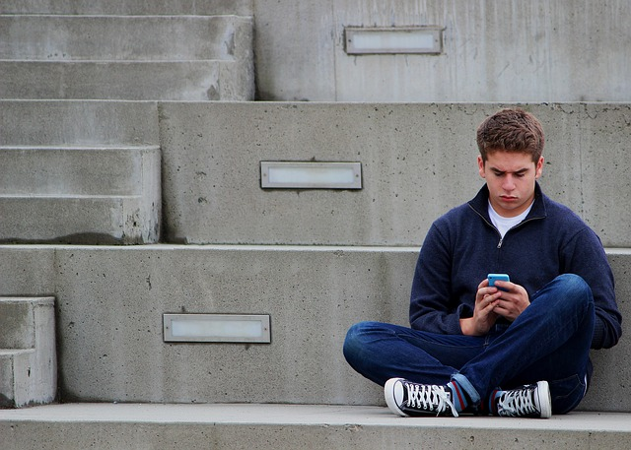
Signs and symptoms
Closing computer or device.
Refusing to go to school.
Feeling nauseous.
Headaches.
Irritability.
Exhaustion.
Notes:
Tips for the facilitator
If parents and carers are vigilant, they may be able to recognize some of the signs and symptoms that all is not well in their child’s online environment.
While certain signs may be indicative of other illnesses, recognizing that there may be a link to their online activities can be helpful.
For example, a child with headaches and eyestrain may be overusing their devices. Or a child who refuses to go school or who closes the computer when a parent walks in the room may be a victim of online bullying.

Slide 13

Creativity and learning
Important for children to be creative through digital media.
Emphasis on safety.
Notes:
Background
“Arts and creativity are potent tools to inspire and engage. Whether in a literacy, numeracy or science lesson, they can unlock novel and exciting new ways of thinking and doing for young people.”
The creative learning zone on Hwb (https://hwb.gov.wales/creativity) has a range of supportive resources to use in schools and colleges.
Tips for the facilitator
Parents and carers can check if the websites their children are using have educational or creativity value by looking at reviews on Common Sense Media (https://www.commonsensemedia.org).

Slide 14

Resilience
Help children become resilient.
Being online more leads to more risk (and potentially more resilience).
Notes:
Background
EU Kids Online interactive report, (https://lsedesignunit.com/EUKidsOnline/index.html?r=64) Sonia Livingstone: “The term ‘resilience’ describes several related elements. It describes people with appropriate self-esteem and self-confidence. This appears to reduce the risks of children and young people having mental health problems. Resilience also involves belief in one’s own effectiveness and being able to cope well with change. People who are resilient have repertoires of approaches to solving the social and other problems in which they find themselves and have good relationships with other people on whom they can depend for help when problems or difficulties arise.”
Thinking positively. Emotional health and well-being in schools and Early Years settings. (http://learning.gov.wales/docs/learningwales/publications/121128thinkingen.pdf) Produced by the Welsh Government.
Tips for the facilitator
Online resilience means that your child has appropriate self-esteem and self-confidence when engaging in online activities.
Parents and carers can help their children bounce back from perceived issues by being present, by communicating and by supporting their children.

Slide 15

Empathy
Kindness and empathy can be lost online.
Necessary skills to reduce bullying.
EMPATHY
Notes:
Background
Empathy and the ability to understand and consider the feelings of others.
Tips for the facilitator
As a parent or carer think about the images that you see online and whether they evoke empathy. Sometimes we are so busy getting through our day that we may miss signals.
When our children are online, they may see images or videos that inspire them to take positive action, just as other images or videos may bully, harass or intimidate.

Slide 16

Other Ideas
Notes:
Tips for the facilitator
Open discussion to parents and carers for other reasons why a healthy self-image and digital well-being are important.

Slide 17
Tips for parents and carers to use starting today
Notes:
Tips for the facilitator
We will look at things that you can start doing with your children
Here are some starting actions to consider
Check privacy settings on computers, tablets, smartphones, websites, etc.
Help your children understand the idea to think before posting
Be positive online and offline.
Manage screen time and achieve a balance of offline and online activities.

Slide 18
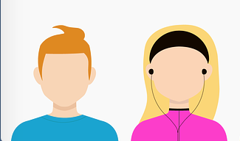
Use of screen names and avatars
Safe use without personally identifying information.
Especially as children are gaming more.
Notes:
Background
On most websites or social networking sites, children need to create profiles in order to use the site.
It is important to remember that screen names and avatars can lead to personally identifying information and should be used with caution.
Tips for the facilitator
Playing around online with creative identities, screen names or avatars can be a safe and imaginative way for children to explore who they are:
For example a shy child may want to display an extroverted identity online; this different persona can be a real chance to play differently.
The best screen name or avatar is one that does not include any personally identifying information, such as school, city, age, and gender.
Children should avoid screen names like CoolKidCardiff or FunGirl12 that identify location, gender, age.

Slide 19

Digital Citizenship
Self-esteem.
Well-being.
Responsible use of digital technology.
Notes:
Background
Digital citizenship is about developing the skills needed to contribute positively to the digital world.
Digizen from Childnet (http://www.digizen.org/digicentral/digital-citizenship.aspx) provides information for learners, practitioners, parents and carers about digital citizenship.
A bank of websites to help support the Citizenship Strand of the Digital Competence Framework is available on Hwb. (https://hwb.gov.wales/resources/resource/03e1ee60-cbb5-4f96-b4cc-bdc8e9fa68ed)
Tips for the facilitator
Today, our children need to understand that they must just as they follow the rules in the real world; they must do the same online.
Being a responsible citizen is transferred online and our children must respect others.
We want learners to critically evaluate their place within the digital world, so that they are prepared to encounter the positive and negative aspects of being a digital citizen.

Slide 20

Conversation starters
Who?
What?
Where?
When?
Notes:
Background
Talking with your child regularly is one of the best ways to keep them safe online and keep their activities positive.
By understanding where a child goes online, parents and carers can start a family discussion about boundaries and agree on what is appropriate.
Advice from the NSPCC about talking to your child about staying safe online (https://www.nspcc.org.uk/preventing-abuse/keeping-children-safe/online-safety/talking-your-child-staying-safe-online).
Tips for the facilitator
Understanding what children are doing online is key to helping them increase their self-esteem and well-being.
Parents and carers who know about their children’s online activities are better able to guide those activities positively. For example, if your young child likes to play video games and tells you how someone in Minecraft (or any other game) keeps destroying their creations, you will be able to use this as a conversation starter.

Slide 21
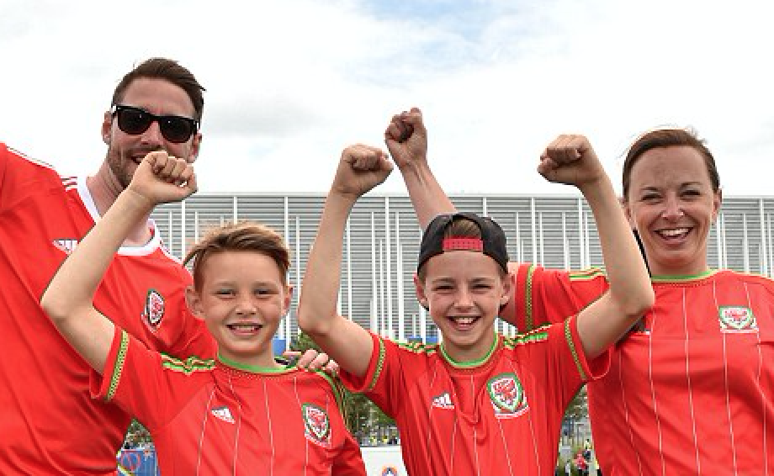
Sharing family values
Transferring your family views on offline behaviour to the online world.
Your rules, your values, your expectations.
Notes:
Tips for the facilitator
This is an extension of the ‘starting a conversation' idea.
The goal is for parents and carers to realise and feel empowered to transfer family views on offline behaviour to the online world.

Slide 22

Social media and social life
Using social media positively for social life and opportunity.
Demonstrate a positive identity by positive social media use.
Notes:
Background
Digital footprints and social media can prove challenging for children.
“With more and more kids on social media these days, it's hard for parents and carers to keep an eye on what their children are getting up to in the world of cyber socialising. Many mark becoming a teenager by setting up a profile on Facebook and recent figures show that 78% of children under the age of 13 have at least one social media account.” From a list of age restrictions for social media apps (http://www.walesonline.co.uk/whats-on/family-kids-news/age-restrictions-social-media-apps-12609380) as listed by Wales Online.
Tips for the facilitator
Digital footprints are not foremost in the minds of young children so parents and carers must protect their children in order to keep private information private.
Whatever the age of your child, they can never begin too early to think about building a positive online reputation.
Using social media responsibly and positively can have a later impact when students apply for university or employment.

Slide 23

Footprints are forever
Delete key does not exist online.
Your unique traces, actions, data can exist in some form, forever.
Notes:
Background
“Digital life is both public and permanent. Everything our children do online creates digital footprints that migrate and persist. Something that happens on the spur of the moment – a funny picture, an angry post – can resurface years later. And if they aren’t careful, their reputations can be harmed. A child may think he or she just sent something to a friend, but that friend can send it to a friend’s friend, who can send it to their friends’ friends, and so on.” Taken from the Common Sense Media Family Tip Sheet – Protecting and Respecting Privacy Digital Footprint and Reputation for parents and carers (http://resources.hwb.wales.gov.uk/VTC/2014/10/03/eng/14_ks2_ks3_familytip_protectingandrespectingprivacy.pdf )
Tips for the facilitator
As children grow older, they need to understand that their digital footprints can expose their private information.
Educators and employers can find what is posted online in public accounts.

Slide 24


Over-sharing and personal information
Reduce the need to post too much, to share too much, to tag everyone.
Keep secrets secret.
Notes:
Background
“Though there are many benefits to sharing information online, it is important that children and young people understand that the internet should generally be considered public because 'private' information can become public if passed on, and in many online communities posts are public by default.” From this article published (https://hwb.gov.wales/onlinesafety/resources/resource/536929bd-a274-4d30-b933-b6903b7787e8/en) on Hwb
Digital Footprint and Reputation for parents and carers (https://hwb.gov.wales/onlinesafety/resources/resource/cd4a603f-1460-4a93-a7d5-bc808db159ae)
Tips for the facilitator
We need to make sure that even our youngest children are aware of simple rules for sharing images and data: photographs cannot be taken of others and shared online without asking permission first.
Even though sharing “funny” images might seem fun or amusing, we need to think before we post a picture or video. What is funny to be one person can be considered offensive, outrageous, inappropriate or insensitive to other people.

Slide 25
Other Ideas
Notes:
Tips for the facilitator
Open discussion to parents and carers for self-image protection and well-being tips.

Slide 26
Thank you!
Be a role model on positive self-image, online reputation and well-being.
Check the Online Safety Zone for more resources.
Notes:
Tips for the facilitator
End session with a reminder to be a good digital role model.
Point to links on the website.
Provide number for helpline.
Hand out tip sheets. You may want to include the online reputation checklist (http://www.childnet.com/ufiles/Online%20Reputation%20Checklist.pdf ) for parents of older children.

