Slide 2
Aim
To know about volcanoes and where in the world they can be found.
Success Criteria
To describe the structure of a volcano.
To locate some of the major volcanoes on a world map.

Slide 3
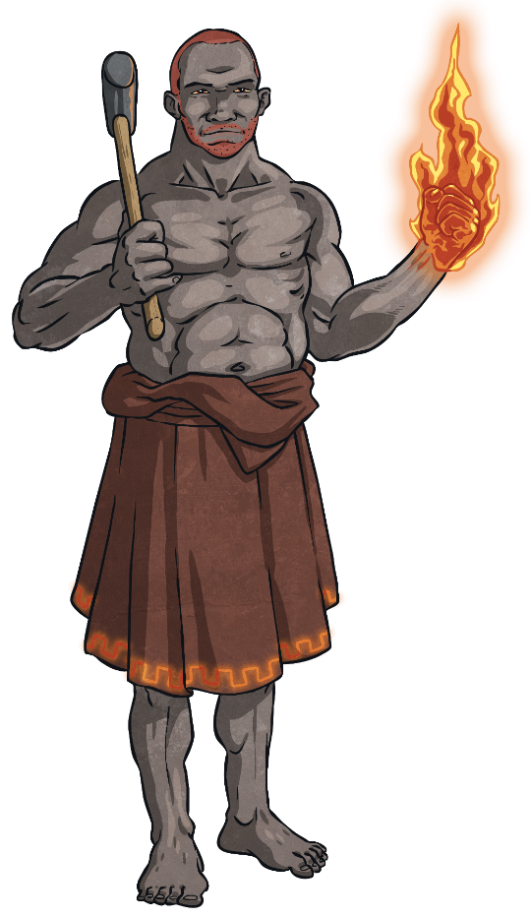
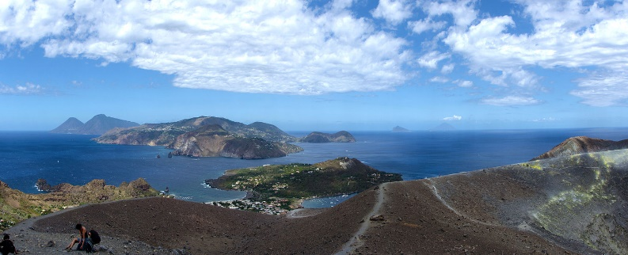
Where Does the Word ‘Volcano’ Come From?
Have you ever thought about why volcanoes are actually called 'volcanoes'? Can you think of a reason why?
The word 'volcano' comes from the island ‘Vulcano’, which is a volcanic island in Italy.
The island actually gets its name from the Roman god of fire – Vulcan.
Vulcano, Italy.

Slide 4
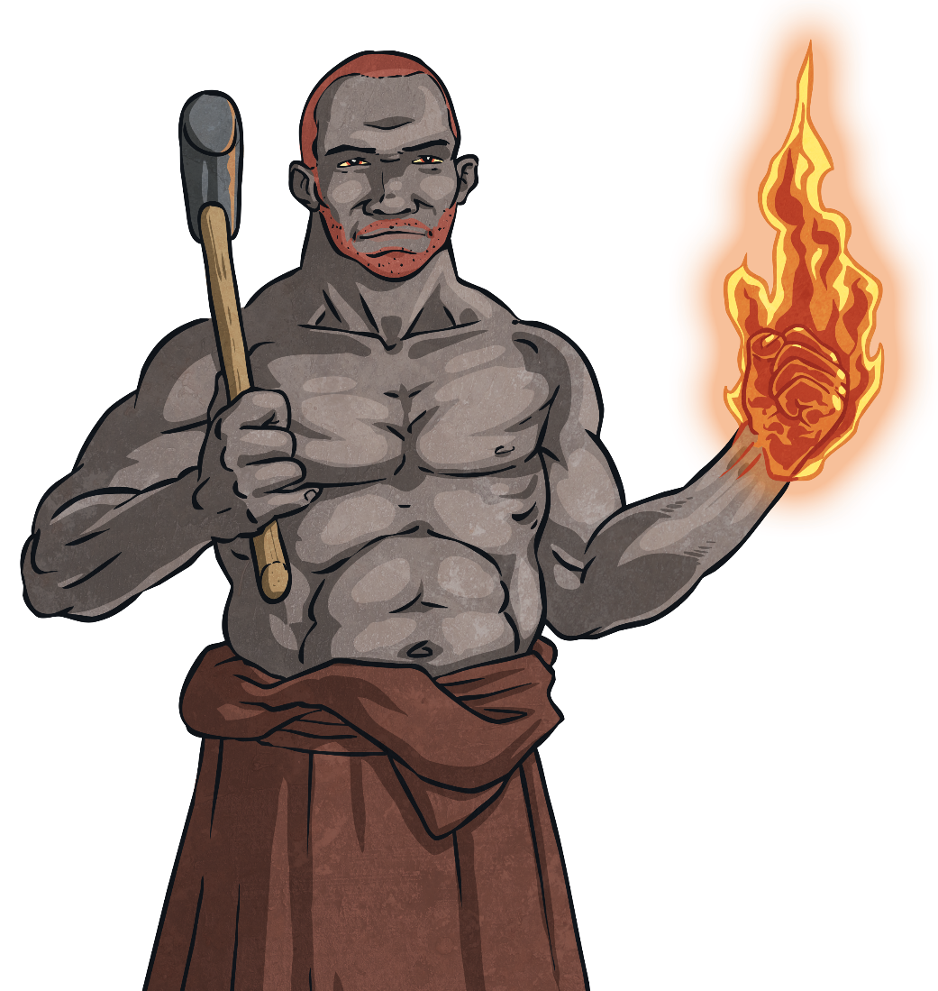
The Roman God of Fire
Roman mythology says that Vulcan lived in a volcano. As well as being the god of fire, he made many weapons and forged them using metal and fire. He was a very skilled blacksmith.
Romans believed that if Vulcan was made angry, the volcano would erupt. So they tried their best to please him and not anger him.
Forged: to have made or shaped a metal object using a fire or furnace.
Click on the word in bold to find out what it means!

Slide 5
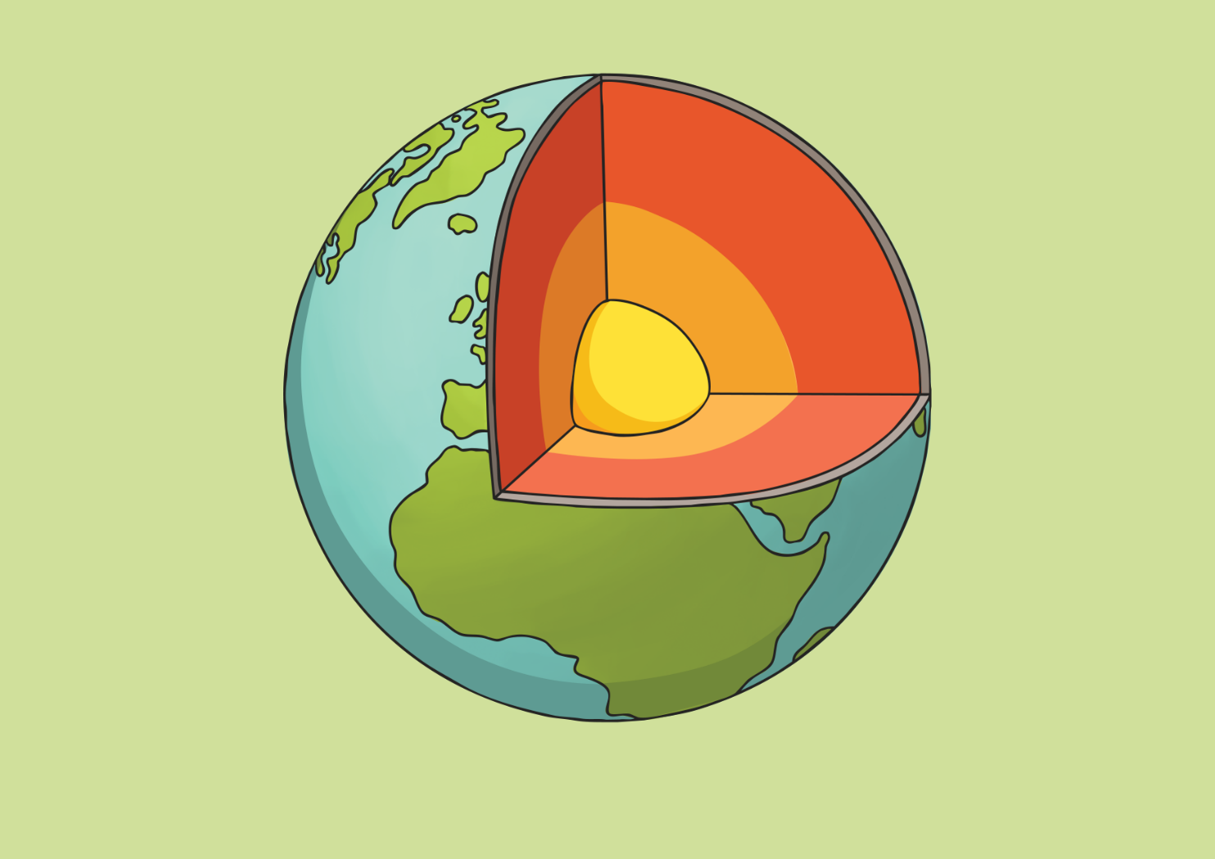
What Is Our Earth Made Of?
Click on the circles to reveal the information.
The Outer Core
The outer core is a liquid layer made out of molten iron and nickel. This liquid metal creates the earth's magnetic field.
+
×
+
×
×
+
The Crust
This is the outer layer of the earth. It varies in thickness from 0 – 60km thick. It is not even and is made up of pieces which overlap to cover the entire planet. These pieces are called ‘tectonic plates’.
The Mantle
The mantle is approximately 2897km thick and is made of a solid, rocky substance called molten rock or magma. This is what escapes when a volcano erupts.
×
+
The Inner Core
This is a solid layer and is made of iron and nickel. It is the hottest part of the earth and can reach temperatures of up to 5500ºC!

Slide 6
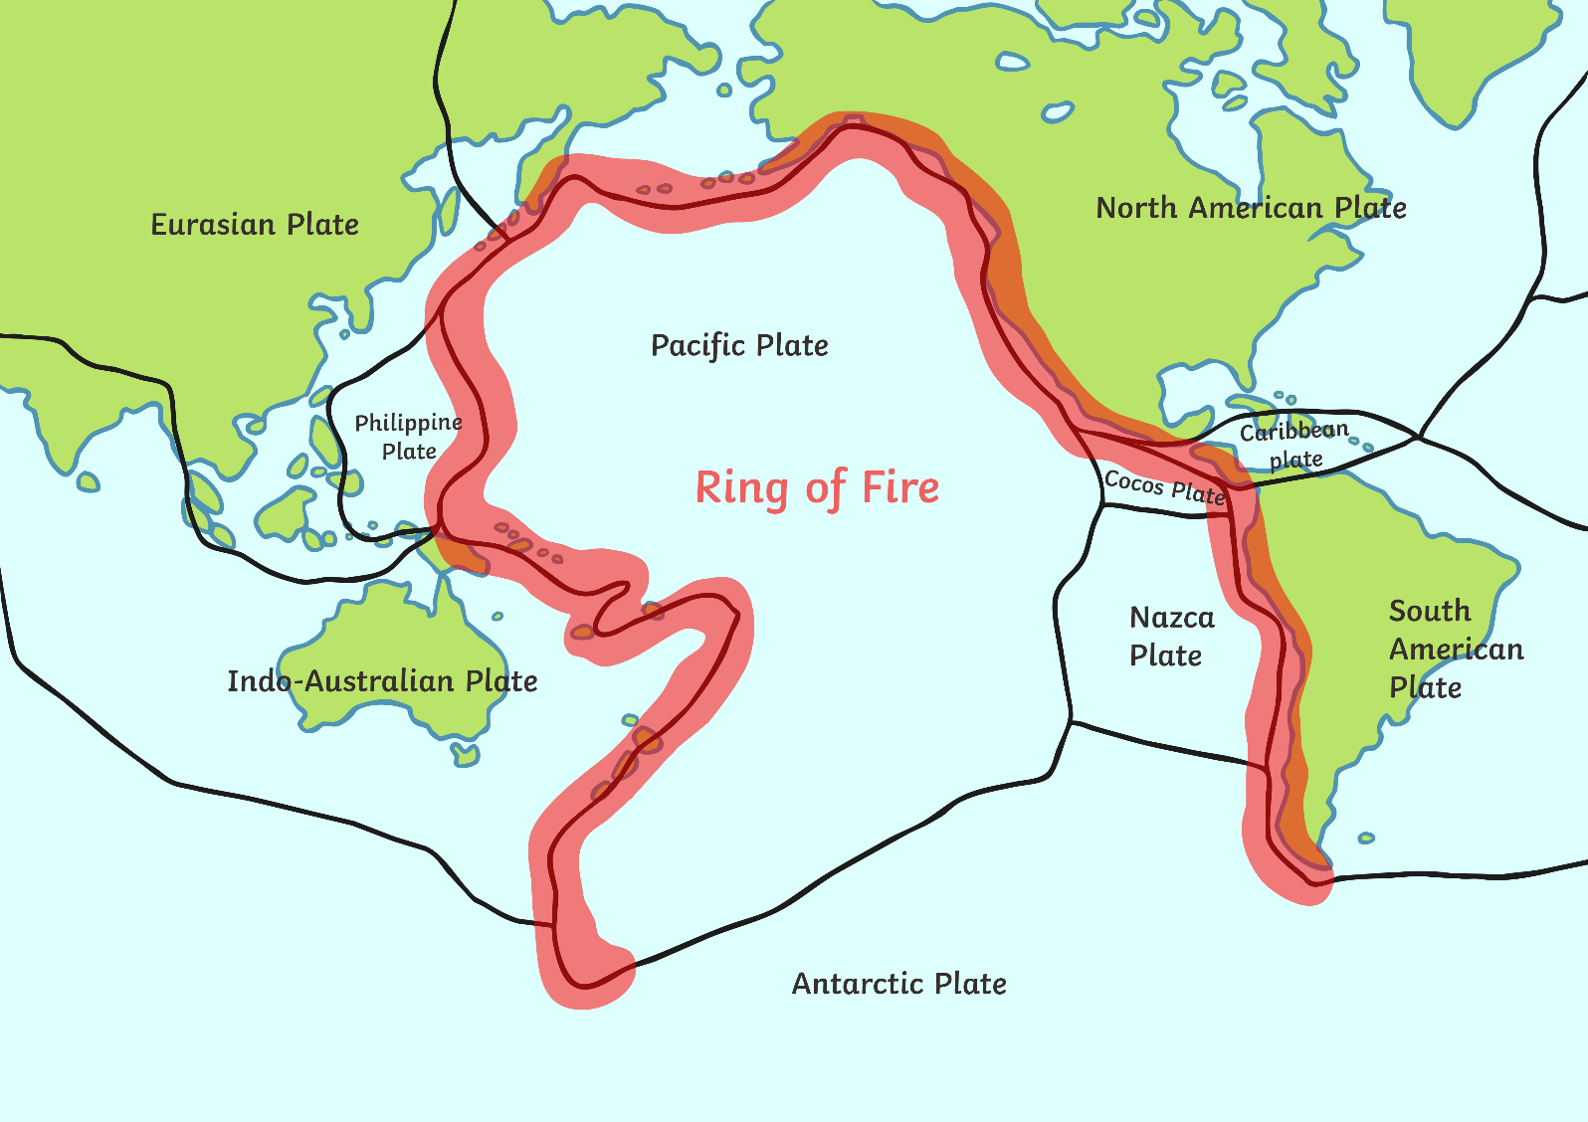
Where Are Most Volcanoes Located?
The ‘Ring of Fire’ is an area of the Pacific Ocean that is shaped like a horseshoe. It is home to 90% of the world's earthquakes and 75% of the world's volcanoes.
It contains a string of 452 volcanoes, which stretches from the southern tip of South America, up along the coast of North America, down through Japan, and into New Zealand.

Slide 7

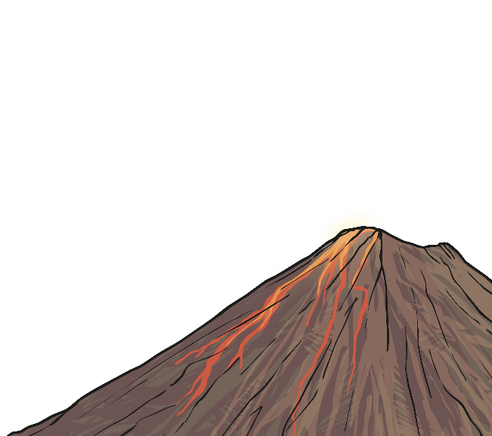
How Are Volcanoes Formed?
Deep in the earth, it is extremely hot. It is so hot, in fact, that rocks actually melt and form magma, which makes up the mantle of the earth.
The upper mantle mixes and moves, which creates pressure underneath the crust. This pressure can sometimes cause the mantle to leak out onto the surface of the earth – this is a volcano!
Over time, as this magma leaks out, the volcano will get bigger and bigger.

Slide 8
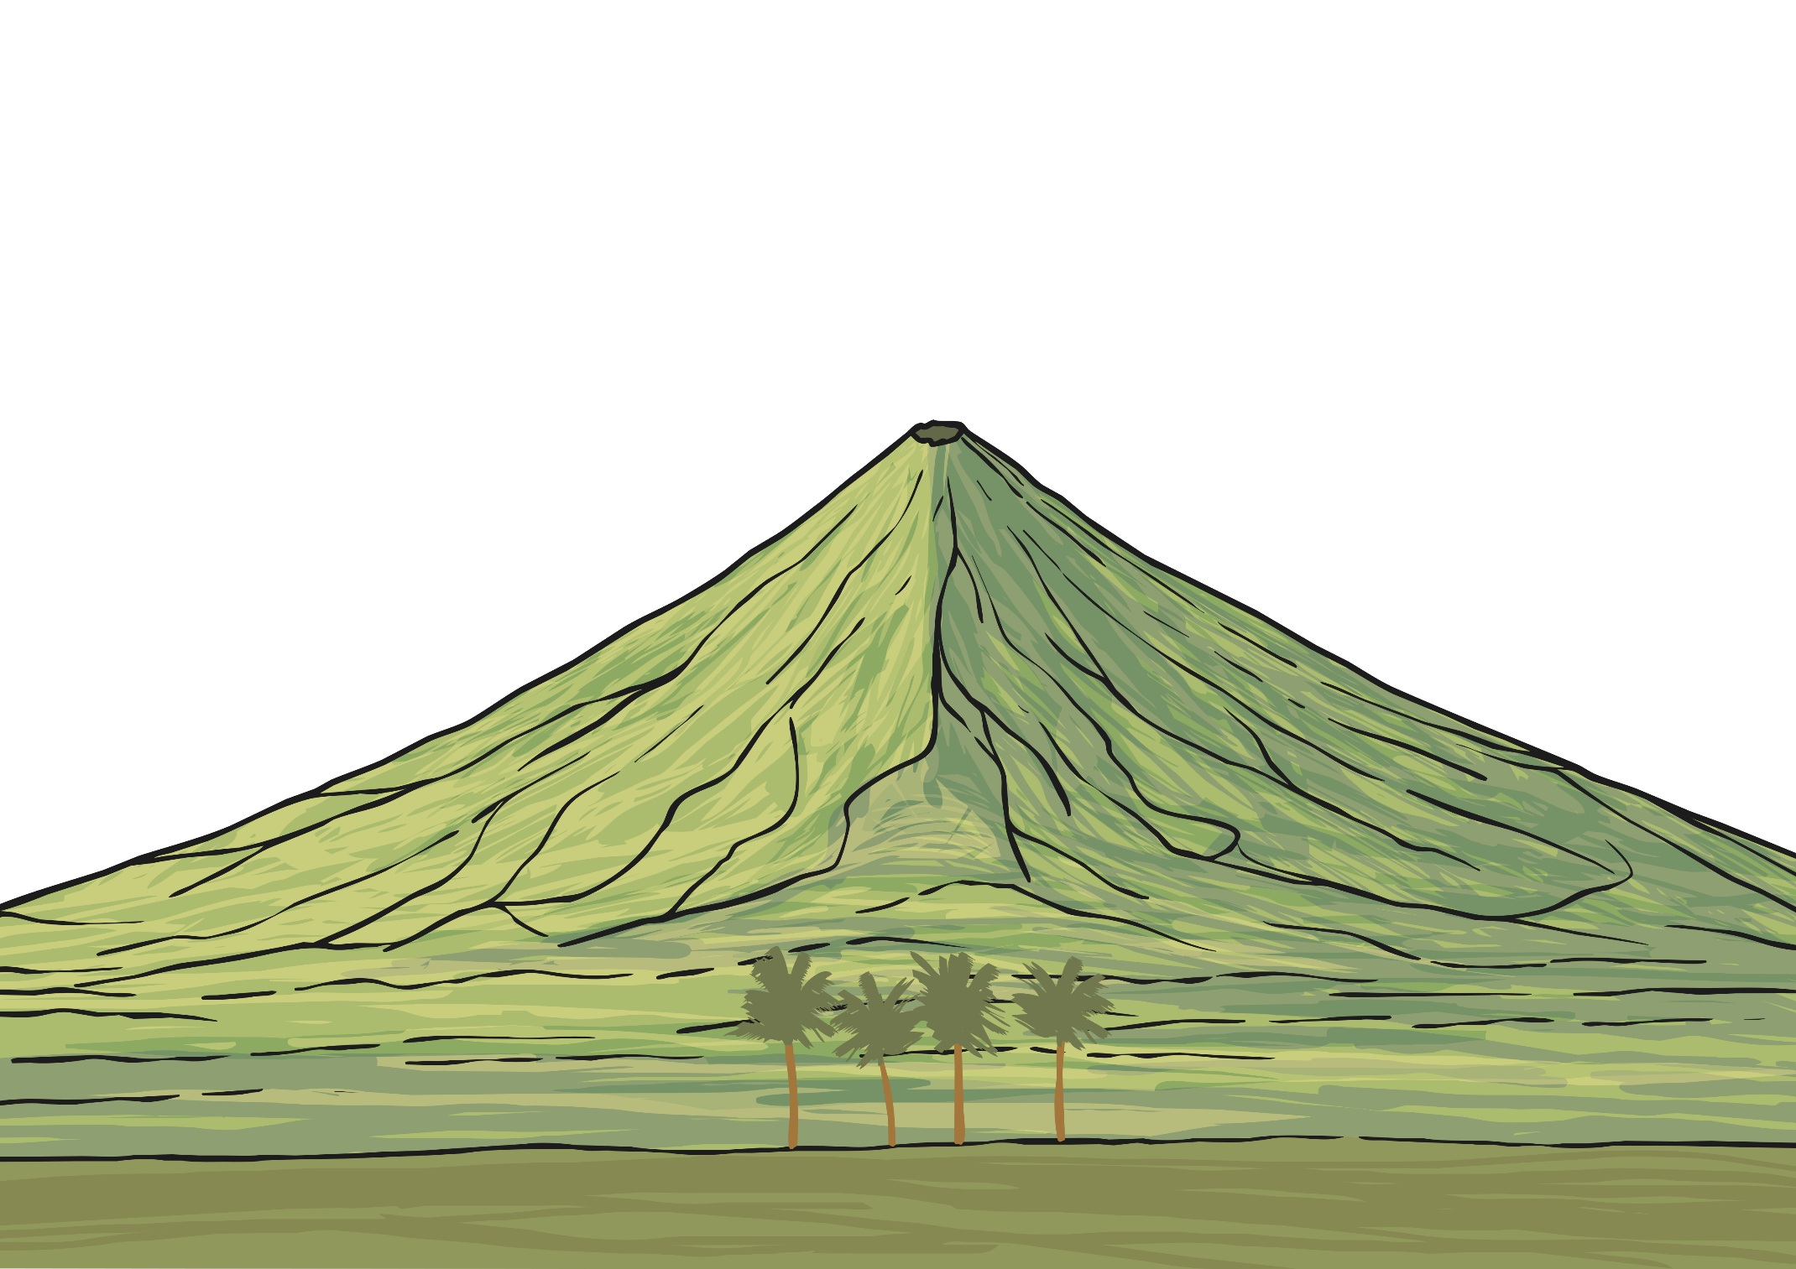
The Three Stages of Volcanoes
Scientists have placed volcanoes in to three different categories. What do you think each one is?
Active
An active volcano is one that has erupted recently, and there is the possibility that it may erupt again.
Dormant
A dormant volcano is one that has not erupted for a long time, however, it may still erupt in the future.
Extinct
An extinct volcano is one which has erupted
thousands of years ago, but it will
probably never erupt again.

Slide 9
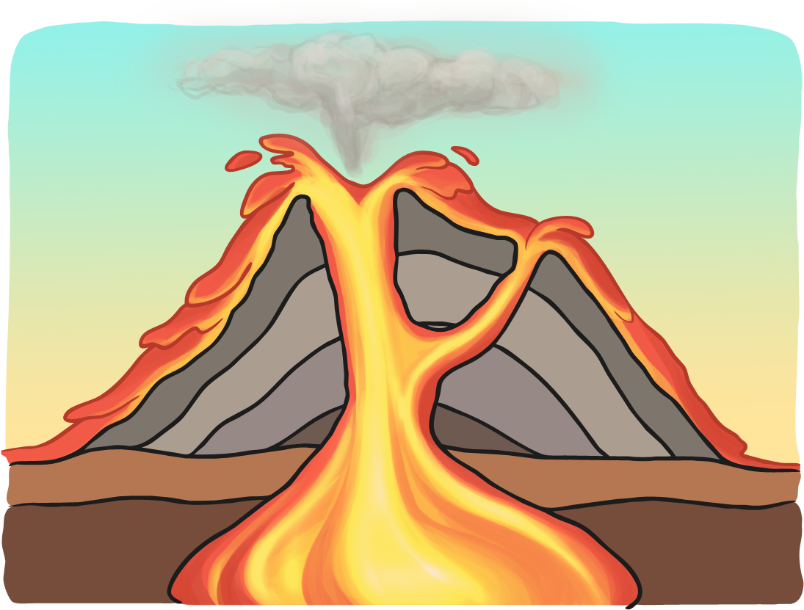
Why Do Volcanoes Erupt?
We know that the earth's crust is made up of huge slabs called tectonic plates. These fit together like a jigsaw puzzle and they sometimes move.
The movement causes friction which causes earthquakes and volcanic eruptions near the edges of the plates. The theory that explains this process is called ‘plate tectonics’ – this means the plates are moving in different directions and at different speeds. Sometimes they collide or brush past each other and cause these earthquakes and volcanic eruptions.
Friction: the resistance created when one surface rubs against another.
Click on the word in bold to find out what it means!

Slide 10
What Are the Different Parts of a Volcano?
Click on each label to find out more. Click again to remove.
vent
ash cloud
An opening in the surface of the Earth through which volcanic materials, such as magma, can escape.
A cloud of ash. It is formed by volcanic explosions
crater
The mouth of a volcano. It surrounds the vent.
throat
conduit
The entrance of a volcano. It ejects lava and volcanic ash.
An underground passage which magma travels through.
A large underground pool of liquid rock found beneath the surface of the Earth.
magma reservoir

Slide 11
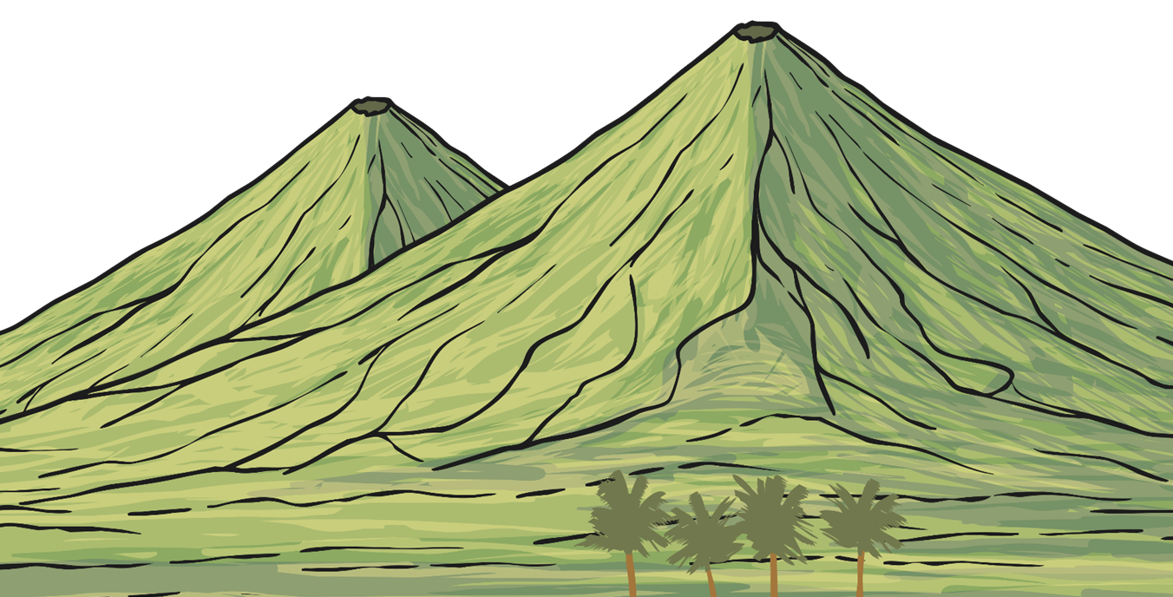
How Many Volcanoes Are There?
There are more than 1500 active volcanoes on Earth. There are also more than 80 volcanoes under the ocean, although these are just the ones that have been discovered.

Slide 12
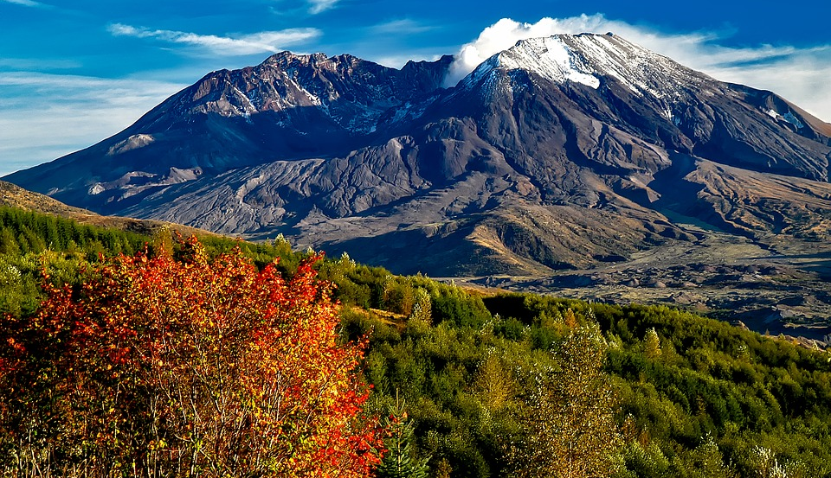
What Types of Volcano Are There?
Mount St. Helens in Washington, USA is a composite volcano.
Composite Volcanoes
These volcanoes are steep-sided volcanoes and are made up of lots of layers of volcanic rocks. They usually erupt in an explosive way because the magma in these volcanoes is quite sticky. It clogs up the passage that it has to pass through. Pressure is built inside the volcanic chamber and this results in the volcano erupting violently.

Slide 13
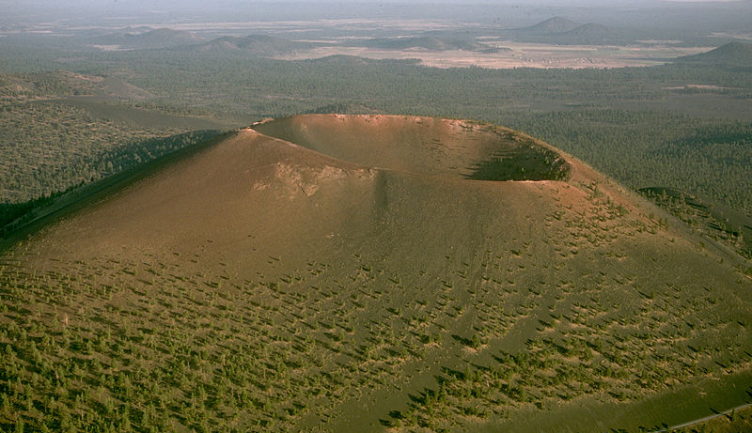
What Types of Volcano Are There?
Sunset Crater in Arizona, USA is a cinder cone.
Cinder Cones
Cinder cones are circular or oval cones. They are made up of small fragments of lava, which are blown into the air through a single vent. When they cool down, they form rock around the vent. They grow quickly, but are not usually very big. They are not usually
dangerous either.

Slide 14
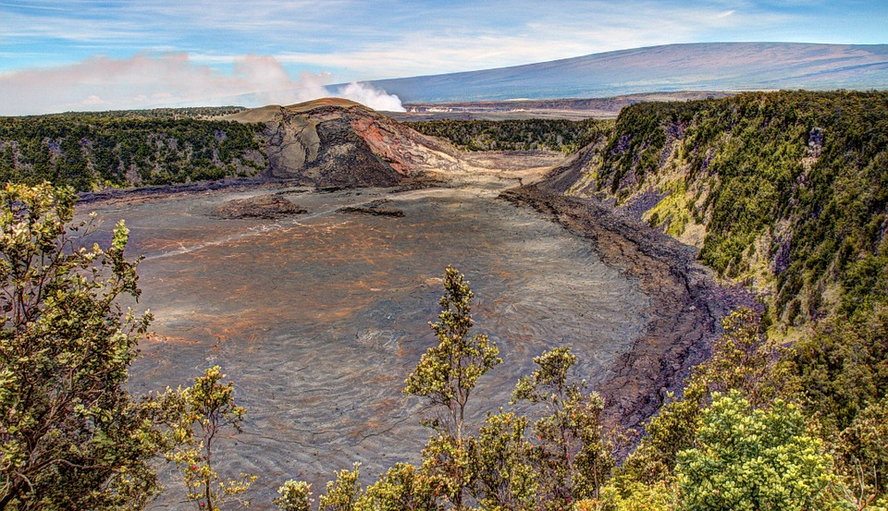
What Types of Volcano Are There?
Shield Volcanoes like this one in Hawaii are common in this part of the world.
Shield Volcanoes
Shield volcanoes are bowl or shield-shaped in the middle. When they erupt, the lava is quite runny and it travels long distances down the side of the volcano before it cools down. This lava forms long, gentle slopes that look like a warrior's shield, which is how they got their name. These volcanoes do not often explode.

Slide 15
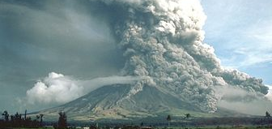

More Volcano Facts
What is the difference between magma and lava?
Magma is liquid rock inside a volcano. Lava is the name for liquid rock that has flowed out of a volcano. Lava takes a long time to cool down as it is not a good heat conductor. As a lava flow cools down, it gets slower and thicker.
What is a ‘pyroclastic flow’?
This is the most deadly of all volcano activities.
It is a liquidised mixture of solid and part-solid fragments and hot, expanding gases.
They look like a snow avalanche but are extremely hot and contain poisonous gases. They move at the speed of a hurricane.
Heat Conductor: something which can transfer heat from one object to another.
Click on the word in bold to find
out more!

Slide 16
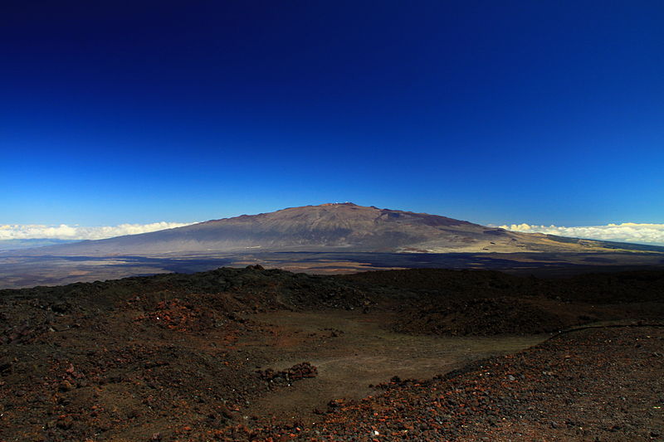
What Is the Largest Active Volcano?
Mauna Loa
The largest, active volcano in the world is Mauna Loa in Hawaii. It is 13,677 feet above sea level. From its base below sea level to its summit, Mauna Loa is taller than Mount Everest.

Slide 17
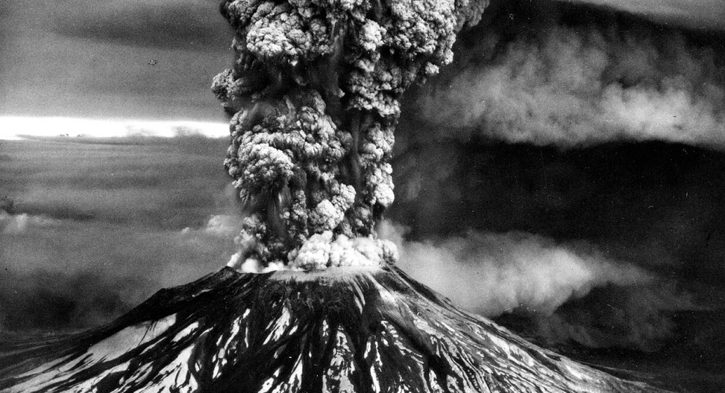
Volcanoes of the World
Mount St Helens
1
×
2
×
Mount St Helens is an active volcano located in Washington, USA in the Cascade Mountain Range.
On 18th May 1980, it erupted and killed 57 people and destroyed lots of roads and homes.
5
×
×
3
4
×
An earthquake triggered a landslide, which caused a sideways blast, sending clouds of ash, gas and rock speeding away from the volcano.
This was the first time pyroclastic flows (the clouds of hot gas, ash and rock) were studied using new scientific techniques.
Mount St Helens is still active, and is monitored closely by geologists to predict if it will erupt again.
Click on the numbers to reveal the facts.

Slide 18
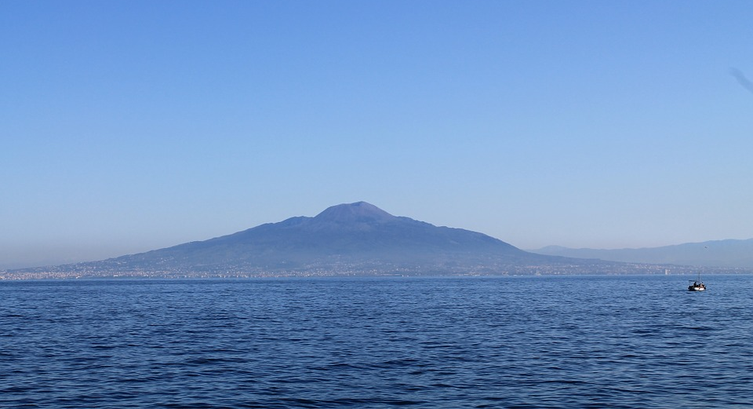
Volcanoes of the World
Mount Vesuvius, Naples, Italy
1
×
2
×
Mount Vesuvius has a very famous history. Its base is 30 miles wide and it is estimated to be around 17,000 years old.
In 79AD, Vesuvius erupted for a whole day. Thousands of people were killed, and the city of Pompeii was buried.
5
×
×
3
4
×
Over the years, archaeologists have found bodies preserved by the ash from the volcano along with other items, such as heating stoves and cooking utensils.
In 1995, Vesuvius was made a National Park. Visitors can climb the mountain.
Vesuvius has erupted over 50 times in the last 200 years. The last time was in 1944 during the Second World War.
Click on the numbers to reveal the facts.

Slide 19
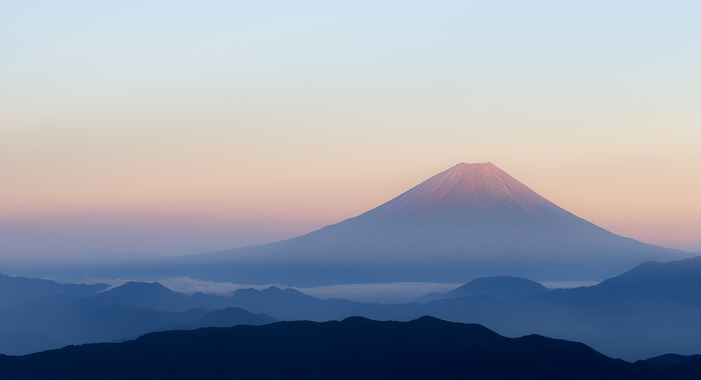
Volcanoes of the World
Mount Fuji, Japan
1
×
2
×
Mount Fuji is the highest mountain in Japan. It is 3776m high. It is on the island of Honshu, about 100km from Tokyo.
Over 100,000 people climb Mount Fuji every year. It is the most climbed mountain in the world.
5
×
×
3
4
×
Mount Fuji last erupted in 1708. It has become a symbol of the country and is featured in lots of paintings.
A forest named Aokigahara lies at the foot of the mountain and is said to be haunted by ghosts and goblins.
The volcano is actually three separate volcanoes piled one on top of the other with Fuji at the top.
Click on the numbers to reveal the facts.

Slide 20
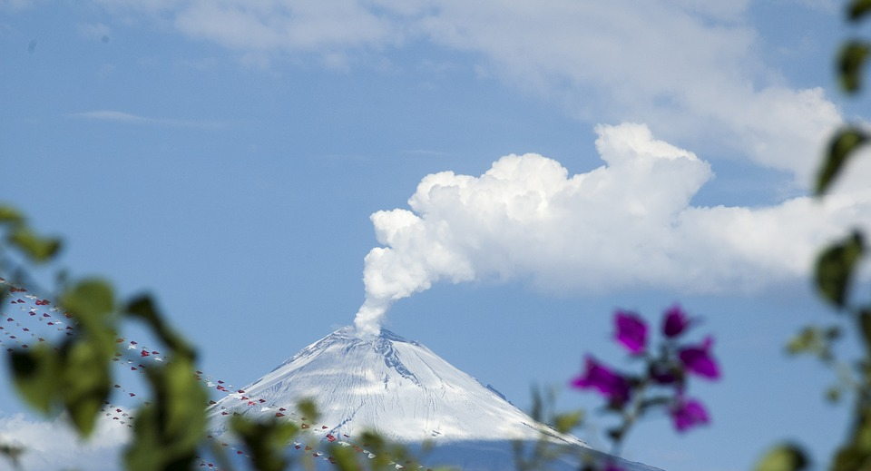
Volcanoes of the World
Popocatépetl, Mexico
1
×
2
×
Until it erupted in 1994, Popocatépetl was dormant for 50 years.
It is nicknamed 'El Popo'. It has erupted several times since 1994.
4
×
×
3
It is considered one of the world’s most dangerous volcanoes. It last erupted in January 2020.
Flights over Mexico have been cancelled several times due to ash and steam being produced by the volcano.
Click on the numbers to reveal the facts.

Slide 21
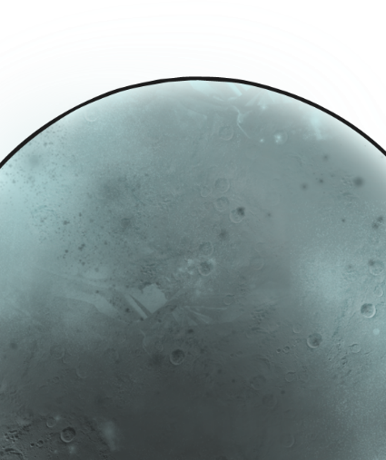
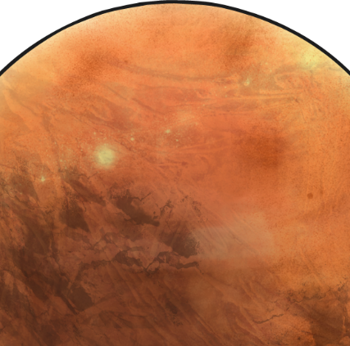
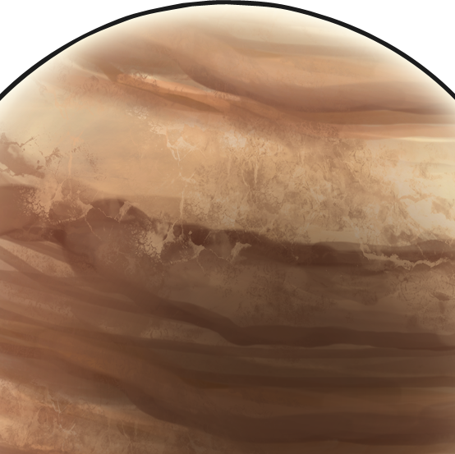
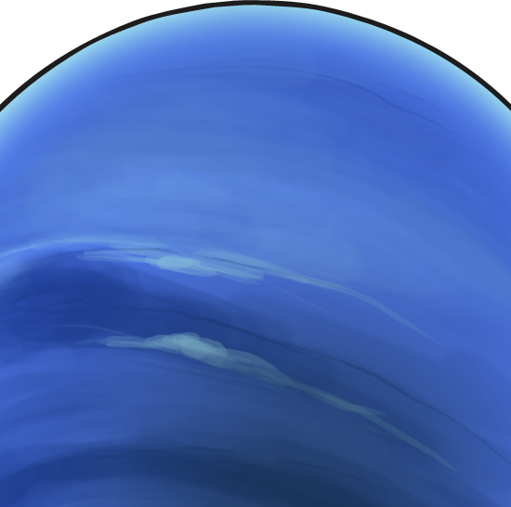
Are There Volcanoes on Other Planets?
Earth is not the only planet to have volcanoes, although most of the volcanoes on other planets are now extinct.
Mercury used to have volcanoes but when the planet's interior cooled down, the volcanoes died.
Mars has the largest known volcano called Olympus Mons. It is no longer active and will probably never erupt again.
Io is one of Jupiter's moons and has several active volcanoes.
Triton is Neptune's largest moon. Instead of lava, the volcanoes on Triton actually release ice.

Slide 22
Glossary
Forged: to have made or shaped a metal object using a fire or furnace.
Molten: something made in to a liquid by heat.
Magma: hot fluid or semi-fluid below the earth's crust.
Friction: the resistance created when one surface rubs against another.
Heat conductor: something which can transfer heat from one object to another.
Archaeologist: someone who studies history using evidence from fossils and artefacts.

