Slide 2
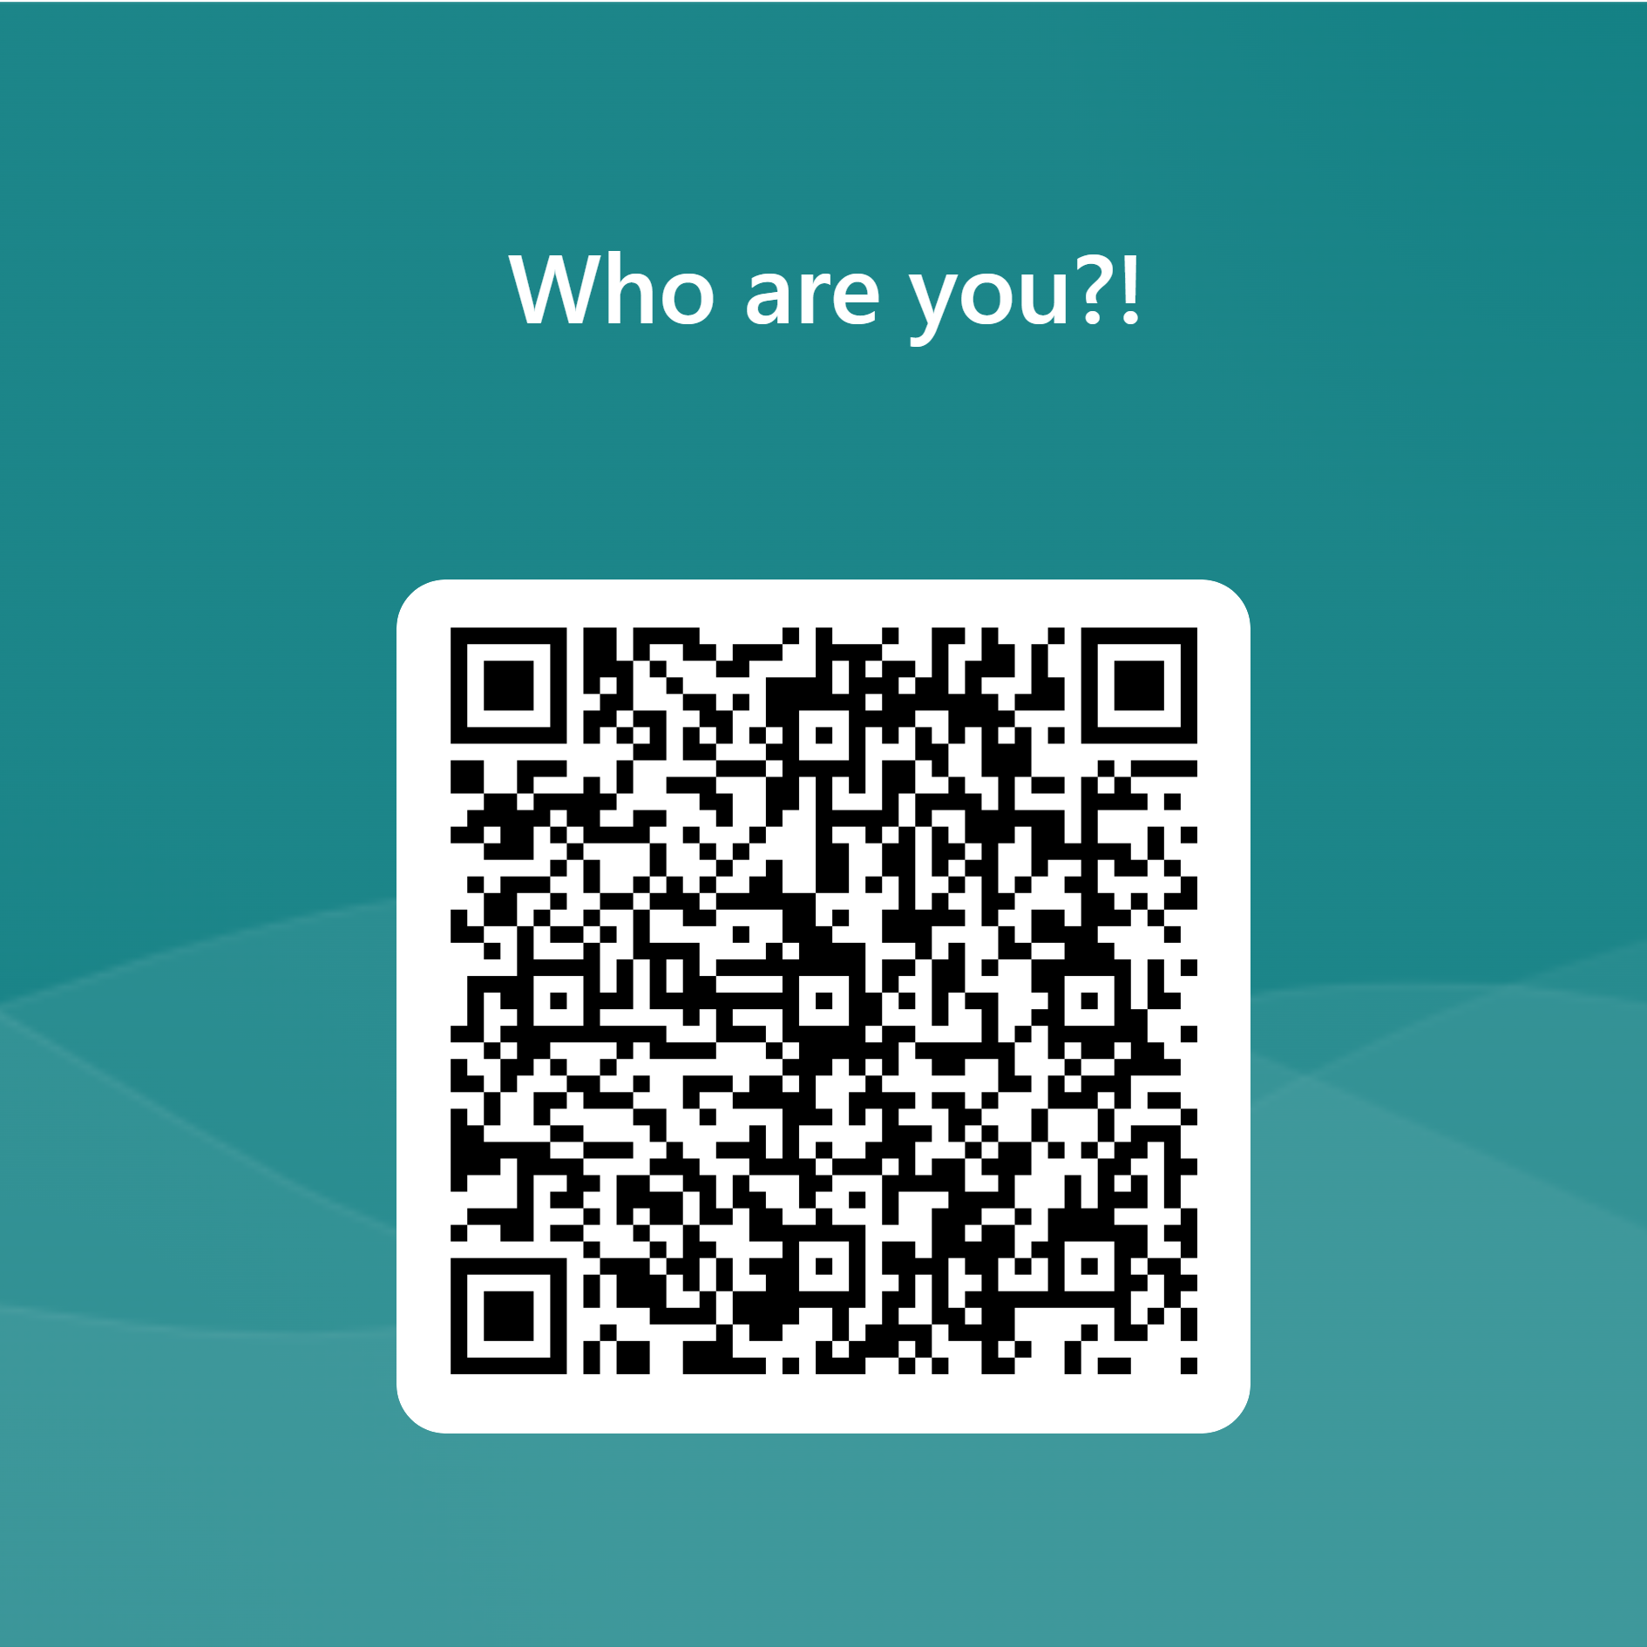
https://forms.office.com/e/FsUDYaTDgp

Slide 3
Safer Internet Day 2024
https://forms.office.com/e/FsUDYaTDgp

Slide 4
Safer Internet Day
Aim
To inspire a national conversation about using technology responsibly, respectfully, critically and creatively
Promoting the safe, responsible and positive use of digital technology for children and young people.
Raising awareness, increasing knowledge and understanding of how children and young people and the responsible adults in their lives can stay safe online

Slide 5
Safer Internet Day 2024 Theme
How can we use the internet to make changes?
What influences and changes the way children think, feel and act online and offline ?
What do we think about new and emerging technology ?

Slide 6
Supporting the Day

Slide 7
Supporters

Slide 8
Supporters 2023
455,785
Yubo users saw the campaign.
With 69,801 redirected to UKSIC Tips for Young People
Over a quarter of a million views of BBC Safer Internet Day Live Lesson
13,000
Safer Internet Day resource downloads on Twinkl

Slide 9
What else we provide to support the day
Social Media Packs
Printable template
Blogs
Top Tips
Newsletters
Safeguarding advice
Quizzes
Advice for parents
Guidance for Educators
Newsletter text
Films
Graphics
saferinternetday.org.uk

Slide 10
Celebrate on Social Media
#SaferInternetDay
Spread the word on X
@UK_SIC
Follow us on Instagram
@UK_SIC
Like us on Facebook
saferinternetuk
Watch our films on YouTube
youtube.com/uksic

Slide 11
Digital Resilience in Education

Slide 12
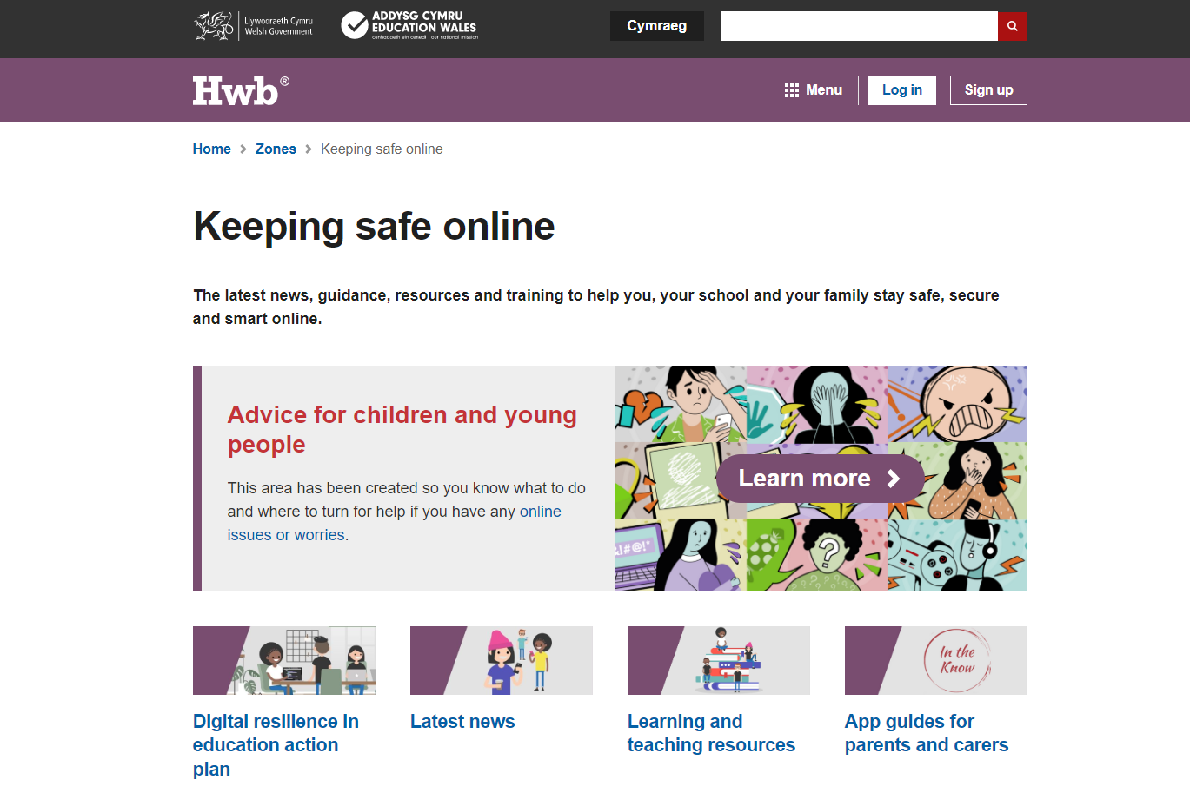
Keeping safe online hwb.gov.wales/keepingsafeonline
tailored content for practitioners, governors, learners, parents and carers including resources, information and quick guides
guidance to support effective safeguarding practices
opportunities to get involved
latest news and featured articles
information on support services to report online issues

Slide 13
App guides for families
Key information about the most popular social media and gaming apps children and young people are using today, including:
Official age rating
How children and young people use the app
Key features and terminology
Potential risks
Tips for keeping your child safe

Slide 14
Advice for children and young people
Created to help young people make sense of some of the issues they may have to deal with, including:
advice on what to do
where to turn for help

Slide 15
Resources for education practitioners
Teaching and learning resources
Guidance to support the development and review of online safety policies and procedures
Training modules to support practitioners with digital resilience

Slide 16
Headlines from 2023
Ongoing development and review of advice, guidance and resources​ available on KSOL
Development of Social Media guidance
Development of Digital Education Plan
New advice for children and young people
New app guides - ChatGPT, Threads, W App and Vent
Views from the Experts (E-sports and Sextortion September)
Communications and campaigns

Slide 17
Next Steps 1
Continuing to work closely with colleagues in Safeguarding in Education to finalise online/digital aspect of peer on peer sexual harassment action plan ​
Emerging trends ​
Considering the opportunities and concerns surrounding AI
Keeping Safe Online Youth Group​
Recruiting new members – SID project
Development of DRiE Action Plan
Digital Resilience symposium ​
Shaping DRiE priorities to inform the next Action Plan

Slide 18
Next Steps 2
Tools and services ​
IWF​
360 safe Cymru​ - technology element review
Web filtering guidance review
Training and Development ​
Cyber Incident Response training for schools available to book on Hwb

Slide 19
Supporting Safer Internet Day 2024 6th February
Education activities for schools – including SID Education resources available bilingually on Hwb
Supporting SID through Hwb and Social Media #SIDCymru #SaferInternetDay
Keeping Safe Online Safer Internet Day page -
https://hwb.gov.wales/keeping-safe-online/safer-internet-day/

Slide 20
SID Events Supporting Safer Internet Day w/c 5 February 2024
Understanding, preventing and responding to online sexual harassment | Childnet
Keeping learners safe and enabling children and young people to speak out when then need support | Estyn
Reviewing and improving your online safety policies and practice with the 360 safe Cymru self-assessment tool | South West Grid for Learning
Online safety film for parents and carers | Welsh Government
Online safety leaflet | Welsh Government
Keeping Safe Online Youth Group | Welsh Government
And more in development……

Slide 21
Wales Police Schools Programme
Lesson Packages for 5-16 years
Assembly Presentations for 5-16 years
Teacher’s Section www.schoolbeat.cymru
Partner’s Section www.schoolbeat.cymru
Police Safeguarding the Children of Wales
through Crime Prevention Education

Slide 22
Perspective from Young People

Slide 24
Education Resources

Slide 25
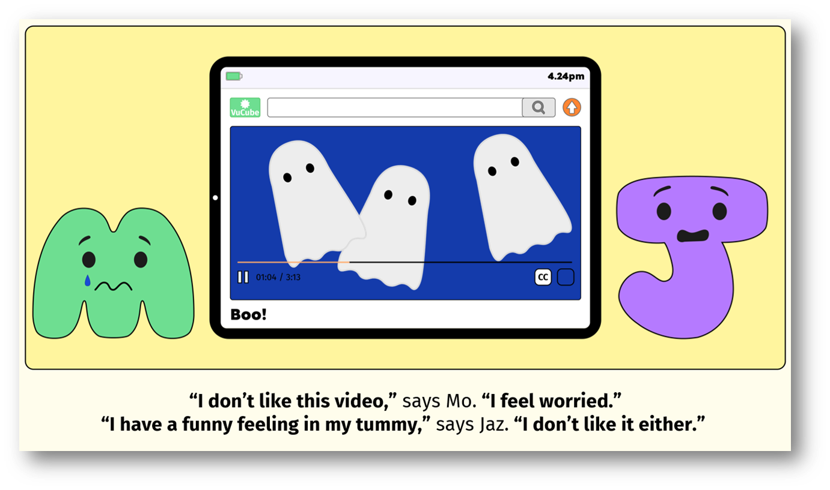
Age Range:
3-7

Slide 26
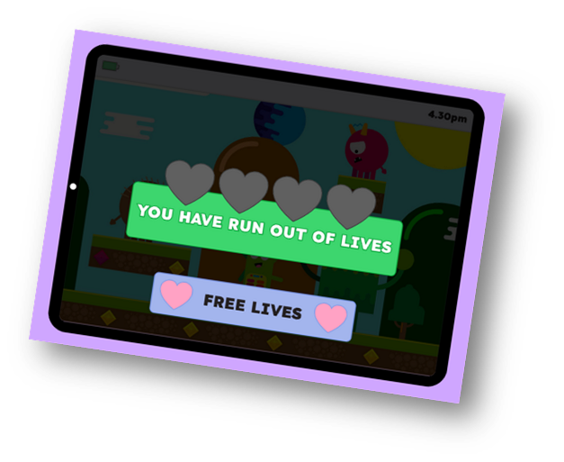
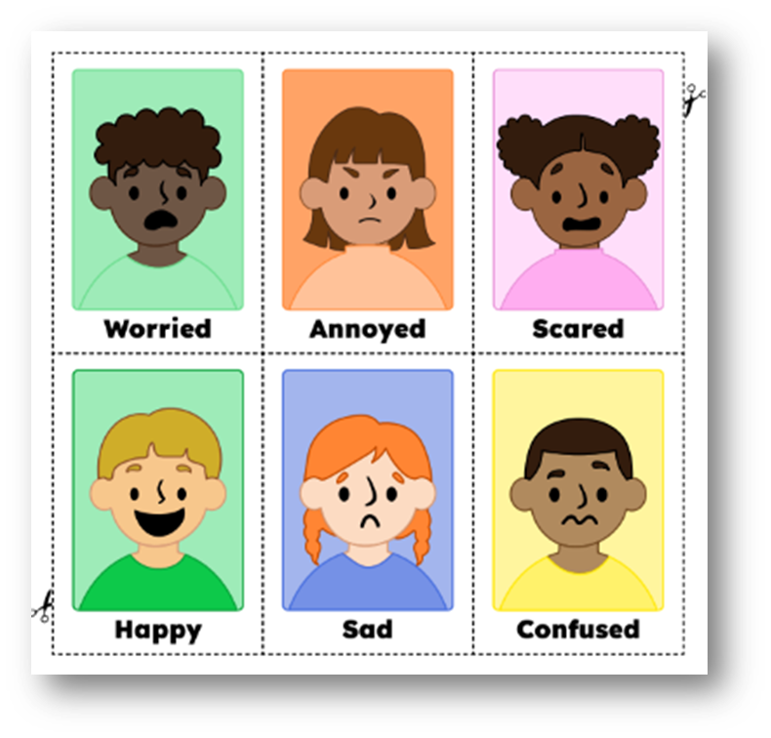
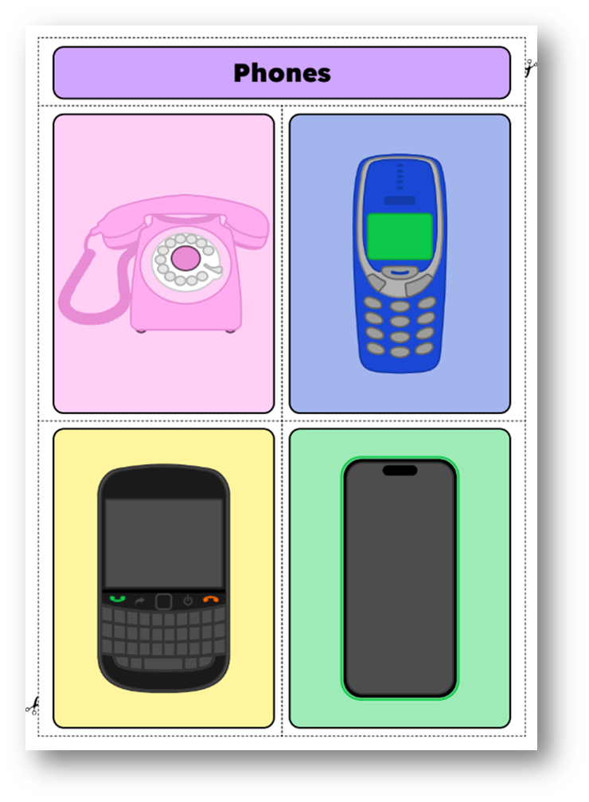

Slide 27
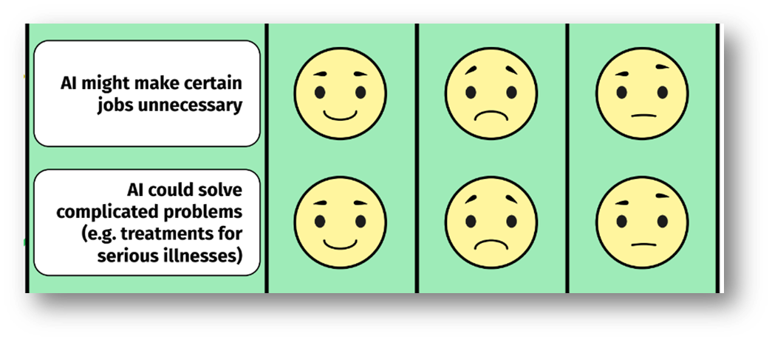
Age Range:
7-11

Slide 28
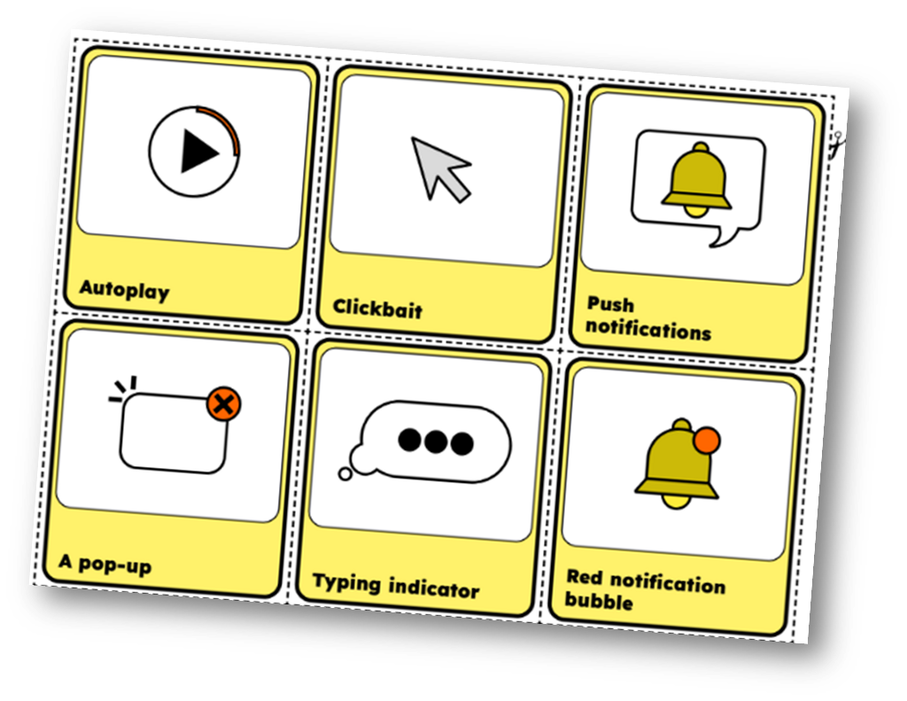

Slide 29
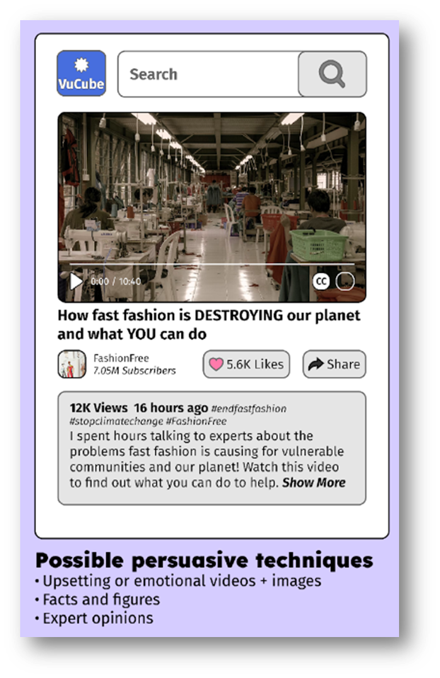
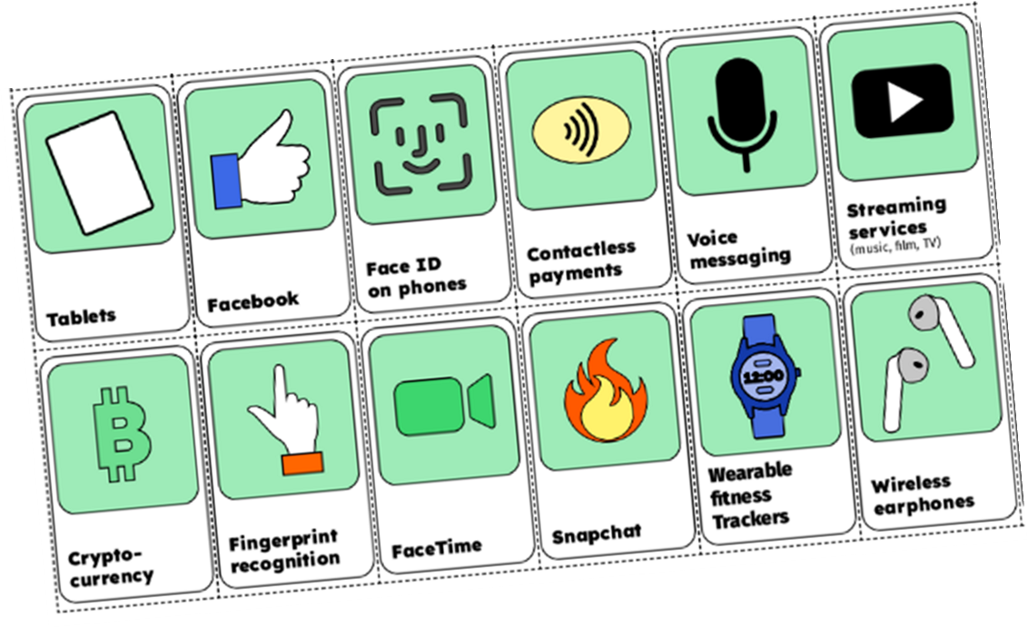
Age Range:
11-14

Slide 30
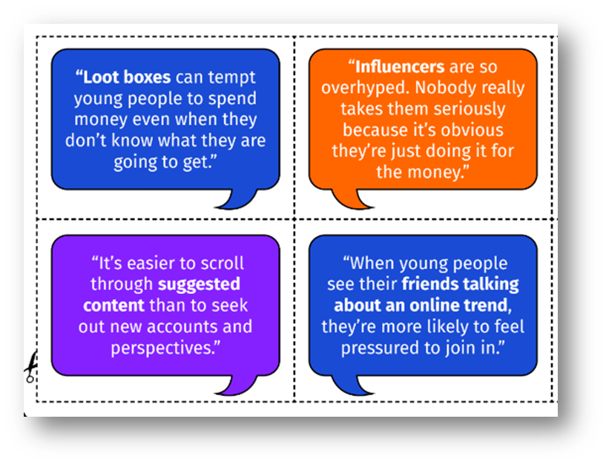

Slide 31
Age Range:
14-18

Slide 32
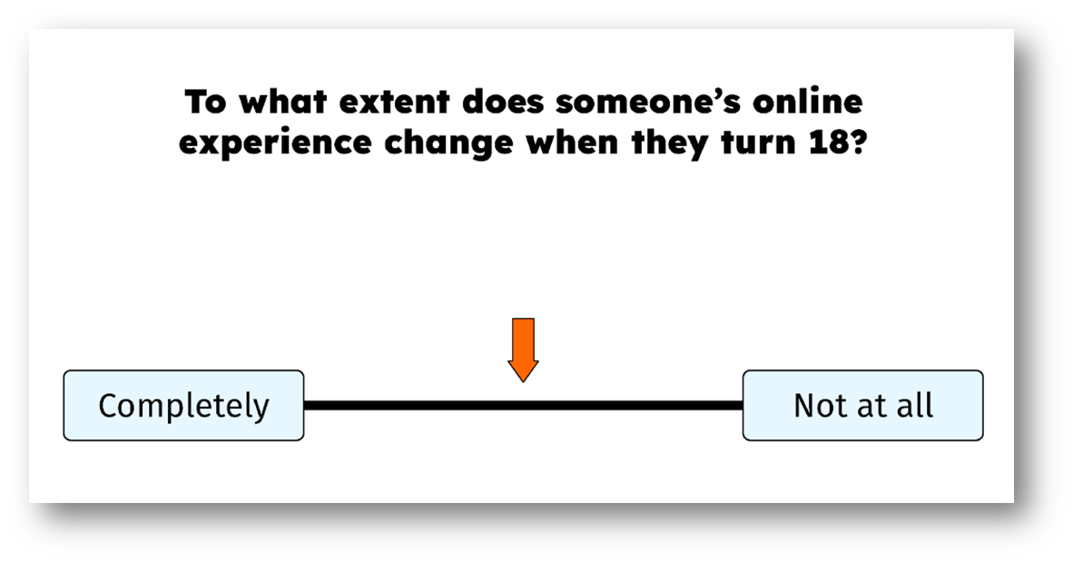

Slide 34
Safer Internet Day 2024 Theme
How can we use the internet to make changes?
What influences and changes the way children think, feel and act online and offline ?
What do we think about new and emerging technology ?

