Slide 1
Write a Biography on a Welsh Football Player
Language, Literacy and Communication – Year 4
Euro 2016: A Welsh Curriculum Resource for 7-11 year olds

Slide 2
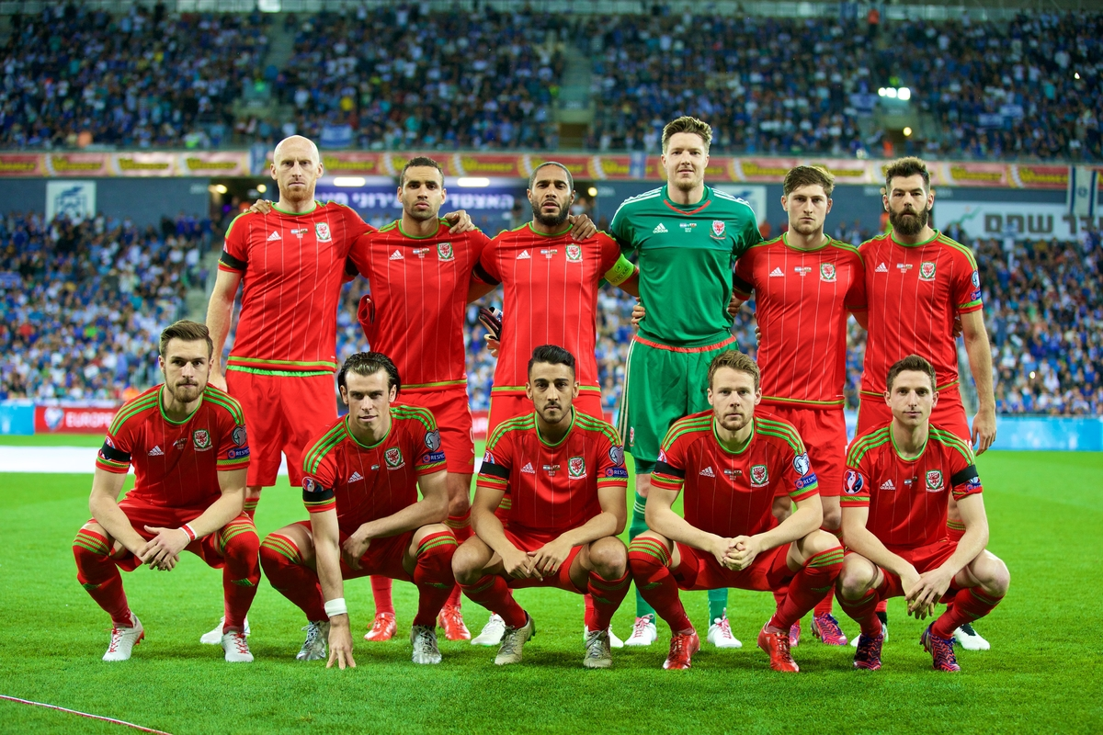
Write a biography on a Welsh football player

Slide 3
What is a biography?
Biographical writing is about someone else’s life. It is about a real person but written by someone else.
A biography highlights the key events that have happened in their life, sometimes talking about their childhood.
A biography can be written about someone who is dead or alive.

Slide 4



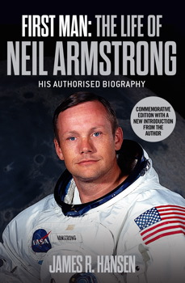
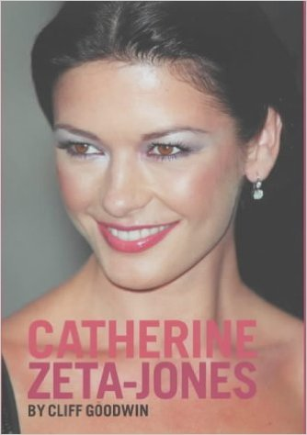

Some examples of biography book covers

Slide 5
Putting your knowledge into practice!
Task 1
Research a Welsh player who is playing in the Euro 16 squad and present this information in a solo talk.
Task 2
Now that you are an expert on this person and know lots of information about them, you are going to write your very own biography using all of the knowledge you have!

Slide 6
When writing your biography – Can you...
Include a Title? (name of biography)
Write in the Past Tense?
Write in the Third Person? – He/she/they
Ensure you have a Catchy Introduction? – Who/what/where/when/why
Organise your writing into Paragraphs?
Include life events in chronological order?
Remember time openers and connectives?
Include quotes from others about what they think?
Finish your piece of writing with a conclusion? - How they will be remembered.

Slide 7

Biography example
Have a look at the example biography
Using the colour suggested on the last slide, underline the success criteria if you can see it in your example.

Slide 8
Introduction
Your introduction is very important if you want to catch the reader’s attention. You might want to use a question as an opener like the example you looked at, however you must introduce your famous person using the 5 Ws.
  Who is the person? – their name (real name also if their birth name is different)
  What are they famous for?
  When did it happen?
  Where did it happen?
  Why are they famous today?

Slide 9
Plan and write your introduction
Using your planning sheet, briefly answer the 5 Ws.
Swap with your partner. Have they answered the 5 Ws? Give their plan a tick if they have.
Now that you are ready to go, use your 5 Ws to write a catchy introduction.

Slide 10
Main body of biography
Using your previous knowledge from your talk or the fact sheets, choose the most important events in their life to write about. You can talk about their childhood if you wish.
Write down your chosen key events on your planning sheet.
Remember to write them in the order they happened!

Slide 11
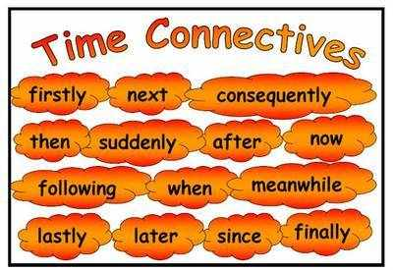
Time openers
With your partner, brainstorm the openers you could use to show the passing of time between each of your main events.

Slide 12
Plan
Go back to your planning sheet to the box which says ‘openers’.
Write the openers you want to use in your biography.

Slide 13
Main body
Now that you have the key events and the openers you want to use, you can write the main body of your biography.
As you write your biography, tick the openers when you use them.
On your planning sheet, you can write down any WOW words and connectives you aim to use in your biography.

Slide 14
Conclusion
To conclude your biography, you should write about the impact they have on people today (think about these questions below):
  1. Have they taught us anything?
  2. Why will they always be remembered?
  3. Quote something someone said about them.
Briefly answer the above questions on your planning sheet before writing it into you main piece of writing.
Use the example biography to help you.

Slide 15

Re-read, edit, re-draft

