Slide 1










Sleid 1

Slide 2





Sleid 2
GWASANAETHAU BYW E-SGOL LIVE ASSEMBLIES
Gwasanaeth 1 - Assembly 1 | Gwasanaeth 1 - Assembly 1 | Gwasanaeth 1 - Assembly 1 | Gwasanaeth 1 - Assembly 1
Cynradd - Primary | Cynradd - Primary | Uwchradd - Secondary | Uwchradd - Secondary
Cymraeg Welsh | 9:15am 3/2/25 | Cymraeg Welsh | 9:15am 4/2/25
Saesneg English | 10am 3/2/25 | Saesneg English | 10am 4/2/25
Gwasanaeth 2 - Assembly 2 | Gwasanaeth 2 - Assembly 2 | Gwasanaeth 2 - Assembly 2 | Gwasanaeth 2 - Assembly 2
Cynradd - Primary | Cynradd - Primary | Uwchradd - Secondary | Uwchradd - Secondary
Cymraeg Welsh | 9:15am 11/2/25 | Cymraeg Welsh | 9:15am 11/2/25
Saesneg English | 10am 11/2/25 | Saesneg English | 10am 11/2/25

Slide 3

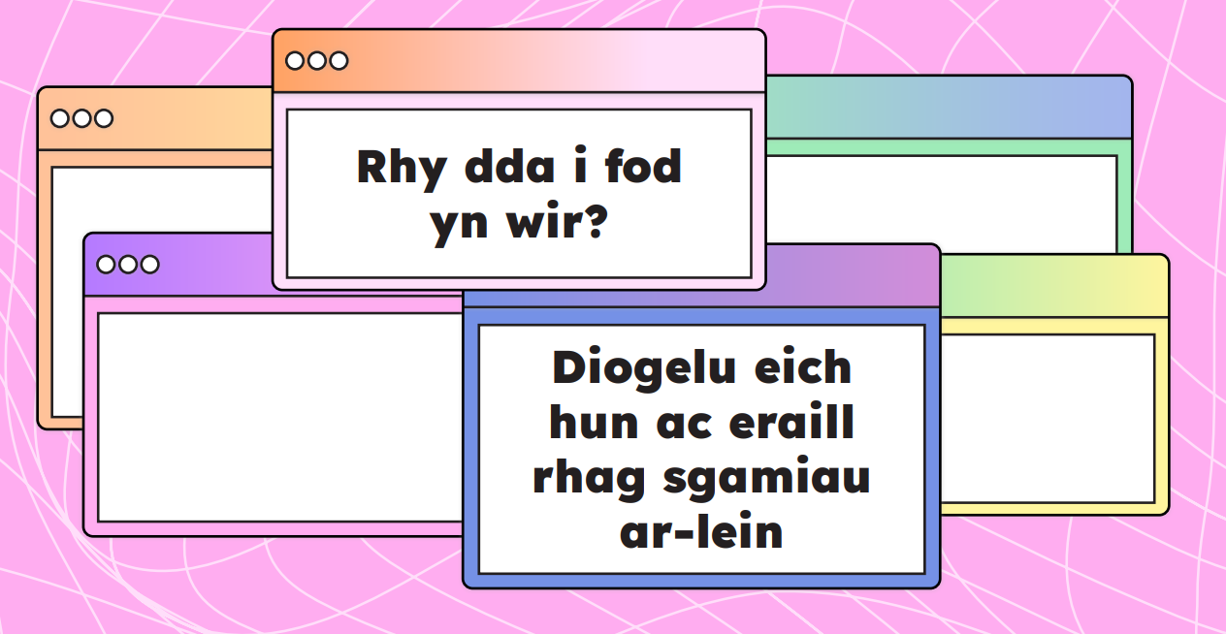
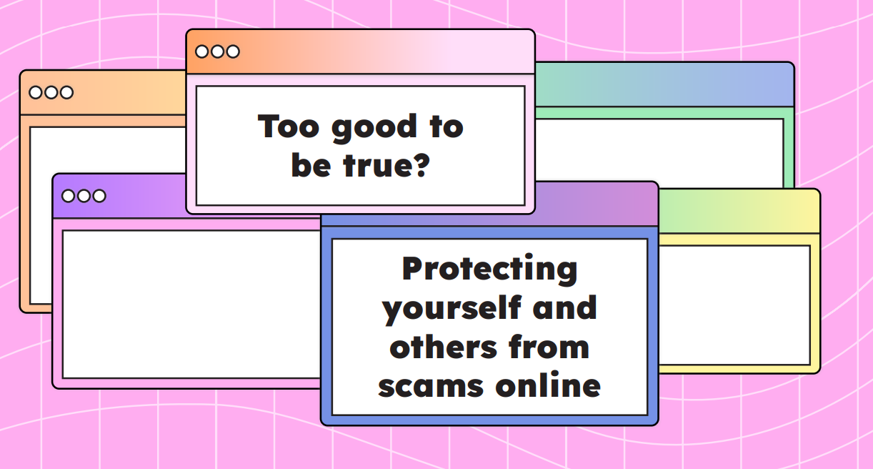




Sleid 3
GWASANAETHAU BYW E-SGOL LIVE ASSEMBLIES

Slide 4






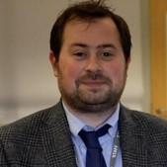

Sleid 4
GWASANAETHAU BYW E-SGOL LIVE ASSEMBLIES

Slide 5

Sleid 5
GWASANAETHAU BYW E-SGOL LIVE ASSEMBLIES
Gwasanaeth 1 - Assembly 1 | Gwasanaeth 1 - Assembly 1 | Gwasanaeth 1 - Assembly 1 | Gwasanaeth 1 - Assembly 1
Cynradd - Primary | Cynradd - Primary | Uwchradd - Secondary | Uwchradd - Secondary
Cymraeg Welsh | 9:15am 3/2/25 | Cymraeg Welsh | 9:15am 4/2/25
Saesneg English | 10am 3/2/25 | Saesneg English | 10am 4/2/25
Gwasanaeth 2 - Assembly 2 | Gwasanaeth 2 - Assembly 2 | Gwasanaeth 2 - Assembly 2 | Gwasanaeth 2 - Assembly 2
Cynradd - Primary | Cynradd - Primary | Uwchradd - Secondary | Uwchradd - Secondary
Cymraeg Welsh | 9:15am 11/2/25 | Cymraeg Welsh | 9:15am 11/2/25
Saesneg English | 10am 11/2/25 | Saesneg English | 10am 11/2/25

