Slide 1
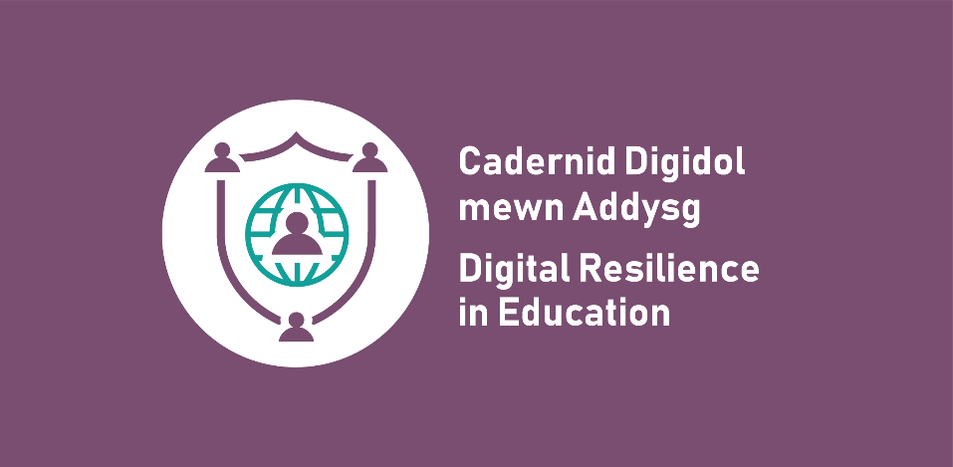
Your right to be safe and secure online: Primary lesson

Slide 2
Learning outcomes
Learners will be able to:
give examples of what their rights are as a child
recognise how these rights may apply online
explore how challenges may exist around exercising all rights online.

Slide 3
What are your rights?

Slide 4
How do you know what your rights are?

Slide 5
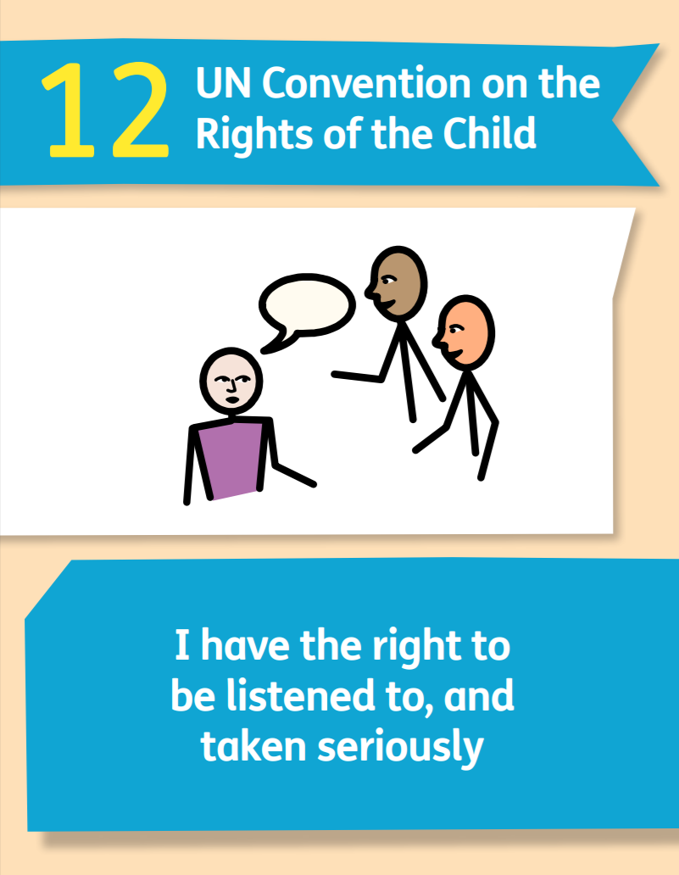
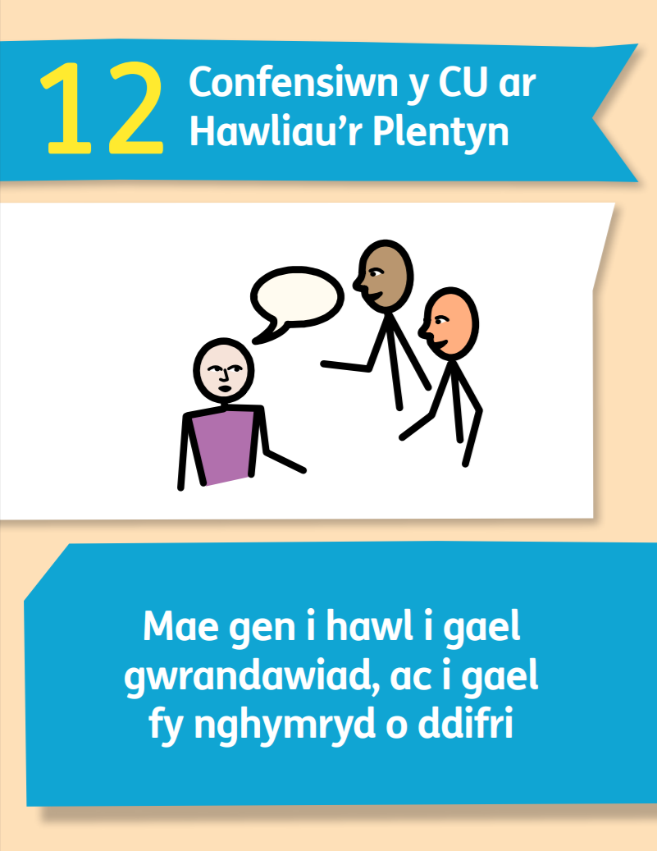
United Nations Convention on the Rights of the Child (UNCRC)
UNCRC Articles cards
UNCRC overview poster

Slide 6
Who is responsible for upholding your rights?
Parents/carers
Teachers and schools
Local councils and governments
Police
People who help protect children (e.g. social workers)
Courts and the legal system
You!

Slide 7
What are your online rights?

Slide 8
Online rights
Article 12 Your right to say what you think should happen and be listened to. | Article 13 Your right to have information. | Article 15 Your right to meet with friends and join groups and clubs.
Article 16 Your right to have privacy. | Article 19 Your right to not be harmed and to be looked after and kept safe. | Article 28 Your right to learn and go to school.
Article 30 Your right to use your own language. | Article 31 Your right to relax and play. | Article __

Slide 9
Examples
Forming a team/party with your friends in your favourite online game. | A webpage lets you switch the text to a different language. | Your school blocks you from seeing a website because it is not for children.
Watching a video on a website for children to learn the latest news. | Completing an online survey to give suggestions about improving your local park. | A game developer creates a game that is just for children and is a lot of fun!
Downloading your homework or taking lessons online if you cannot go to school. | Using settings on an app to decide who can talk to you or see your information. | Your example:

Slide 10
The big question
Does being anonymous online support your rights as a child, or go against them?

Slide 11
Why would someone choose to be anonymous online?
To protect their identity/stay private
More freedom to say what they think
To avoid being criticised by others
To avoid being harassed or bullied
To break the law
To trick someone (e.g. scammers)
To criticise someone
To bully someone more easily
To harm someone

Slide 12
Things to consider
Which rights can be linked to anonymity?
Is being anonymous illegal? What could an anonymous person do that might break the law?
Are people more honest when they are anonymous? Is this a good or bad thing?
Does anonymity help you keep your personal information safe?
Do people behave the same or differently when they are anonymous? Is this a good or bad thing?

Slide 13
What do you think?
Does being anonymous online support your rights as a child, or does it go against them?
Anonymity online is an important right.
Anonymity online violates children’s rights.

Slide 14
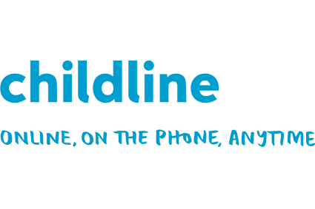
Getting help
meiccymru.org
080880 23456
childline.org.uk
0800 1111

