Slide 1
Digital Resilience and Online Safety
The View from Estyn
February 2024 Update
Dyfrig Ellis,
Assistant Director

Slide 3
‘A minimum digital standard of living includes, but is more than having accessible internet, adequate equipment, and the skills, knowledge and support people need. It is about being able to communicate, connect and engage with opportunities safely and with confidence’
Towards a Welsh Minimum Digital Living Standard
February 2023

Slide 4
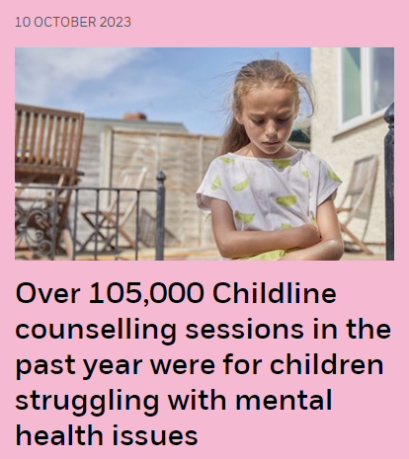
Last year, Childline delivered almost 200,000 counselling sessions to children and young people, with about 75% of these taking place online.

Slide 5
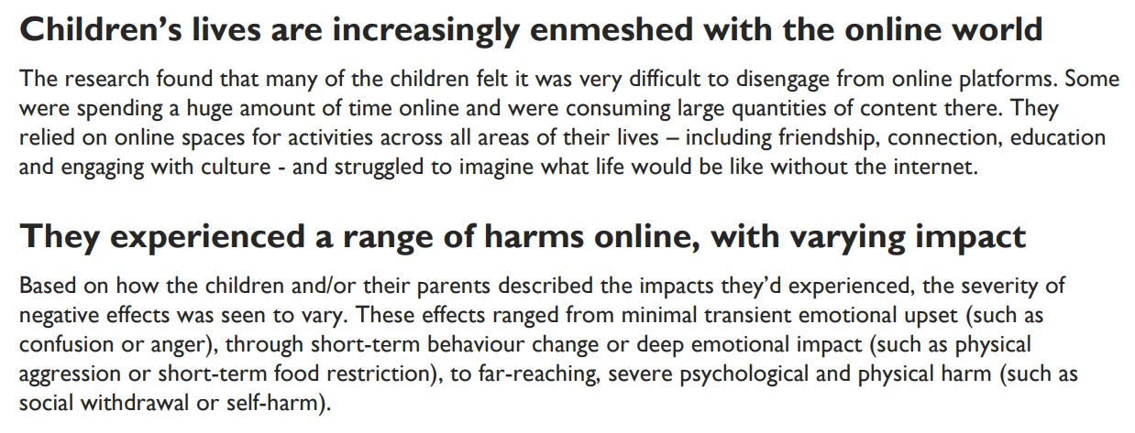
Understanding how to keep children safe online November 2023

Slide 7
Circumstances and characteristics of children
Design features and functionalities of platforms
Content that children were exposed to online

Slide 8
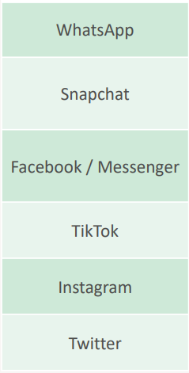
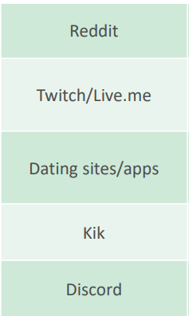

Slide 9
11-18 year olds’ social media use, motivations and ways of communicating
Eleven to eighteen year olds are more likely to say they feel confident communicating online (71%) than in person (53%).
They mainly said they used social media platforms to chat and interact with those they already know (58% average) but motivations varied by platform.
Nearly ninety percent of 11-18 year olds reported gaming at least weekly on one or more platforms. Mobile and tablet (79% weekly) are the most commonly used devices / methods for gaming.
Four in five (79%) weekly online gamers said they communicate with others online while gaming.
Understanding online communications among children November 2023

Slide 10
How and why 11-18 year olds expand their online networks
Accepting friend requests from others (44%) and adding phone contacts (41%) were the most popular ways for 11-18 year olds to expand their online networks – but there was considerable variation by platform.
Two in five 11-18 year olds (42%) received friend requests at least weekly from someone they had not spoken to before.
Knowing the person in real life (46%) or having mutual close friends (41%) were the most common considerations used to decide whether or not to accept a friend request from someone they haven’t messaged or spoken to before.
Around one in four 11-18 year olds (23%) said they would be likely to reply to a message on social media from someone they don’t know personally. Those aged 11-13 were less likely to reply but 1 in 5 still said they would do so (19%).

Slide 11
11-18 year olds’ experience of potentially uncomfortable interactions/conversations
Three in five (60%) 11-18 year olds have ever experienced some form of potentially uncomfortable interactions/conversations when communicating online at some point in the past.
This includes 13% of 11-18s who have ever been sent pictures or videos of naked or half-dressed people and 10% who have ever been asked to share these types of pictures or videos themselves. For 11-13-year-olds, these figures stand at 6% and 4% respectively.
These potentially uncomfortable experiences can happen on a child’s first contact with another user. For example, 49% of 11-18s who received naked or half-dressed images said this was the first contact they’d had with the user. For others, these interactions/conversations occurred after a longer period of communication.
After encountering inappropriate or unwanted behaviour, most 11-18 year olds said they ignored, deleted and/or blocked communication with the person/people in question, but a small proportion of children said they did respond.

Slide 12
Are learners safe online?

Slide 13
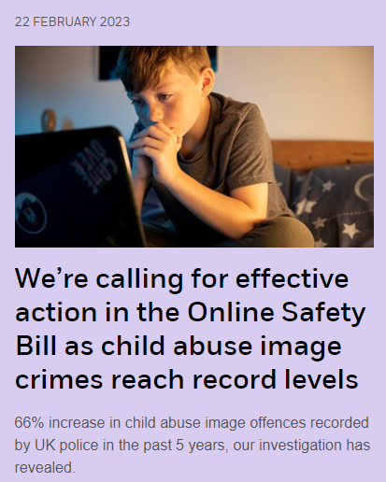
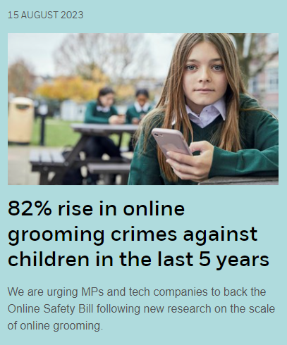
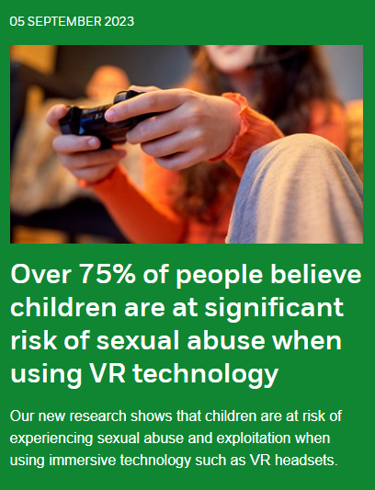

Slide 14
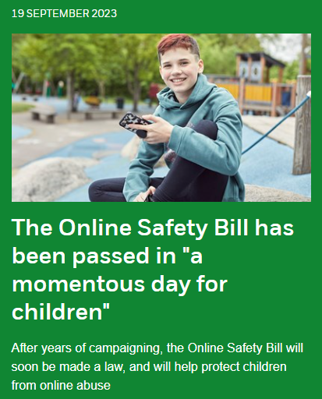
The legislation will finally require tech companies to make their sites safe for children by design.
It marks a new era for children's safety online at a time when online grooming, child abuse image crimes are at an all-time high.
People who have experienced child abuse online tell how the Online Safety Bill will address further preventable harm to countless other children.

Slide 15
estyn.llyw.cymru
estyn.gov.wales
How much content is actioned?

Slide 16
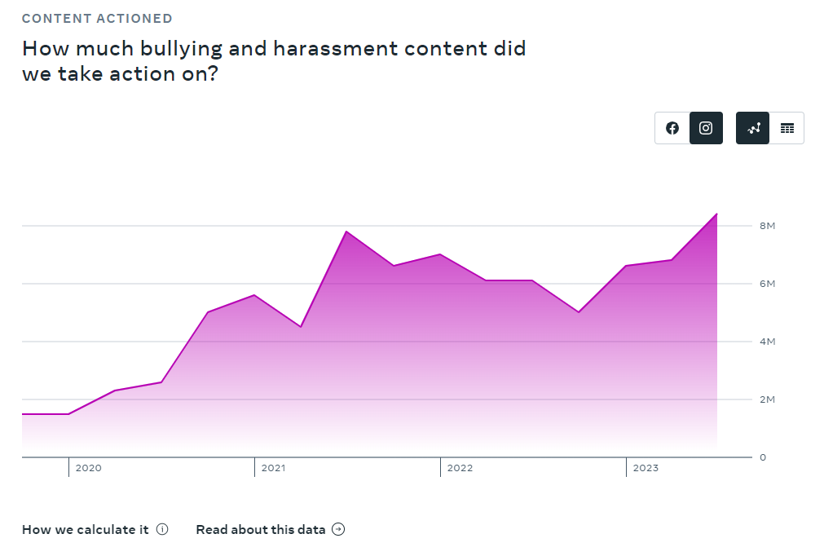
estyn.llyw.cymru
estyn.gov.wales
Data taken from the Meta Transparency Report 2023Q3

Slide 17
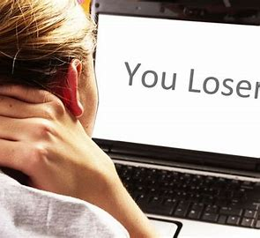
estyn.llyw.cymru
estyn.gov.wales
School or online?

Slide 18
estyn.llyw.cymru
estyn.gov.wales
72%
Data taken from the Office for National Statistics (ONS) Children’s online behaviour in England and Wales: year ending 2020 and Online bullying in England and Wales: year ending 2020

Slide 19
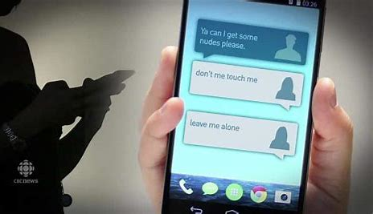
estyn.llyw.cymru
estyn.gov.wales
What percentage of children who are bullied online, understand that they are being bullied?

Slide 20
estyn.llyw.cymru
estyn.gov.wales
52%
Data taken from the Office for National Statistics (ONS) Children’s online behaviour in England and Wales: year ending 2020 and Online bullying in England and Wales: year ending 2020

Slide 21
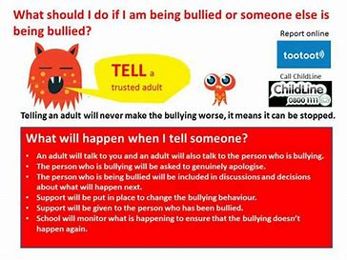
estyn.llyw.cymru
estyn.gov.wales
Do children report (online) issues?

Slide 22
estyn.llyw.cymru
estyn.gov.wales
26%
Data taken from the Office for National Statistics (ONS) Children’s online behaviour in England and Wales: year ending 2020 and Online bullying in England and Wales: year ending 2020

Slide 23
A vast landscape
Fast and ever-changing
Online mirrored in schools
Negative behaviours not recognised
Children don’t report it

Slide 24
Are learners safe online?
How would we know?

Slide 25
estyn.llyw.cymru
estyn.gov.wales
Inspection work
culture of safeguarding

Slide 26
Peer-on-peer sexual harassment among secondary school pupils in Wales: A report for learners
‘We don’t tell our teachers…. but schools need to know’

Slide 27
What we found out
Pupils told us that:
50% of them have experienced peer-on-peer sexual harassment and abuse and 75% have seen it happening to others.
Twice as many girls have personal experience of this harassment than boys.
The most common types of harassment in school are catcalling, hurtful comments (such as about appearance) and homophobic comments.
Peer-on-peer sexual harassment is more common online and outside school than in school.

Slide 28
Recommendations
R1: Recognise that peer-on-peer sexual harassment is highly prevalent in the lives of young pupils and adopt a whole-school preventative and proactive approach to dealing with it.
R2: Provide a safe, enabling and supportive environment for open and honest discussions.
R3: Improve the way schools record, categorise and analyse incidences of harassment and bullying to include online and digital incidences
R4: Regular and purposeful professional learning opportunities

Slide 29
The right culture
Staff that listen carefully and see conversations about these issues as part of their everyday duties.
Staff who are skilled and well trained so that these conversations are handled effectively.
Leaders who respond quickly when issues are raised.
High expectations of pupil behaviour.
Regular, high quality and authentic PSE and RSE education for all pupils.
Time to talk openly to pupils about these issues

Slide 30
Peer-on-peer
sexual harassment
among 16 to 18-year-old
learners in further education
June 2023

Slide 31
What we found:
The issue of peer-on-peer sexual harassment among 16 to 18-year-old college learners is complex and widely underreported, with many learners choosing not to, or being unsure how to, report incidents of sexual harassment for a variety of reasons.
Colleges have well established learner disciplinary policies and processes and most deal effectively with the most serious reported cases of alleged peer-on-peer sexual harassment.
Learners identifying as female, LGBTQ+ and learners with additional learning needs may be more likely to experience sexual harassment. Sexual harassment incidents involve a mix of face-to-face and online issues.

Slide 32
What we found:
College systems for accurate recording and analysis of sexual harassment among learners are underdeveloped. Too often, incidents of sexual harassment are recorded and categorised within generic classifications of bullying.
Many staff told us they lack confidence and feel that there is a need for more professional development and updates in relation to sexual harassment.
Where colleges have held specific training sessions on addressing sexual harassment, these have helped staff to recognise incidents and address them appropriately.

Slide 33
Recommendations
Ensure that all learners benefit from opportunities to take part in learning activities and discussions about forming and maintaining healthy relationships
Develop strategies to prevent and tackle misogynistic attitudes and cultures developing among groups of learners
Ensure that all relevant staff members undertake professional learning that enables them to confidently recognise and respond to sexual harassment as well as help learners develop their understanding of healthy relationships

Slide 34
Recommendations
Ensure that all learners feel safe and comfortable in all areas of college buildings, grounds, virtual spaces, and transport
Record, categorise and analyse instances of sexual harassment, assault and abuse in a consistent way that enables leaders to identify trends and take appropriate measures in response

Slide 35
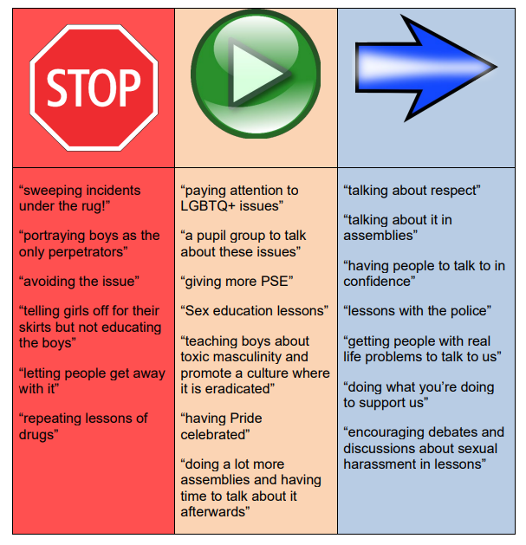
What learners want their schools and colleges to do…

Slide 36
How does your school measure up?
In the best schools:
Respect. Differences celebrated.
High expectations of pupils’ behaviour.
Schools learn from incidents and make improvements.
Schools listen carefully to pupils and respond appropriately
Concerns are tackled before they become big problems
High quality and regular PSE, covering all aspects of RSE.
Schools make time to talk openly and regularly with pupils.
School staff do not tolerate sexist or homophobic language or behaviour.
.

Slide 37
estyn.llyw.cymru
estyn.gov.wales
Support for schools
Estyn:
We don’t tell our teachers - Experiences of peer-on-peer sexual harassment among secondary school pupils in Wales | Estyn (gov.wales)
Inspecting a school’s safeguarding culture | Estyn (gov.wales)
Welsh & UK Government
Keeping Learners Safe (gov.wales)
Enhancing digital resilience in education: An action plan to protect children and young people online - Hwb (gov.wales)
Keeping safe online - Hwb (gov.wales)
Rights, respect, equality: guidance for schools | GOV.WALES
Teaching online safety in schools - GOV.UK (www.gov.uk)
Third Parties:
Homepage - UK Safer Internet Centre
Keeping children safe online | NSPCC
Anti-Bullying Alliance

Slide 38
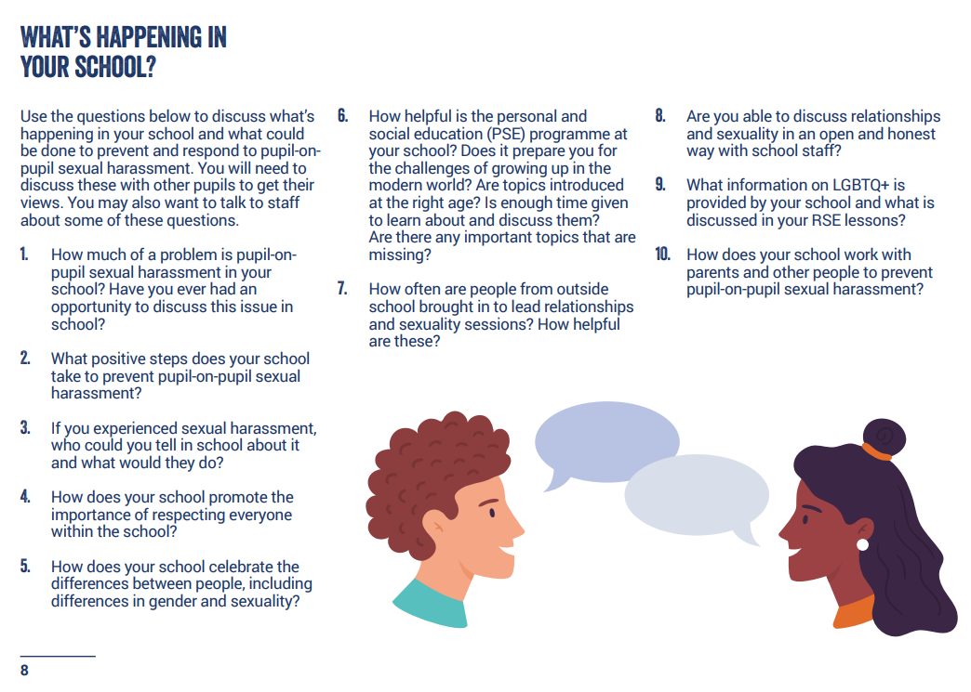

Slide 39
Creating the right culture to support school’s approaches to keeping learners safe online
Q&A
Dyfrig Ellis,
Assistant Director

