Slide 1
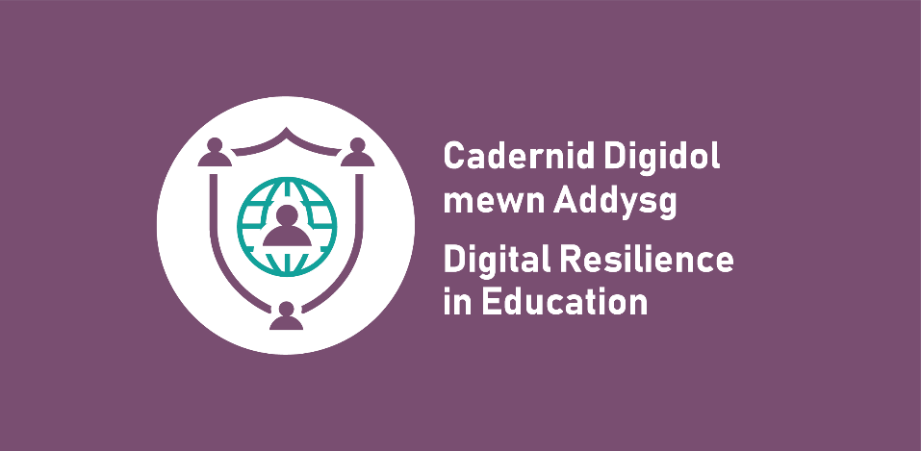
Your right to be safe and secure online: Secondary lesson

Slide 2
Learning outcomes
Learners will be able to:
identify how their rights apply online
explore the challenges around exercising their rights online
suggest strategies for exercising their rights and how to challenge violations.

Slide 3
How do you know what your rights are?

Slide 4
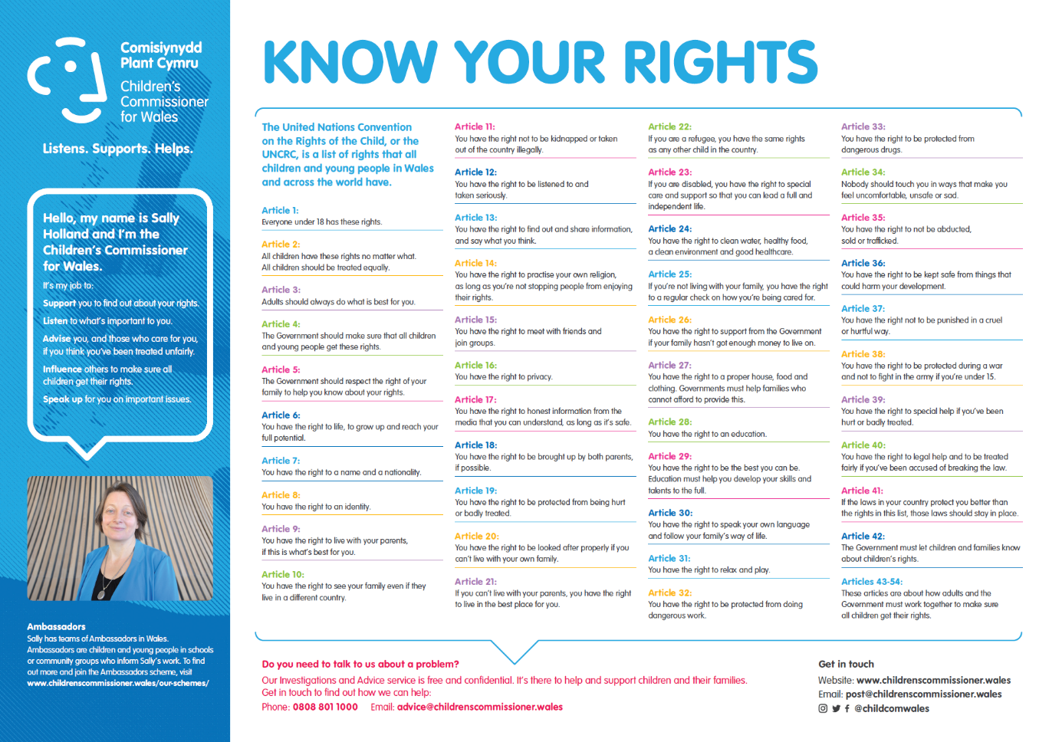
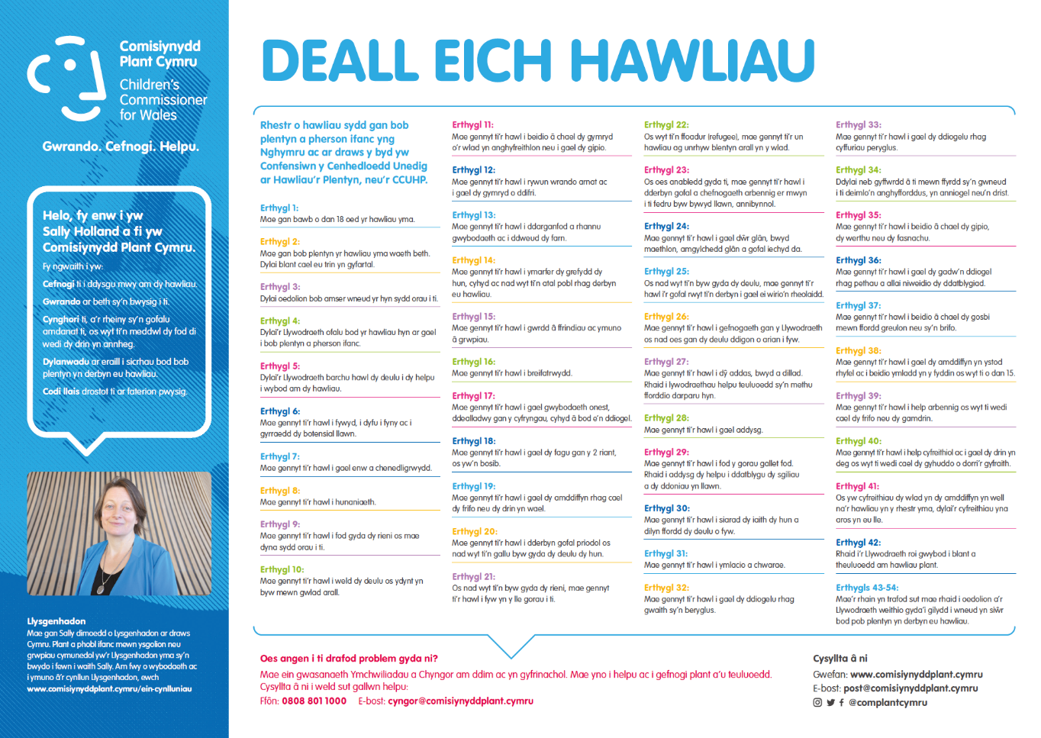
United Nations Convention on the Rights of the Child (UNCRC)
UNCRC overview poster

Slide 5
Who is responsible for upholding your rights?
Parents/carers
Teachers and schools
Local councils and governments
Law enforcement
Those who work with/for children
Courts and the legal system
You!

Slide 6
What are your online rights?

Slide 7
What are your online rights?
Article | Right | Example
16 | The right to privacy | Use privacy settings on social media to limit who can contact me.

Slide 8
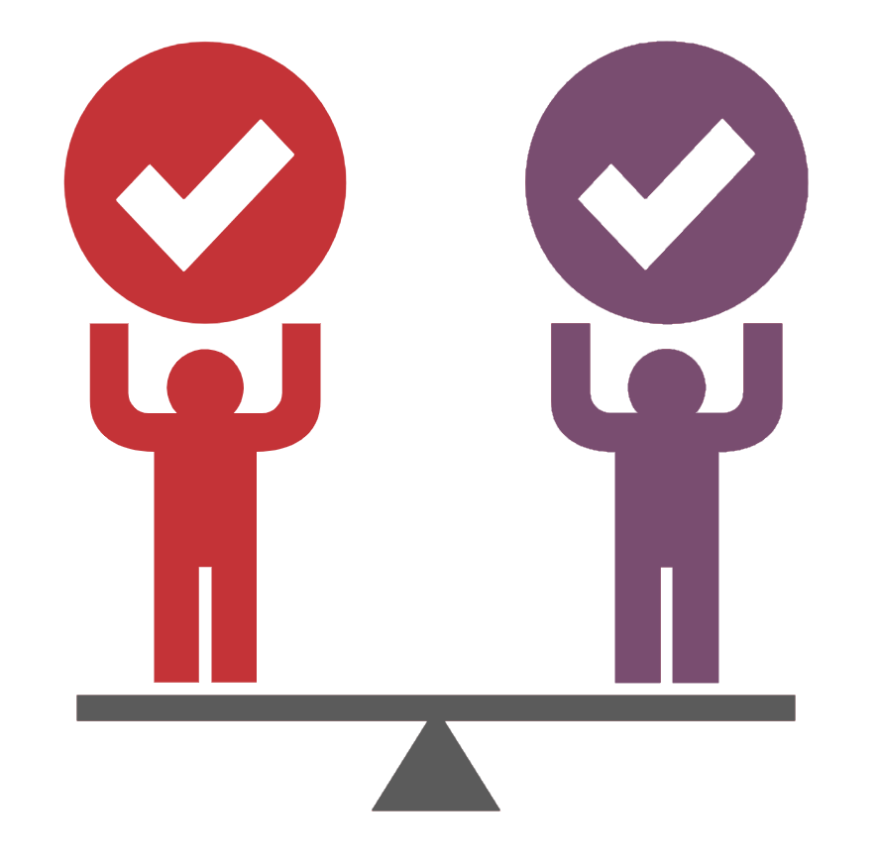
Are all rights equal online?

Slide 9
Scenarios
1. A person posts anonymously online to regularly make fun of a high-profile public figure they dislike.
2. The government monitors children’s online activity to prevent them from being radicalised.

Slide 10
Scenarios
3. An education company offers a free training course for young people online but requires detailed personal information in order to sign up.
4. A charity runs an online chat room to support victims of abuse, but requires users to identify themselves in order to get help.

Slide 11
Scenarios
5. The government introduces restrictions on how long you can play online games during the week.
6. A local council surveys young people on how to tackle climate change but will only accept suggestions by email.

Slide 12
Scenarios
7. A messaging app introduces end-to-end encryption, despite concerns that this could increase sharing of illegal content.
8. A game platform removes the ability to create a party/group with your friends because of an increase in online bullying by players.

Slide 13
Things to consider
Free speech versus protecting others from harmful comments.
What laws could be broken by online behaviours?
What are the consequences to safety of increasing privacy online?
Does restricting access help limit the risk of harm?
How far should national surveillance go to protect citizens online?
What are the advantages and disadvantages of online anonymity?

Slide 14
Notes for teachers
If learners are finding this task challenging, the following table provides suggested Articles that relate to each scenario. Learners can use these as a starting point for discussion around the issues that each scenario may raise.
Scenario | Articles to consider
1 | Articles 12, 13, 16, 19, 36
2 | Articles 3, 4, 6, 11, 12, 13, 14, 15, 16, 17, 19, 30, 35, 36, 39
3 | Articles 6, 13, 16, 28, 29
4 | Articles 6, 8, 12, 13, 16, 19, 20, 31, 34, 35, 36, 37, 39
5 | Articles 6, 12, 13, 15, 19, 31, 36
6 | Articles 12, 13, 16, 36
7 | Articles 6, 8, 11, 12, 13, 15, 16, 19, 31, 36, 39, 40
8 | Articles 6, 12, 13, 15, 16, 19, 31, 36, 39, 40

Slide 15
What can you do if your rights are violated?
Report to an online platform/service.
Report to police (if a crime has been committed).
Positively challenge or call out bad or negligent practice.
Report to the Children’s Commissioner for Wales (www.childcomwales.org.uk/about-us/investigation-advice).

Slide 16
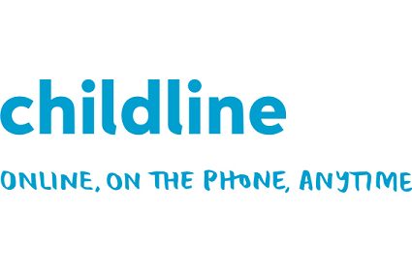
Getting help
meiccymru.org
080880 23456
childline.org.uk
0800 1111

