Slide 1

ENTREPRENEURSHIP
Skills and Behaviours
Learning resources to support the facilitation of enterprise and entrepreneurship education at Key Stage 4 and above

Slide 2
12. Relationships
There are very few jobs around these days in which you don’t need to get on with people
The individuals most likely to succeed are the ones best able to manage the many relationships they experience, whether with colleagues, customers or friends. Interacting well with people is a major asset requiring a whole range of skills that can be developed by your learners. It’s not dependent on natural instincts or an outgoing nature. The success of establishing good relationships is all about understanding yourself and how you relate to others. It’s also about reaching a satisfactory conclusion for everybody through collaboration and compromise. Relationships with other people are often very instinctive but there are practical steps you can take to ensure you develop effective relationships. These activities encourage learners to use their interpersonal skills, effectively sharing information with others by using their listening, negotiating and persuasion skills. It’s about providing opportunities and activities for your learners to deal with difficult situations and communicating their creative ideas to others. Learning to build better relationships with everyone you will deal with is a vital investment in your personal success.
Introduction

Slide 3
12. Negotiation, persuasion and influence
Objective: To enable learners to consider how to manage difficult situations and evaluate persuasion and negotiation skills.
Introduction: This session aims to develop learners’ negotiation skills using a financial crisis scenario set in a football club. Learners will need to recognise in problem solving, there are stakeholders with different interests and points of view. Successful outcomes may require negotiation skills.
Activity: Introduce the terms bargaining and negotiation using the PowerPoint slides and handouts. Next, use the Newspaper Article to introduce the scenario. Allocate learners into groups representing different stakeholders and using the Scenario Cards, learners familiarise themselves with their roles. Explain how to apply a sequence of negotiation to address the scenario ie, by following the Understanding Negotiation Guide: Stage 1: Preparation; learners should research and prepare a proposal for the clubs future. Stage 2: Presentation; learners should present an evidenced and well argued proposal. Groups to consider all proposals. Use Secret Point Cards to develop scenario further. Stage 3: Bargaining; learners to re-evaluate the information available then in their groups use bargaining skills to persuade the other groups to agree with their proposals. Stage 4: Closing Phase; the class reach a solution, for example by voting.
Plenary: Learners evaluate the groups’ negotiation skills and reflect on why the different groups were successful or unsuccessful, identify what might have / should have been done differently. The whole cohort to consider which skill in negotiation they consider to be the most important. Extension Activity: Learners to construct and present a TV, radio, newspaper news script, or video report from the stakeholder viewpoint including the process and outcome of the negotiations.
Entrepreneurship Characteristics: Managing Difficult Situations Negotiation and Persuasion Influence Decision Making
Curriculum Links WBQ EES
Provided Resources: PowerPoint Newspaper Article Scenario Cards Secret Point Cards Handout on Negotiation and Bargaining
Other Resources: Flip chart / whiteboard
Learning Outcome: Learners will be able to select, use and evaluate negotiation skills required to manage difficult situations.
Lesson Plan

Slide 4
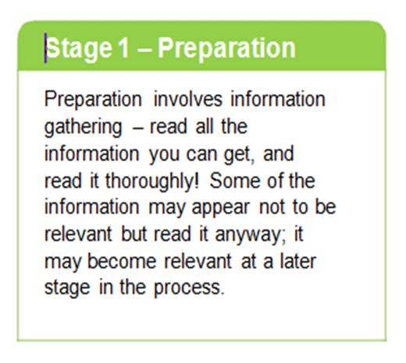
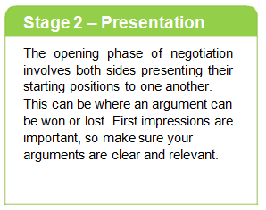
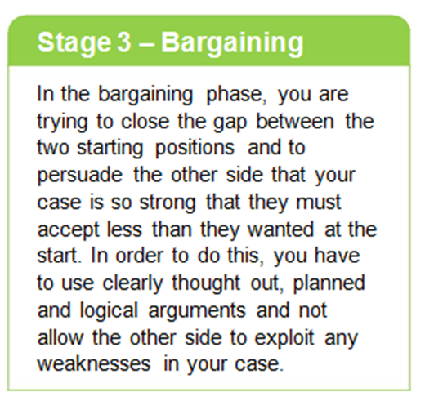
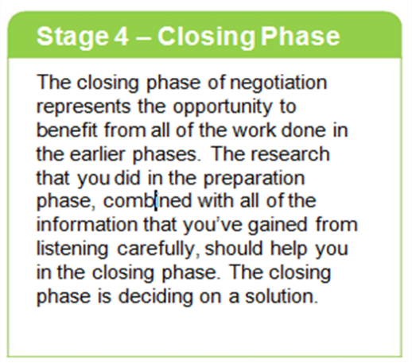
12. Negotiation, persuasion and influence
Understanding negotiation and bargaining
Handout

Slide 5
12. Negotiation, persuasion and influence
Understanding negotiation and bargaining
The key ideas in bargaining are:
Bargaining is used to deal with opposing points of view.
Opposing points of view will have minimum and maximum positions e.g In a rate of pay bargaining process employers will have a maximum they are willing to pay and workers will have a minimum they will work for.
An agreement on a rate anywhere between the extreme positions means both sides are better off than they would be by not agreeing.
Both sides therefore have a common interest in striking a deal. I.e. it is worthwhile agreeing otherwise everyone loses.
Differences will be on identifying and agreeing an exact position between the extreme positions.
Agreement will depend on who has the strongest bargaining power and/or who uses their bargaining power to the greatest advantage e.g. What can each side offer as a ‘bargaining’ incentive? (I’d do this ,if you do that!) Who has most to lose by the discussions breaking down? How much time does each side have to bargain?
The agreement is seen as successful by both sides. A ‘win win’ situation has been reached.
Handout

Slide 6
12. Negotiation, persuasion and influence
Understanding negotiation and bargaining
SCENARIO CARD A
You are on the Board of Directors
The Board of Directors is divided between die-hard fans and the major shareholder. The major shareholder also owns a property development company who will build houses on the existing Dynamo grounds, which should prove a highly profitable venture for her, and not the club. Additionally it will still be a costly venture to not only buy but locate a suitable ground in England. The die hard fans are determined that the club is not sold off or moved 50 miles across the border to England because Dynamo will lose its Welsh identity and will make travelling to games very expensive.
Your next steps:
Discuss within your group the merits of the major shareholder’s offer to sell up, re-develop the site and re-locate the club. Consider the loyalty of the club’s fans and their desire to keep the club and make it a success where it is.
Handout

Slide 7
12. Negotiation, persuasion and influence
Understanding negotiation and bargaining
SCENARIO CARD B
You are the players and other staff
Your group is dominated by the players, some of whom are still on high wages, having negotiated long contracts 3 years ago, which are not due to expire in the near future. Others are more recent recruits on lower wages and shorter contracts, but reaching the end of their careers. As other staff, you are on low wages and have been with the club for many years but will find it difficult to find new jobs if the club closes.
Your next steps:
Consider how each of you will be affected. Who (if anyone) will benefit from the club moving 50 miles away? Will you still be able to work for the club if it moves? Discuss the consequences of possible job losses e.g. What will the effect be on your families? Think about what arguments you can put forward to the other groups, and how you can protect your jobs.
Handout

Slide 8
12. Negotiation, persuasion and influence
Understanding negotiation and bargaining
SCENARIO CARD C
You are dedicated fans and the local community
Your group is split into two areas – dedicated fans and representatives from the local community. As dedicated fans, you feel you have a right to defend the fate of your club and don’t want to see it moved 50 miles away, making it expensive and difficult to get to. As local community representatives, such as shop owners and parents, you are more concerned about the impact it will have on the local community. The children in your area have been using the football grounds for football training and other outdoor sports for years. You’re worried that there will be no provision for replacing this and children will have no safe or suitable place to play, and will turn to hanging out on the streets, near to the shops
Your next steps:
Weigh up the pros and cons of the club moving away and the possibility of a new housing development. Consider the effects on the community e.g. how will fans visit the new grounds? Will there be extra provision for a children’s sports centre in the local community? Will the local shops suffer from the club closing? Could a new housing development make the area a more desirable place to live, increasing the value of existing homes in the local community?
Handout

Slide 9
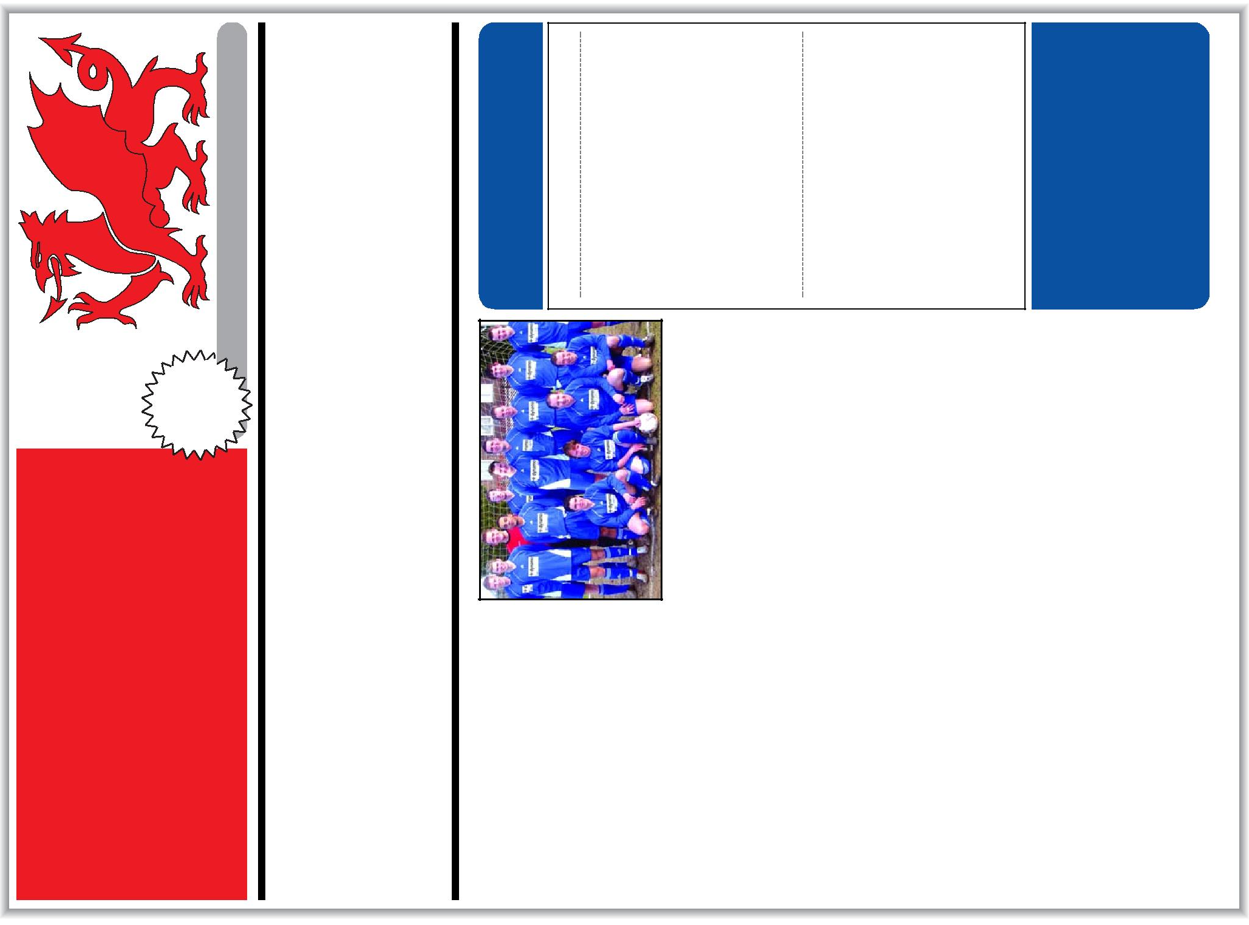
Club Facts:
There are three main stakeholders groups:
The owner and the other main shareholders (mainly die-hard fans).
The players and other staff.
General fans and the local community.
Two options have to be considered:
Selling off the site and the club moving 50 miles over the border into England, unless another solution can be found.
A negotiated solution.
Issue # 217
What are your views?
Do you want to have your say?
Who would you support? Come and visit us at the Stadium on our open day: Tuesday at 3pm.
So… What’s next for
BIW City?
BIW City’s
home ground could be
sold for housing as the club’s fortunes
continue to sink at the bottom of the second division.
The gates are due to be locked and it is believed that the land could soon become a building site – with the club forced to move across the border into England.
It’s the latest twist in the club’s roller coaster ride that once saw it rise from second division obscurity, financed by a rich owner, to the brink of the Premiership.
But City’s gamble of buying highly-paid players on long contracts didn’t succeed. The club’s wage bill at one stage was higher than its income and sent it into a financial downward spiral.
BIW City: An unknown future.
Although new owners stepped in and saved the club from going into receivership, continuing poor results on the field saw a three-year drop in television revenue and gate money. In a bid to avert more financial turmoil, the owners recently sold their majority share, which was snapped up by a local property developer.
With the club’s poor playing performance, crowds are still falling. Rumours persist that the ground could soon be sold for redevelopment.
50p
City housing deal could force club into England
The Wales
Gazette
Footer…

Slide 10
12. Negotiation, persuasion and influence
Understanding negotiation and bargaining
SECRET POINTS CARDS
The Board of Directors:
The majority shareholder cannot sell the ground unless she can win a majority vote. This was a factor written into the terms and conditions of the club’s legal status and cannot be changed. The majority shareholder therefore requires more stakeholders to support her decision than those opposed to it and cannot simply go ahead with the proposal if there is not a majority vote in support of the proposal.
The players and other staff:
The 6 players on long term contracts, which had been arranged at least 3 years ago, have a condition within their contracts that they can only be sacked with a huge payout from the club. The 5 players who have been with the club less than 3 years are on less favourable contracts which state that there will be no payout.
Fans and the local community:
One of the members of your group is the Local Planning Officer who has a large amount of influence within the local council and community to stop the club building houses on the land.
Handout

Slide 11
12. Negotiation, persuasion and influence
What is negotiation?
Understanding negotiation Whether it’s with your boss, your friends or your family, we all negotiate for things each day, like more money, what to do at the weekend or settling arguments with other members of your family. Basic negotiation skills, techniques and strategies can be described in four stages. Study these stages to help you handle negotiation situations more effectively. The Four Stages of Negotiation Stage 1 - Preparation Stage 2 - Presentation Stage 3 - Bargaining Stage 4 – Closing Phase Please see handout for further information
Powerpoints

Slide 12
12. Negotiation, persuasion and influence
What is negotiation?
Bargaining in more detail Bargaining is the process of reaching an agreement made between people as to what each will do for the other e.g. you can bargain for an item you wish to buy, by offering a reduced price to the one being asked. Shop keepers can bargain too; by giving the customer something extra as an incentive to buy. Understanding the bargaining process will help you handle bargaining situations more effectively.
Powerpoints

